Slide 1
A Roadmap to Innovation in Drug Development – Stories About the FDA New Biomarker Qualification Program
John Michael Sauer, PhD
Critical Path Institute’s Predictive Safety Testing Consortium
Tucson, Arizona
jsauer@c-path.org

Slide 2
Outline
So you have a biomarker(s) that you want to use for regulatory decision making…now what do you do?
FDA Predictive Toxicology Roadmap
FDA Biomarker Qualification Program (EMA and PMDA)
Regulatory Acceptance of Biomarkers in Drug Development
Consortia and Public Private Partnerships

Slide 3
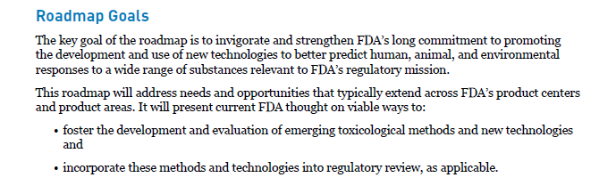
FDA Predictive Toxicology Roadmap
Foster the development of emerging methodology and its incorporation into regulatory review at the FDA across all Centers

Slide 4
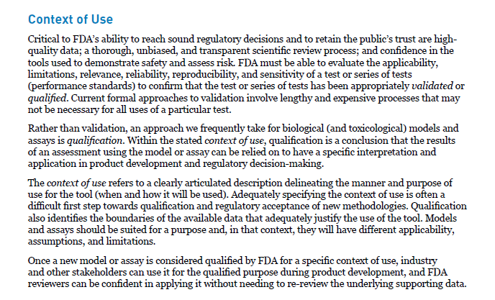
FDA Predictive Toxicology Roadmap

Slide 5
FDA Predictive Toxicology Roadmap
Context of Use; Qualification; Validation; Models; Assays; Tools

Slide 6
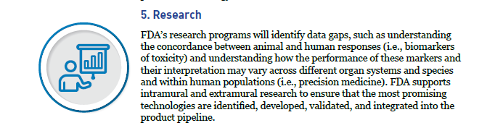
FDA Predictive Toxicology Roadmap
Biomarkers of Toxicity and Precision Medicine

Slide 7
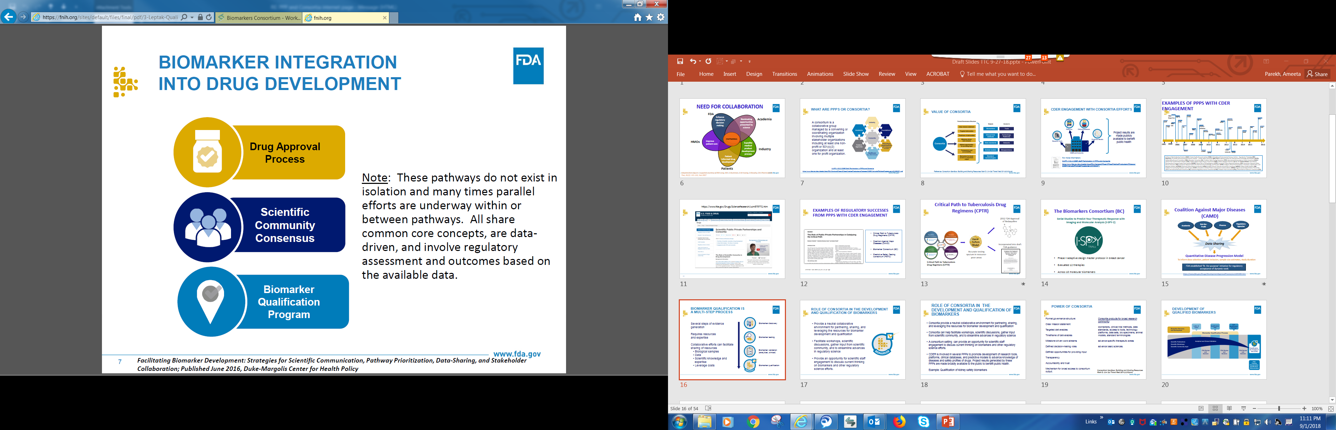
Biomarker Qualification Program - FDA
Biomarker integration into drug development: 3 Pathways
IND
Individual drug development pathway (e.g. Investigational New Drug pathway): based upon agreement with the division, in the context of a specific drug development program
Scientifically-supported community implementation
Scientific community consensus: broadly/widely used biomarker, appropriate scientific support, generally accepted by experts in the field
FDA’s Biomarker Qualification Program
Biomarker qualification program: review and acceptance based upon appropriate submission qualification package; available for use in any development program within approved context of use

Slide 8
Biomarker Qualification Program - FDA
Qualification is a formal regulatory review and acceptance process of biomarkers for their use in drug development
“Qualification is a conclusion that within the stated context of use, the biomarker can be relied upon to have a specific interpretation and application in drug development and regulatory review.”
Qualification results in scientific acceptance and regulatory certainty for the use of the biomarker in drug development

Slide 9



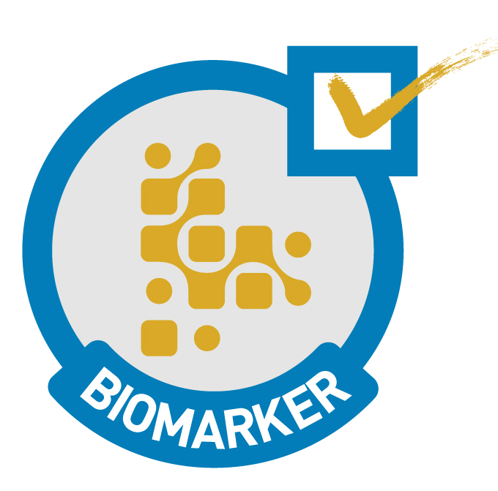
Biomarker Qualification Program - FDA
Qualification results in scientific acceptance and regulatory certainty of the biomarker
  Once qualified the information pertaining to the acceptable use of the biomarker in drug development will be publicly available
  Biomarker qualification not just biomarker discovery or clinical validation, it the formal acceptance of the biomarker by health authorities for use in drug development
  Qualification does not denote that a biomarker is acceptable for use in clinical practice as an in vitro diagnostic or otherwise
Biomarker discovery
Biomarker testing
Biomarker validation
(analytical, clinical)
Biomarker qualification

Slide 10
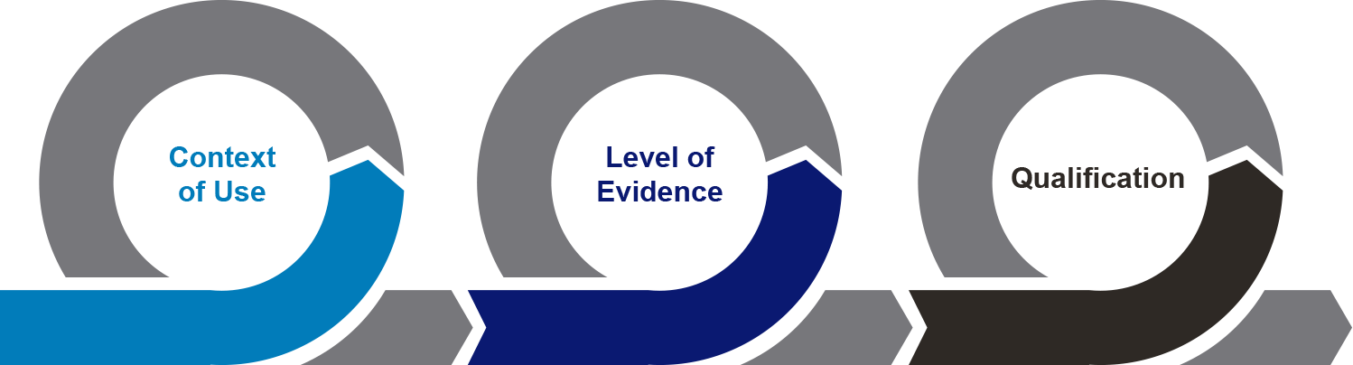
Biomarker Qualification Program
Drug Development
Need
Drug Development
Solution
21st Century Cures Act
Section 507 Qualification of Drug Development Tools
Letter of Intent Qualification Plan Final Qualification Package

Slide 11
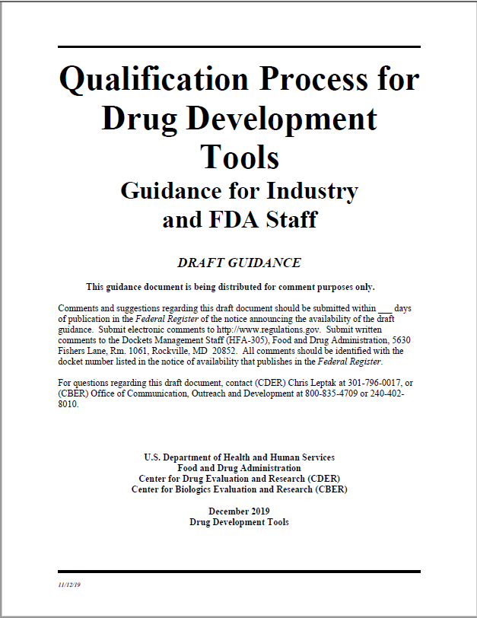
Biomarker Qualification Program
21st Century Cures Act
Section 507 Qualification of Drug Development Tools
https://www.fda.gov/regulatory-information/search-fda-guidance-documents/qualification-process-drug-development-tools-guidance-industry-and-fda-staff

Slide 12
Biomarker Qualification
Objectives of Qualification
To qualify and make DDTs publicly available to be used for a specific context of use in drug development
To streamline drug development and review of regulatory applications
To facilitate integration of qualified DDTs in regulatory review
To provide a framework for scientific collaboration to facilitate DDT development

Slide 13
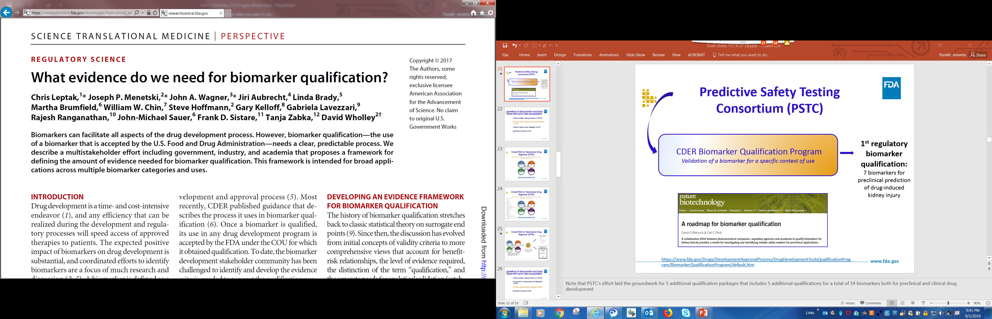
Biomarker Qualification Framework
https://www.fda.gov/Drugs/DevelopmentApprovalProcess/DrugDevelopmentToolsQualificationProgram/BiomarkerQualificationProgram/default.htm
http://www.fnih.org/what-we-do/biomarkers-consortium/programs/framework-for-safety-biomarkers
https://stm.sciencemag.org/content/9/417/eaal4599.abstract

Slide 14
Biomarker Qualification Framework
Roadmap to Biomarker Qualification
Need Statement: what is the knowledge gap or drug development need that the biomarker(s) are addressing.
Context of Use (COU) Statement: A concise description of the biomarker’s specified use in drug development.
Assessment of Benefit to the Patient: e.g., improved sensitivity or selectivity, better mechanistic context to graft loss, enable earlier intervention or selection of certain patients that otherwise wouldn’t be identifiable.
Assessment of Risk to the Patient: Consequences of a false negative or positive.
Evidentiary Criteria: characterizing the relationship of biomarker to the clinical outcome, biological rational, supporting patient level datasets (retrospective or proposed prospective), comparison to current standard, assay performance and statistical methods used.

Slide 15
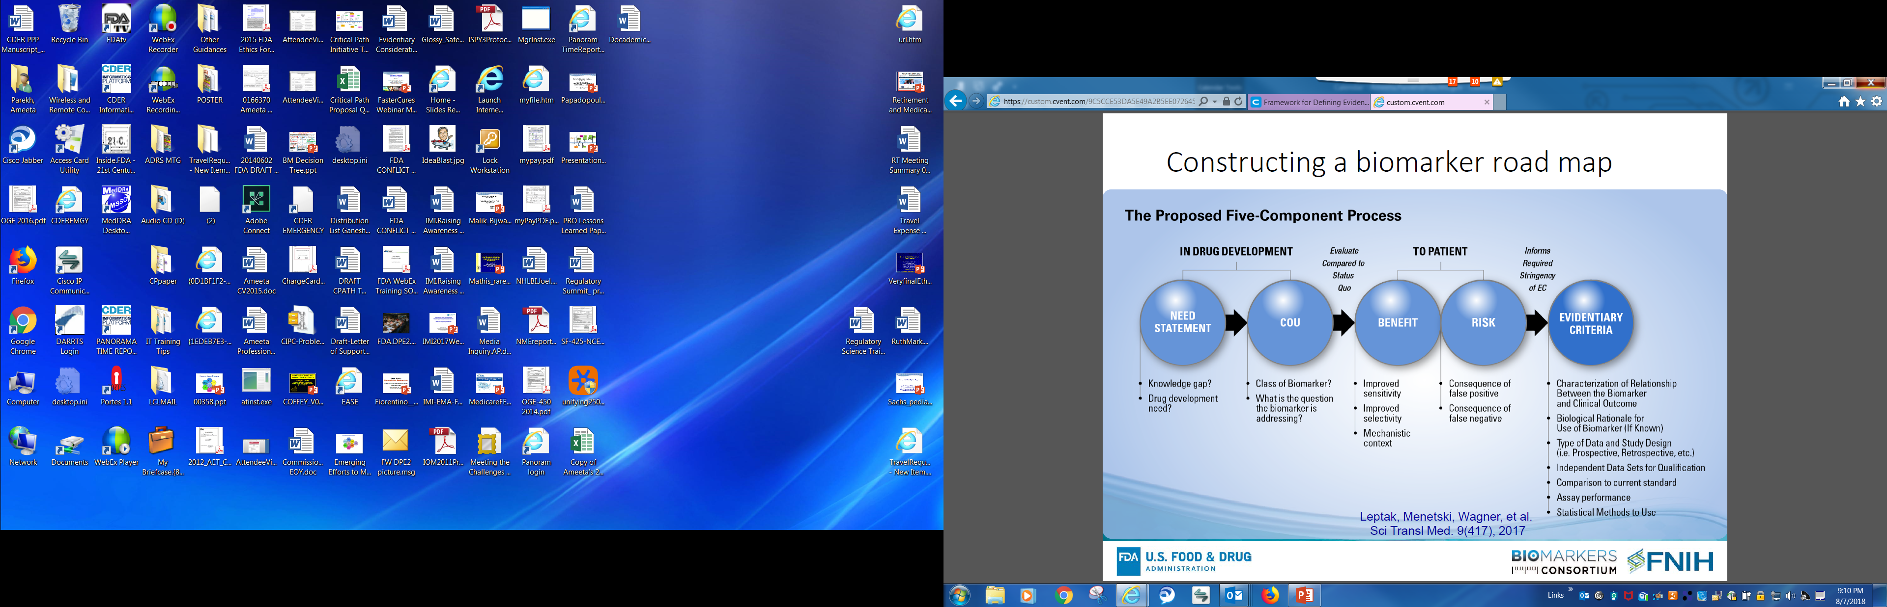
Biomarker Qualification Framework

Slide 16
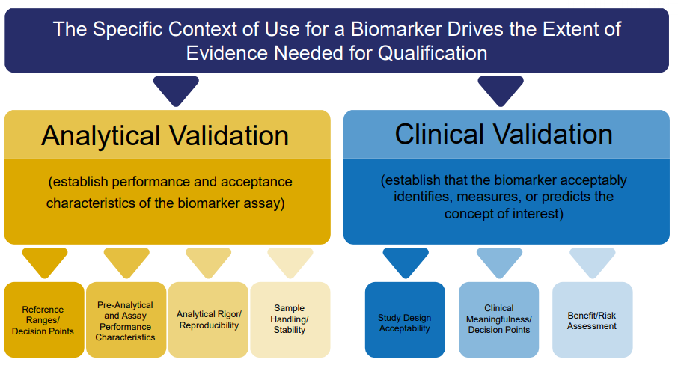
Biomarker Qualification Framework

Slide 17
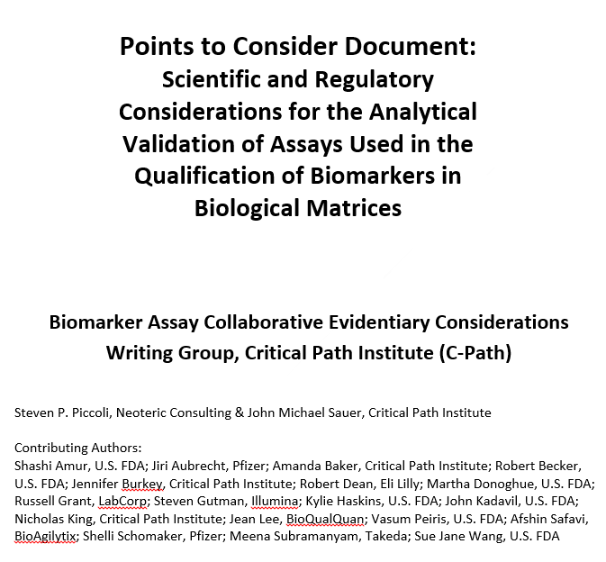
Biomarker Analytical Framework
The Points to Consider Document:
Provides scientific insight into how to address common bioanalytical obstacles encountered during the validation of biomarker assays to be used in biomarker qualification
Is designed to cover all biomarker classes from diagnostic biomarkers to surrogate endpoints
Presents an approach that is customizable based on the biomarker and it’s drug development application
The Points to Consider Document is NOT:
A checklist that can be followed without considering your biomarker and it’s drug development application
https://c-path.org/c-paths-pstc-releases-points-to-consider-outlining-recommendations-for-analytical-validation-of-assays-used-in-qualifying-biomarkers/

Slide 18
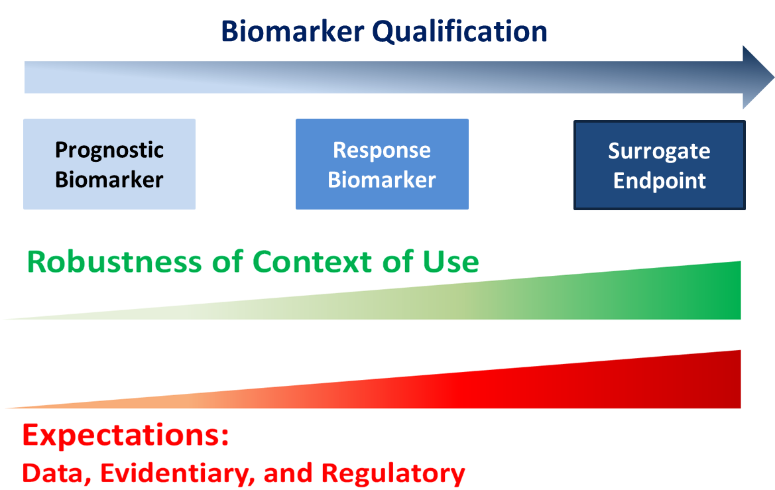
Biomarker Qualification Framework
Qualification truly embarrasses the fit-for-purpose concept of assay validation and clinical validation

Slide 19
Biomarker Qualification Programs
Qualification is a regulatory endorsement process for biomarkers used by US FDA, EMA, and PMDA.
US FDA - https://www.fda.gov/drugs/development-approval-process-drugs/drug-development-tool-ddt-qualification-programs
EMA - https://www.ema.europa.eu/en/human-regulatory/research-development/scientific-advice-protocol-assistance/qualification-novel-methodologies-medicine-development
PMDA – Not well codified; however biomarkers have been qualified

Slide 20
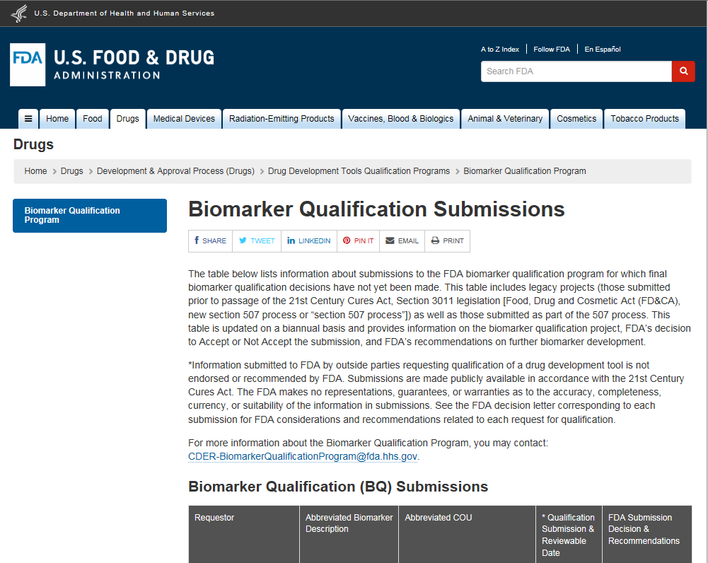
Biomarker Qualification Programs

Slide 21
Biomarker Qualification Programs
Safety Biomarkers in Qualification Development: Drug-induced Organ Toxicities
Novel biomarkers to be used in conjunction with CK and AST to assess skeletal muscle injury
Novel biomarkers to be used as an adjunct to current genotoxicity assessment in pre-clinical drug development programs
Novel biomarkers to be used in conjunction with current nephrotoxicity markers in both pre-clinical and clinical drug development programs
Novel biomarkers to be used in conjunction with current hepatotoxicity markers in clinical trials
Novel biomarkers to assess drug-induced vascular injury
Novel biomarkers to assess cardiac arrhythmic potential

Slide 22
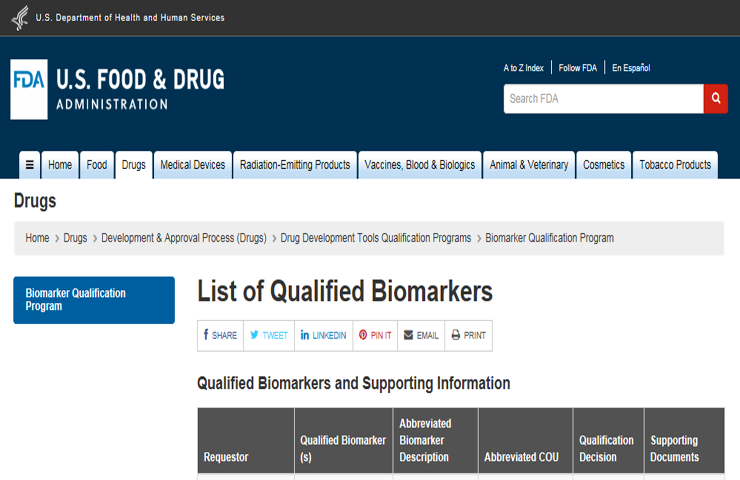
Biomarker Qualification Programs

Slide 23
Biomarker Qualification Programs
Qualified Safety Biomarkers
Nonclinical biomarkers to be used in conjunction with current nephrotoxicity markers to assess renal injury in rats
Biomarker panel to assess kidney tubular injury in Phase 1 healthy volunteers when there is an a priori concern
Cardiac troponins to assess cardiotoxicity in rats/dogs/monkeys to help estimate human toxic dose when testing known cardiotoxic drugs

Slide 24
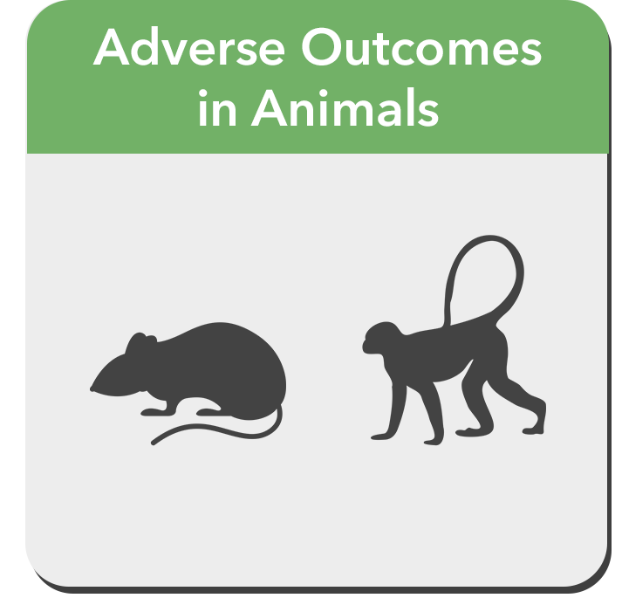
Biomarker Qualification
Translational Safety Biomarkers
Nonclinical studies are conducted to demonstrate that the novel biomarkers are:
Responsive to histological injury of the target organ of interest
Not responsive to injury in other target organs
Not dependent upon the mechanism of toxicity
Histopathological assessment of major tissues
Assessment of standard biomarkers
Assessment of novel biomarkers
Across prototypical toxicants
Sauer JM, Porter AC, Biomarker Programs, Predictive Safety Testing Consortium. 2018. Preclinical Biomarker Qualification. Experimental Biology and Medicine. 243: 222-227.
https://journals.sagepub.com/doi/10.1177/1535370217743949https://journals.sagepub.com/doi/10.1177/1535370217743949

Slide 25
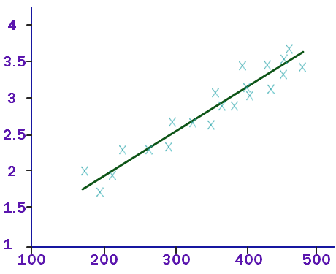
Biomarker Qualification
Translational Safety Biomarkers
Compare response of the Novel Biomarker to histopathological response and response of the current standard biomarker
Correlation
Histopathological Response (TRUTH)
Novel Biomarker Response
Current Standard Biomarker Response

Slide 26
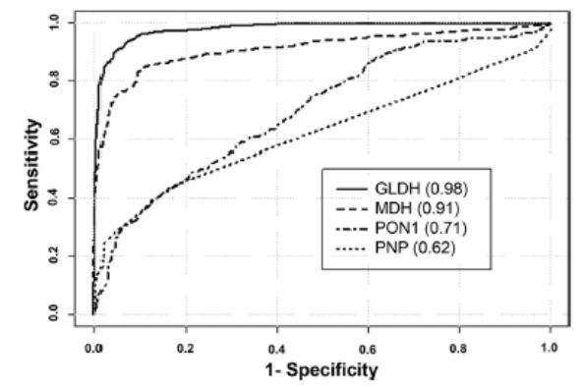
Biomarker Qualification
Translational Safety Biomarkers
Compare response of the Novel Biomarker to histopathological response and response of the current standard biomarker
Receiver Operating Characteristic (ROC) Curve
Histopathological Response (The TRUTH)
Novel Biomarker Response
Current Standard Biomarker Response

Slide 27




Communities of collaboration
Critical Path Institute’s Predictive Safety Testing Consortium (PSTC)
HESI GTTC and eSTAR
Foundation for the National Institutes of Health
OECD Adverse Outcome Pathways, Molecular Screening and Toxicogenomics

Slide 28
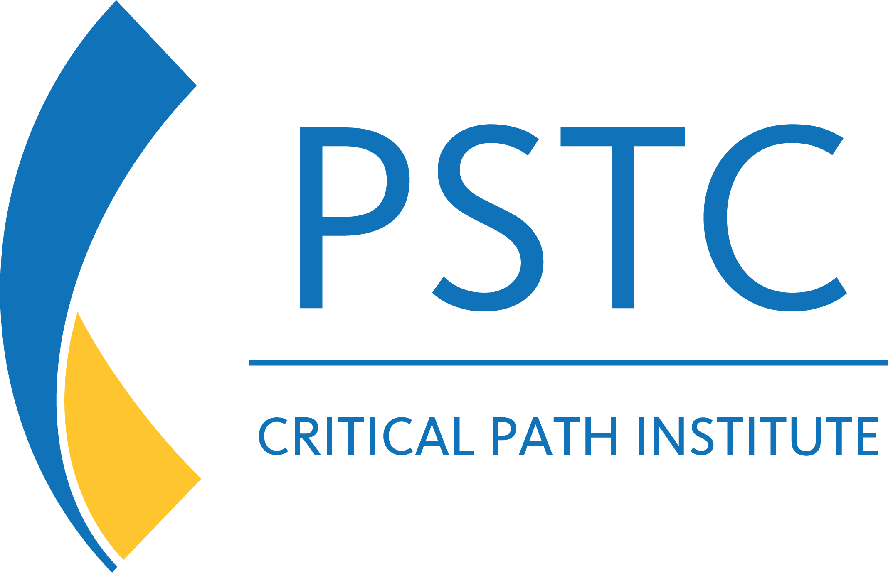
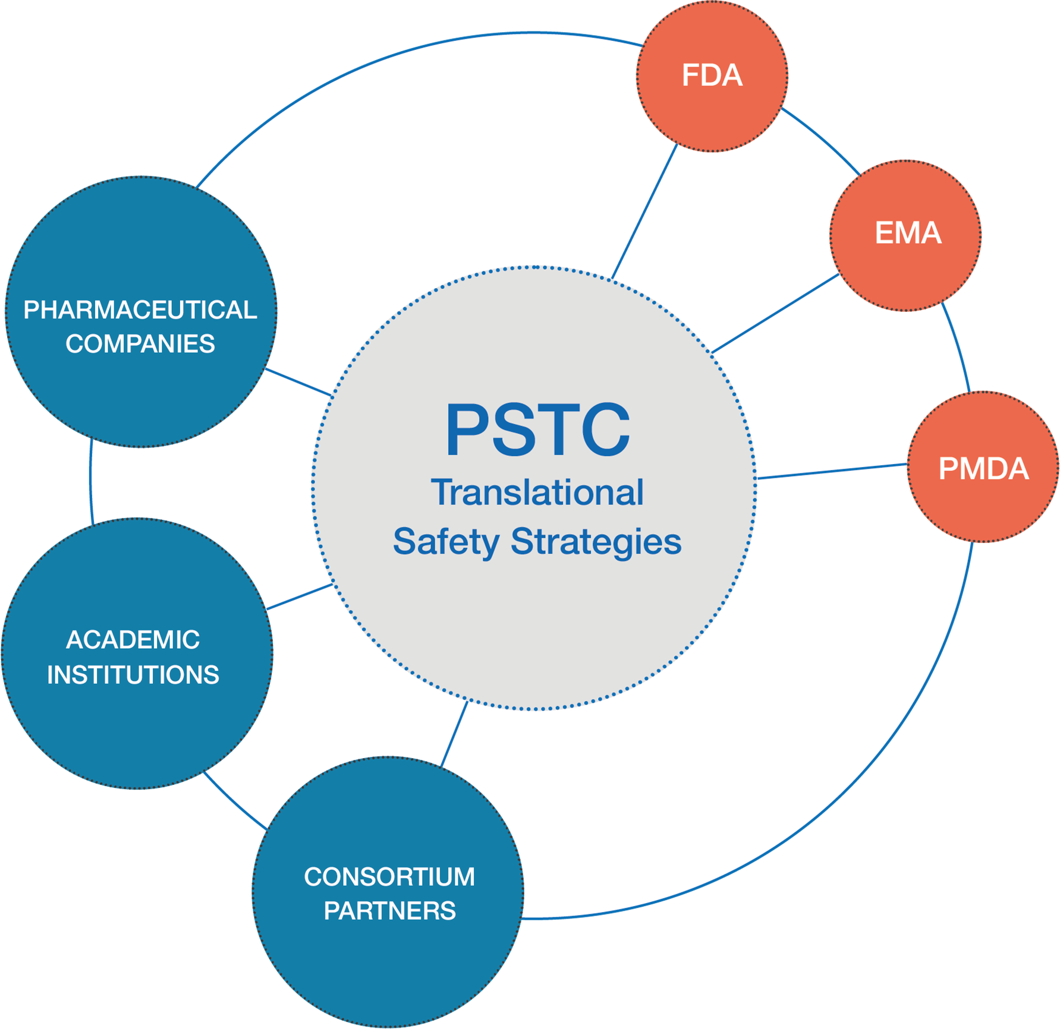
Communities of collaboration
Predictive Safety Testing Consortium (PSTC)
Translational Safety Strategies that Accelerate Drug Development
PSTC was formed on March 16, 2006
PSTC brings together pharmaceutical companies to share and validate innovative safety testing methods under advisement of the FDA, EMA, and PMDA
Corporate members have the same goal: to find improved safety testing approaches and methods
The primary goal of PSTC is the regulatory qualification of novel translational (nonclinical and clinical) safety biomarker for use in drug development

Slide 29
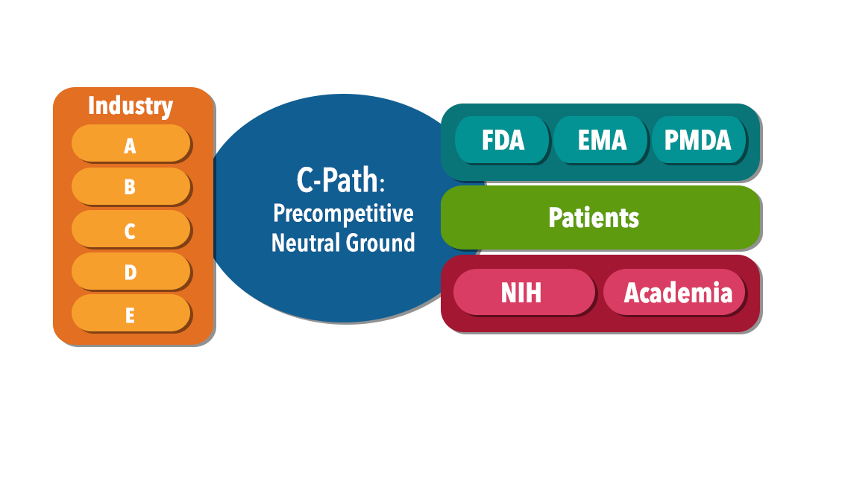
Communities of collaboration
Predictive Safety Testing Consortium (PSTC)
Act as a trusted, neutral third party
Convene scientific consortia of industry, academia, and government for sharing of data/expertise
  The best science
  The broadest experience
  Active consensus building
  Shared risk and costs
Enable iterative EMA/FDA/PMDA participation in developing new methods to assess the safety of medical products
Official regulatory endorsement of novel methodologies and drug development tools

Slide 30
Summary
FDA Predictive Toxicology Roadmap
  FDA clearly wants to include modern approaches in regulatory decision making for toxicology
FDA Biomarker Qualification Program
  There are well defined approaches to receiving regulatory endorsement of biomarkers by health authorities (FDA, EMA, and PMDA)
Regulatory Acceptance of Biomarkers in Drug Development
  The approach to regulatory acceptance of biomarkers has been successfully used in the past and there are multiple efforts currently underway
Consortia and Public Private Partnerships
  Regulatory acceptance of a biomarker takes significant resources and is a major scientific effort that requires the collaboration of multiple stakeholders to be successful

Slide 31
Supporting Materials
Biomarker Qualification Programs
US FDA - https://www.fda.gov/drugs/development-approval-process-drugs/drug-development-tool-ddt-qualification-programs
EMA - https://www.ema.europa.eu/en/human-regulatory/research-development/scientific-advice-protocol-assistance/qualification-novel-methodologies-medicine-development
21 CC Draft Guidance Document
https://www.fda.gov/regulatory-information/search-fda-guidance-documents/qualification-process-drug-development-tools-guidance-industry-and-fda-staff
Biomarker Qualification Framework
https://www.fda.gov/Drugs/DevelopmentApprovalProcess/DrugDevelopmentToolsQualificationProgram/BiomarkerQualificationProgram/default.htm
http://www.fnih.org/what-we-do/biomarkers-consortium/programs/framework-for-safety-biomarkers
https://stm.sciencemag.org/content/9/417/eaal4599.abstract
Biomarker Analytical Framework
https://c-path.org/c-paths-pstc-releases-points-to-consider-outlining-recommendations-for-analytical-validation-of-assays-used-in-qualifying-biomarkers/
Translational Biomarker Qualification
Sauer JM, Porter AC, Biomarker Programs, Predictive Safety Testing Consortium. 2018. Preclinical Biomarker Qualification. Experimental Biology and Medicine. 243: 222-227.
https://journals.sagepub.com/doi/10.1177/1535370217743949https://journals.sagepub.com/doi/10.1177/1535370217743949

