Slide 1
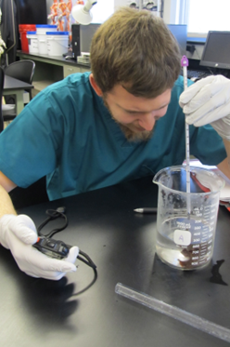
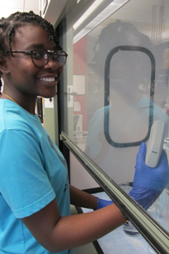
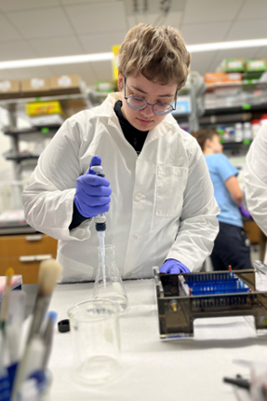
Introduction to Toxicology
Photos courtesy of Chris Curran, Northern Kentucky University

Slide 2
What is Toxicology?
The study of the adverse effects of chemicals or physical agents on living systems.
It impacts us every day. You may have seen these stories in the news or on social media.
Toxicology Impacts Us Every Day!
AGING PIPES STILL LEACH LEAD INTO DRINKING WATER
PESTICIDES FOUND IN 70% OF SUPERMARKET PRODUCE
MICROPLASTICS NOW DETECTED IN HUMAN BLOOD
BPA IN PLASTIC PACKAGING RAISES NEW ALARM
HOUSEHOLD CLEANERS LINKED TO LUNG DAMAGE
EVERYDAY PAINKILLERS HIDE OVERDOSE RISK
© 2026 - Society of Toxicology

Slide 3
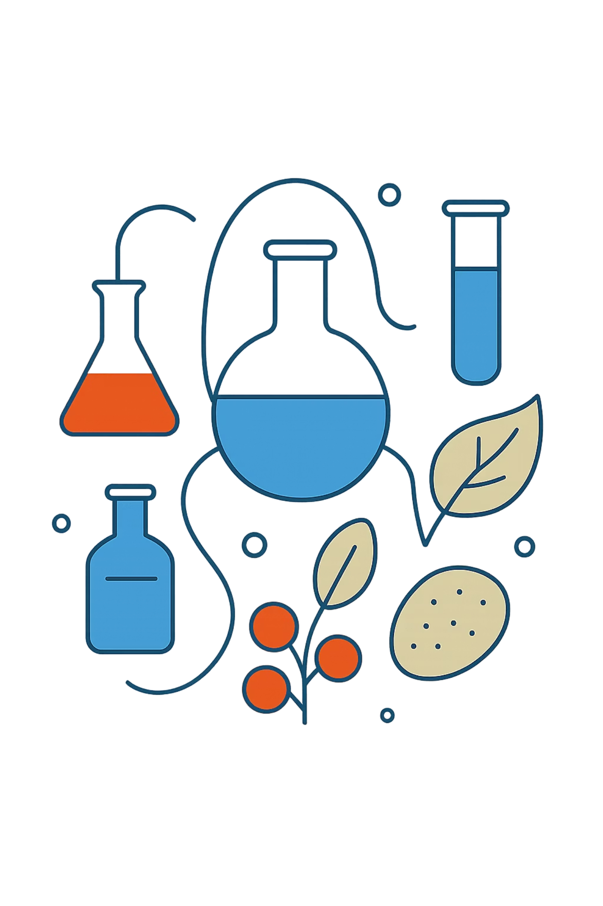


What Are Chemicals?
Naturally Occurring
Minerals, water, carbon dioxide
Biological
Produced by living organisms
Synthetic
Human-made compounds
~250,000 chemicals in use
~700 new formulations annually
© 2026 - Society of Toxicology

Slide 4

Common Exposures: What Were You Exposed to Today?
© 2026 - Society of Toxicology

Slide 5
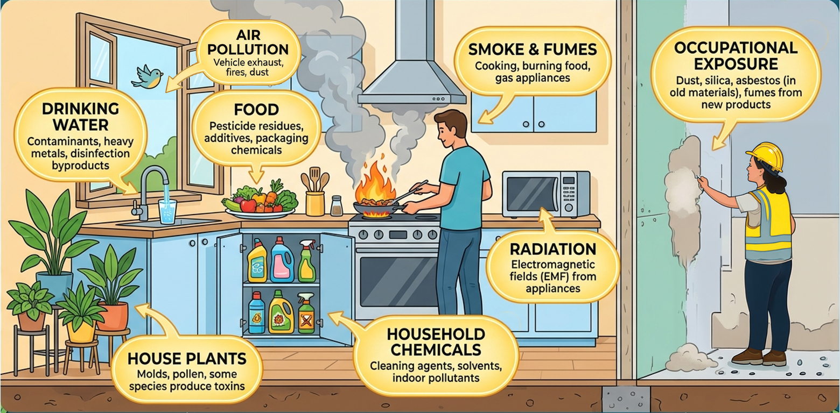
Common Exposures: What Were You Exposed to Today?
© 2026 - Society of Toxicology

Slide 6
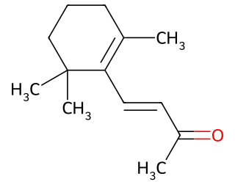
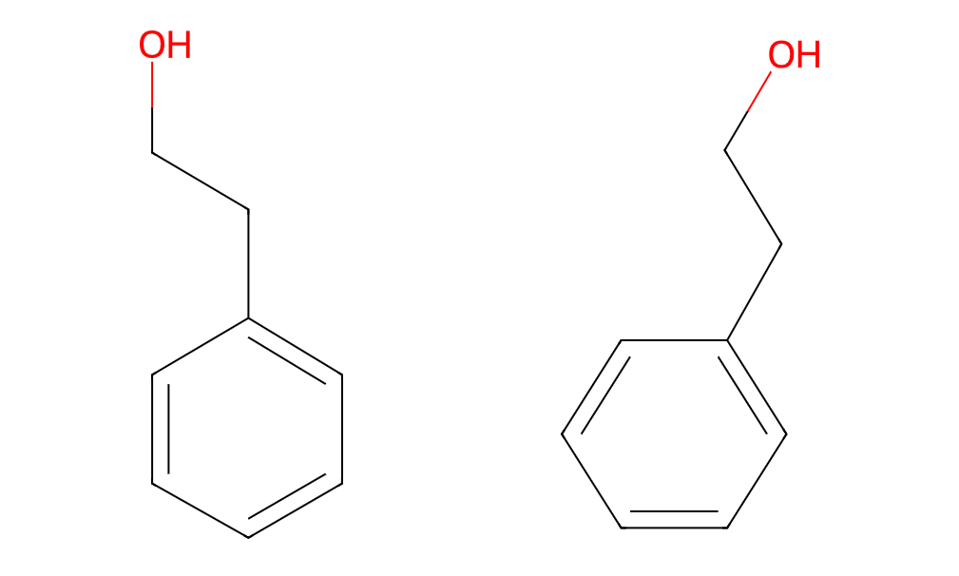
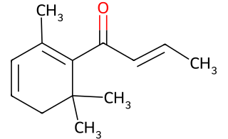
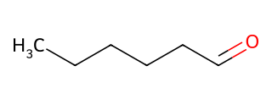
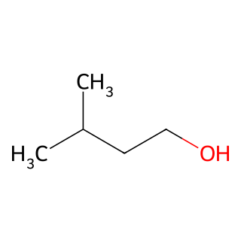
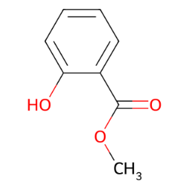
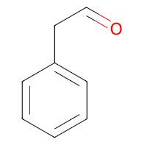
Do You Want to Eat These Volatile Organic Compounds?
ß-ionone
2-Phenylethanol
ß-Damascenone
Hexanal
3-Methylbutanol
Methyl salicylate
Phenylacetaldehyde
Surprise! These chemicals are naturally found in spaghetti sauce and ketchup!
Many chemicals sound scary, but don’t pose a risk.
© 2026 - Society of Toxicology

Slide 7
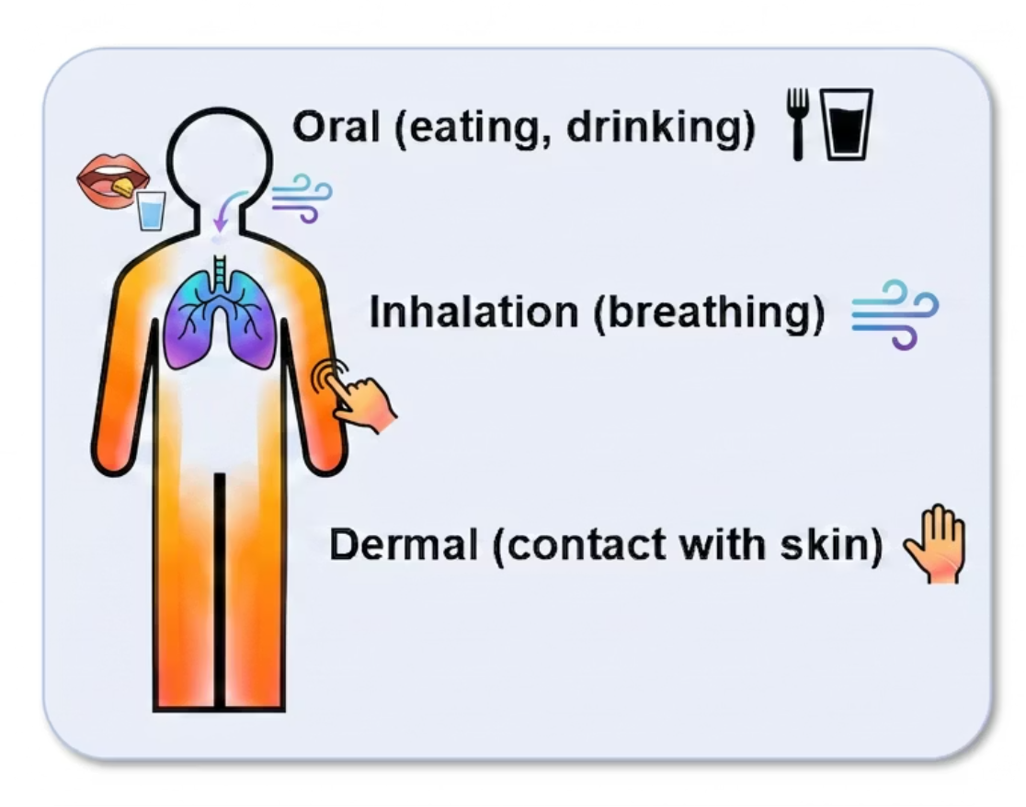
How Are We Exposed to Chemicals?
Routes of Exposure
The toxicity of a substance can change depending on how you’re exposed.
Chewing an antacid made of calcium carbonate is safe.
Inhaling the same amount as a fine powder would inflame the lungs.
© 2026 - Society of Toxicology

Slide 8

The Dose Makes the Poison
A foundational toxicology principle:
Dose determines whether a chemical is beneficial or poisonous.
All substances can be hazardous at certain amounts.
Salt
Lethal dose ≈ 350 g (about 70 teaspoons)
Botulinum Toxin (Botox)
Lethal dose ≈ 0.000001 g — 1/70th the size of a grain of salt
© 2026 - Society of Toxicology

Slide 9
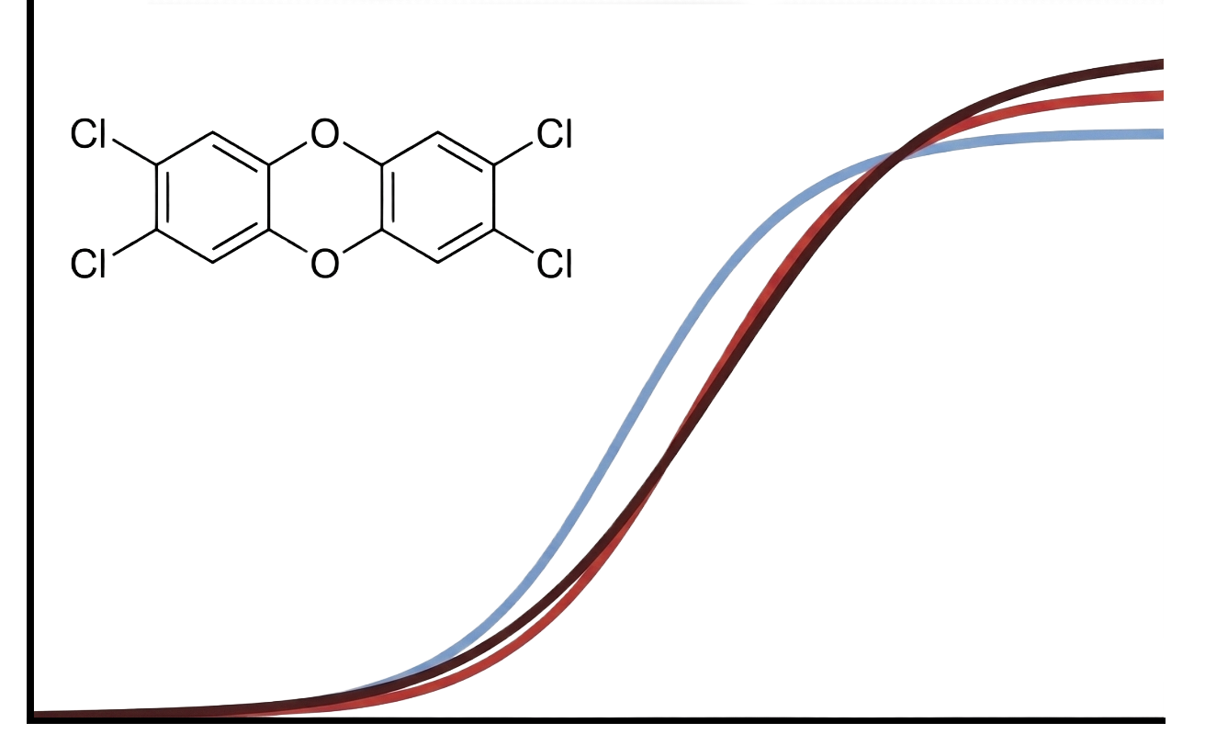
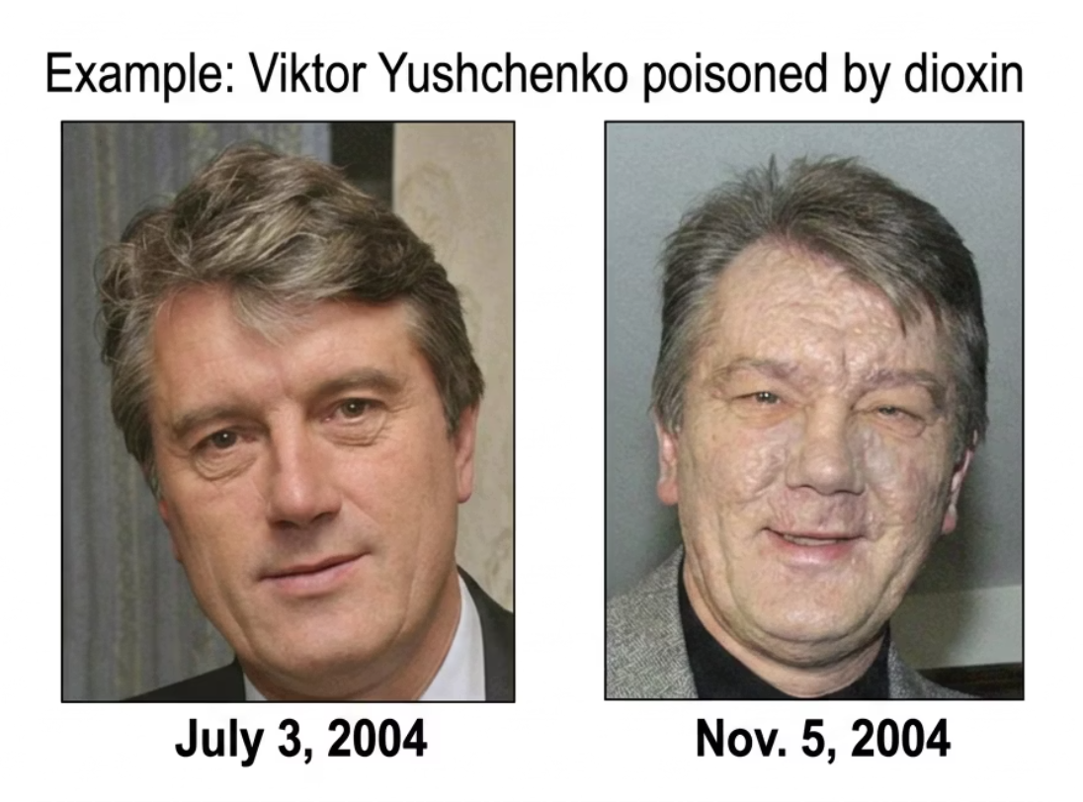

Dose-Response
Dose (exposure) = Amount of chemical contacted by an organism
Response = An adverse reaction to a chemical
Response
Dose
AP Images: left Antoly Medzyk, right Sergei Supinsky
Adapted from Zhou, Y., S. van Leeuwen, et al. 2021. DOI:10.1016/j.tiv.2021.105098
© 2026 - Society of Toxicology

Slide 10
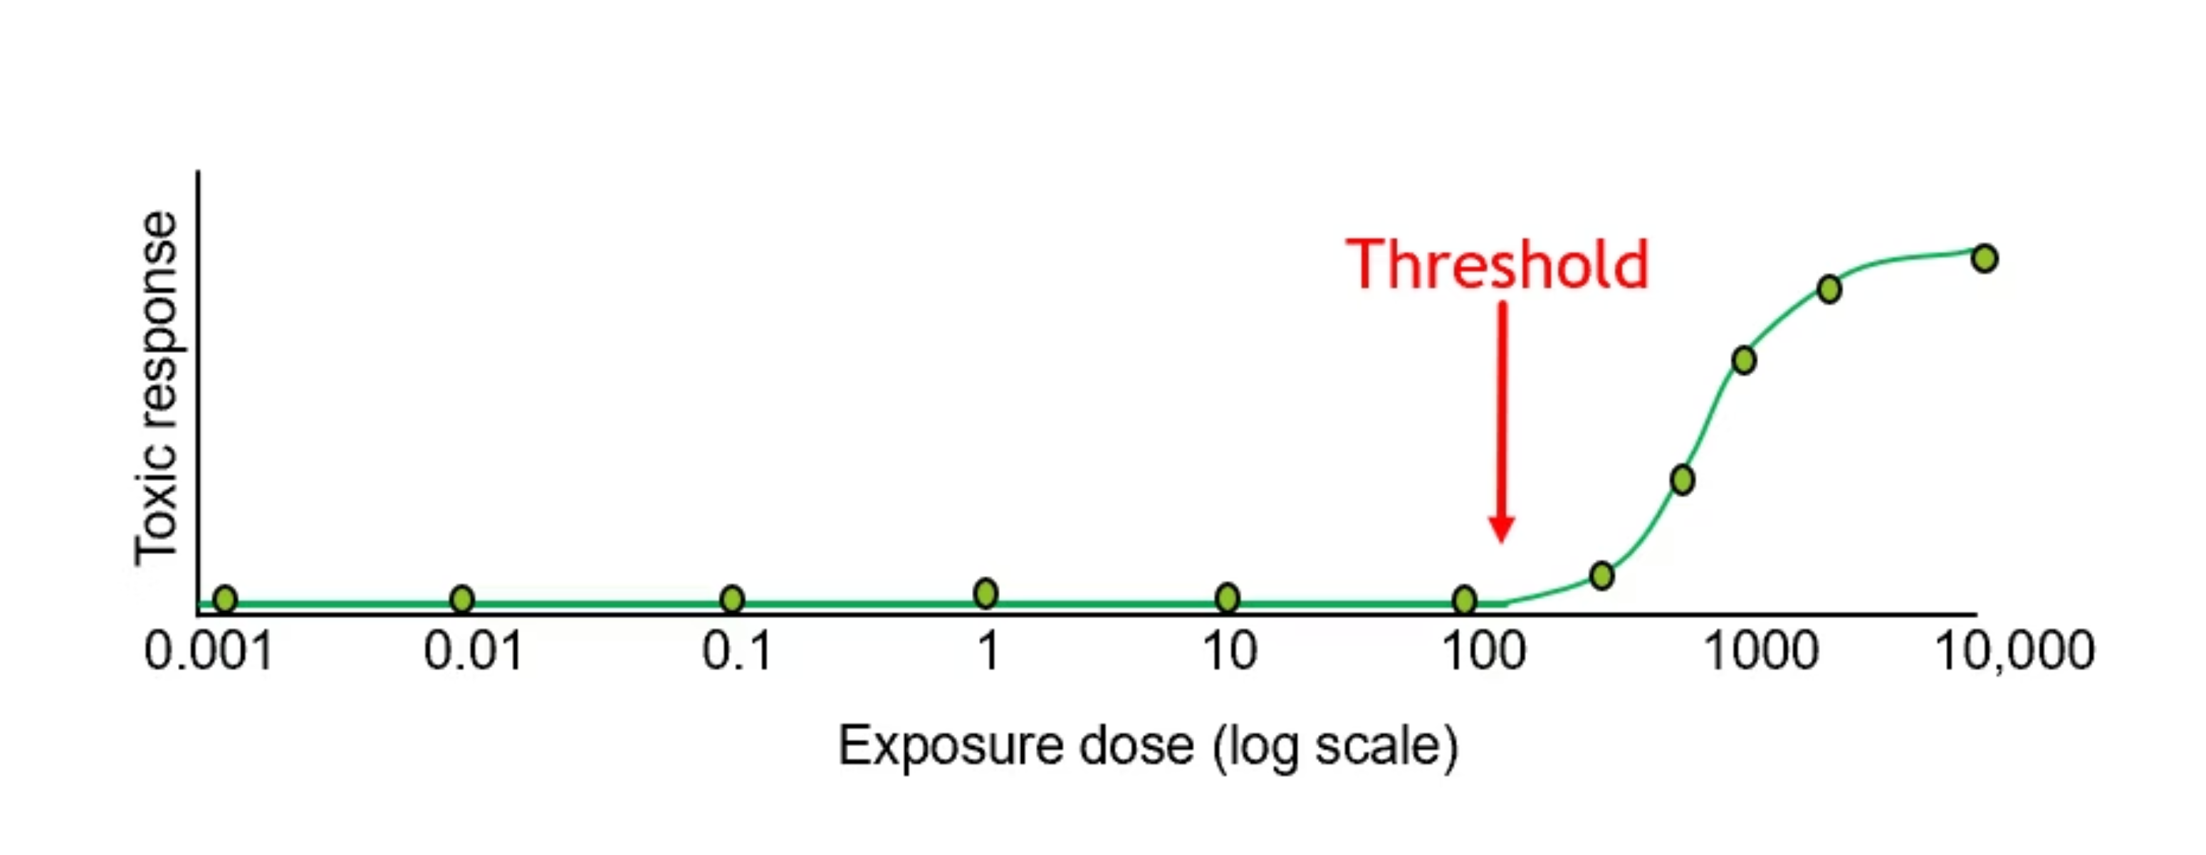
Two Important Toxicology Principles
1
Magnitude of the response relates to dose
2
Threshold Exists
The greater the exposure, the greater the toxic response for most toxic exposures.
Below a certain dose, the chance of a harmful health effect is so low that no adverse effect is expected to occur.
© 2026 - Society of Toxicology

Slide 11
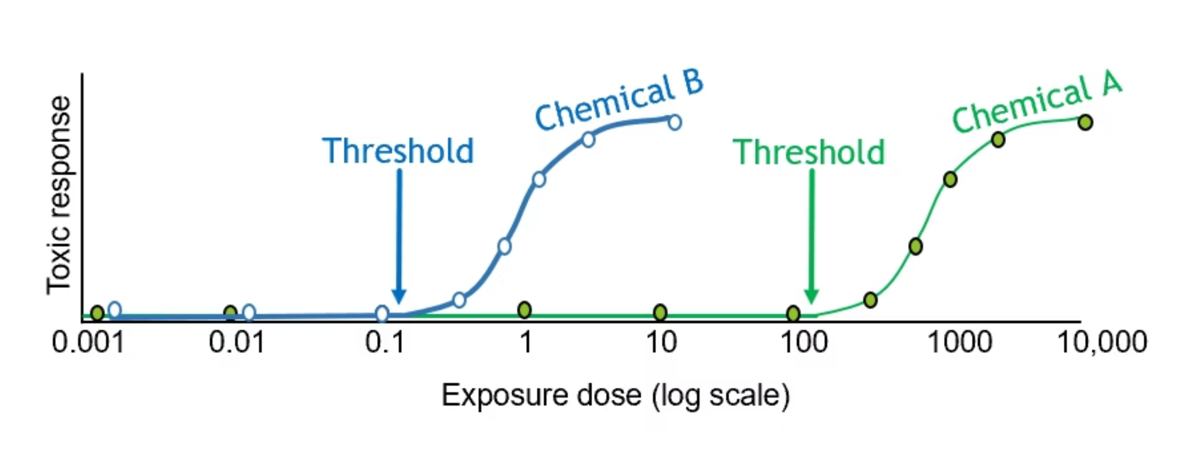
Comparing Chemical Toxicities
Dose-response relationships and thresholds are different for different chemicals.
Comparing them reveals relative potency.
© 2026 - Society of Toxicology

Slide 12
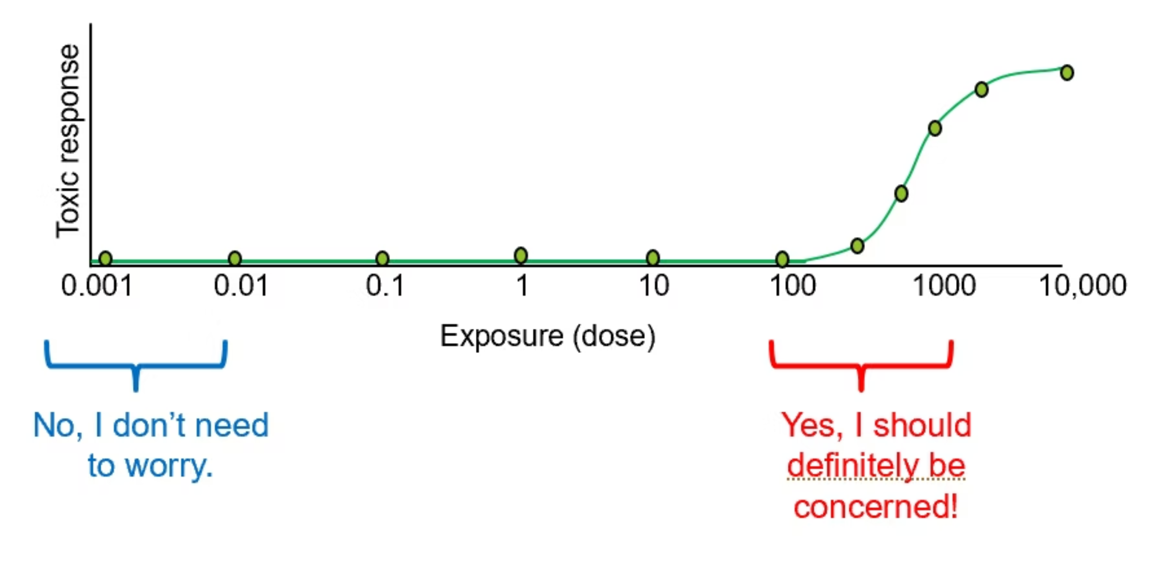
Should I Be Concerned About My Exposure?
The dose-response relationship provides context for thinking about one's own risk from chemical exposure.
© 2026 - Society of Toxicology

Slide 13
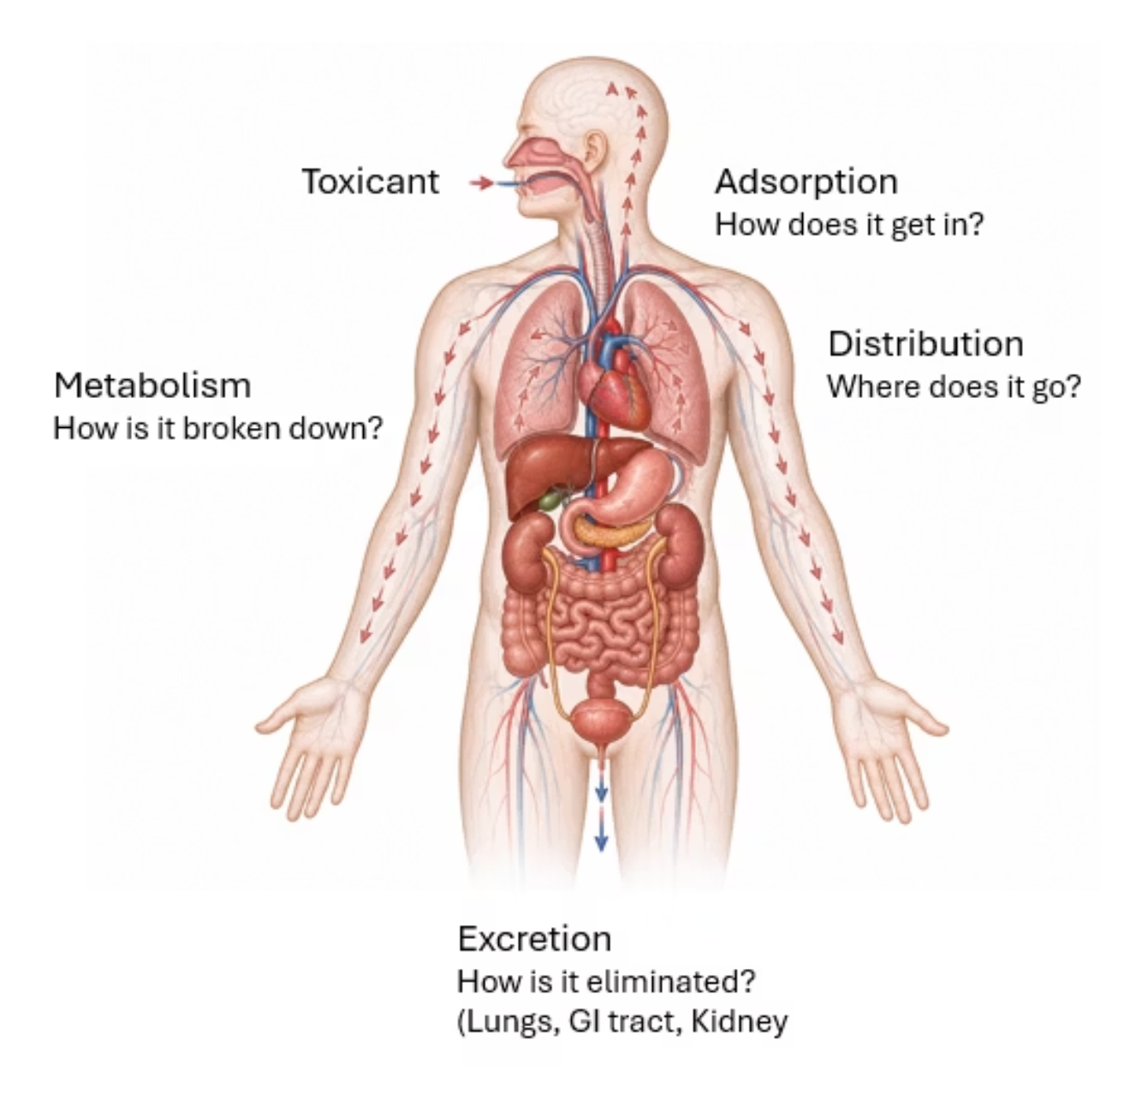
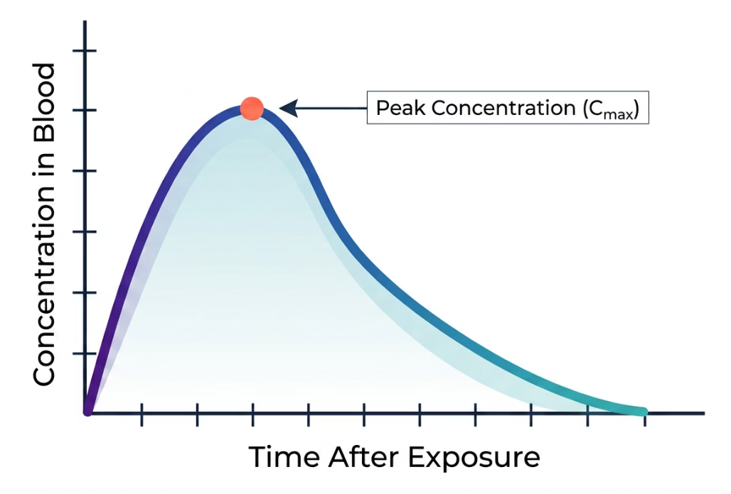
Absorption, Distribution, Metabolism, Excretion (ADME)
After exposure, what happens to a chemical in the body?
Toxicokinetics is the study of how a toxicant enters and moves through the body
© 2026 - Society of Toxicology

Slide 14
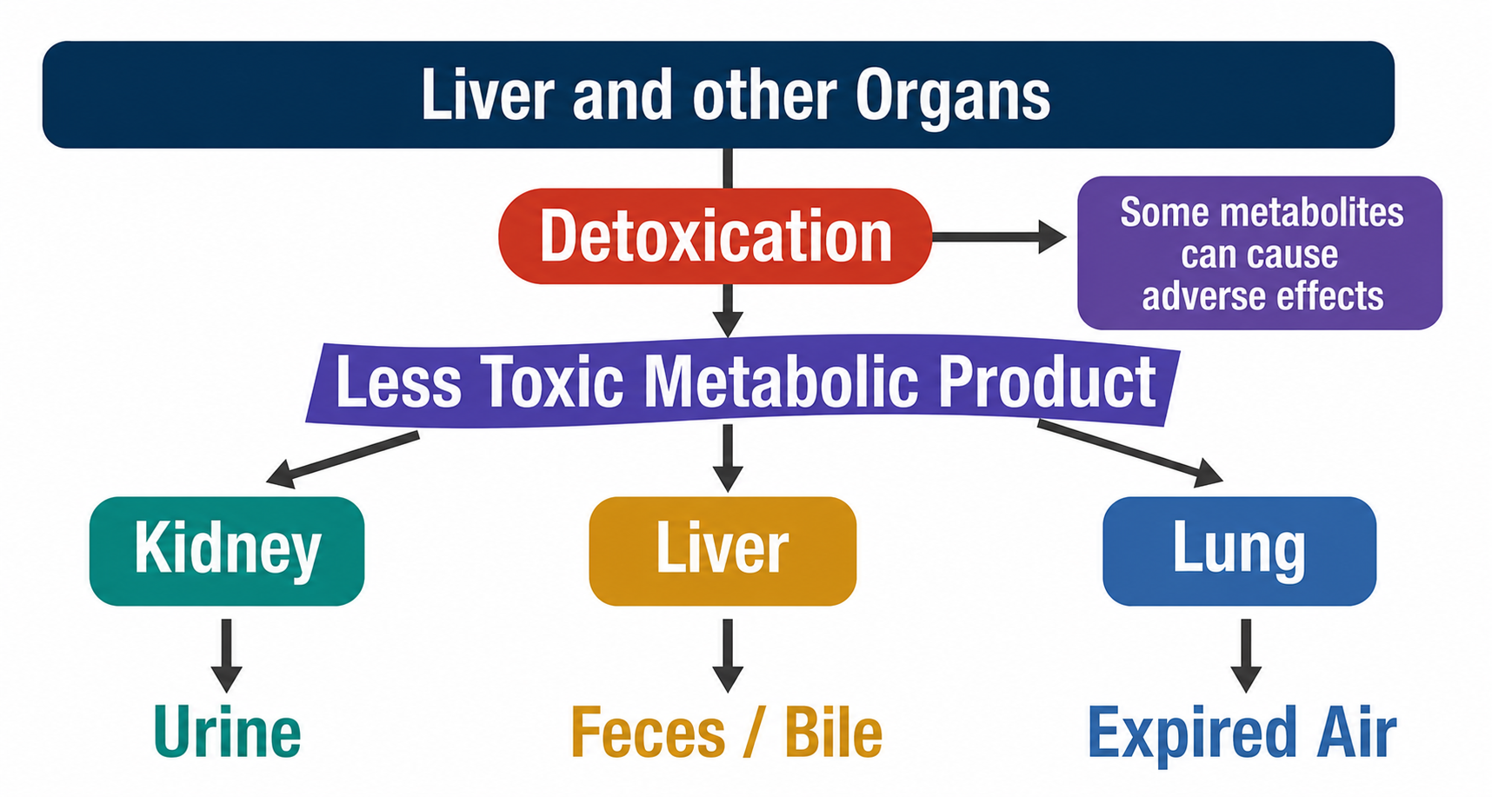
Some Toxicants Are Transformed by the Body
to Aid Excretion
© 2026 - Society of Toxicology

Slide 15
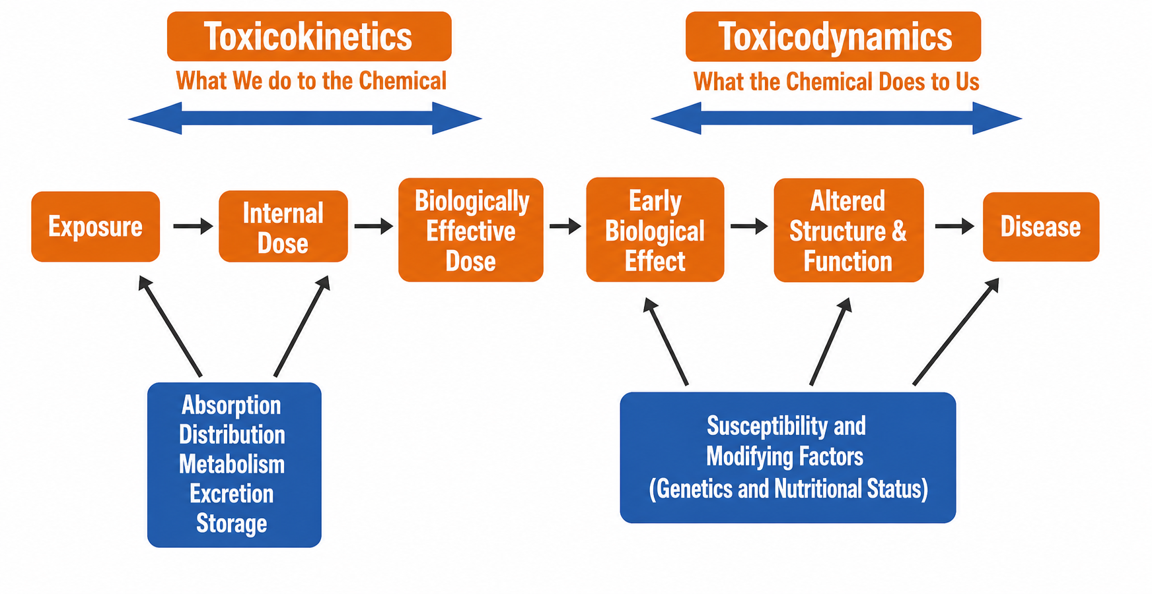
Toxicological Paradigm
© 2026 - Society of Toxicology

Slide 16

Time Matters
A chemical can cause very different health effects depending on:
When
How Often
The exposure occurs
The frequency of exposure
How Long
The duration of exposure
© 2026 - Society of Toxicology

Slide 17


Acute vs. Chronic Toxicity: Same Chemical, Different Outcomes
Acute Toxicity
Chronic Toxicity
Large exposure over a short period.
Symptoms appear in hours to days.
Lead: Accidentally swallowing a large amount.
Repeated small exposures over months or years; symptoms develop slowly.
Lead: Drinking water from contaminated pipes for years.
© 2026 - Society of Toxicology

Slide 18
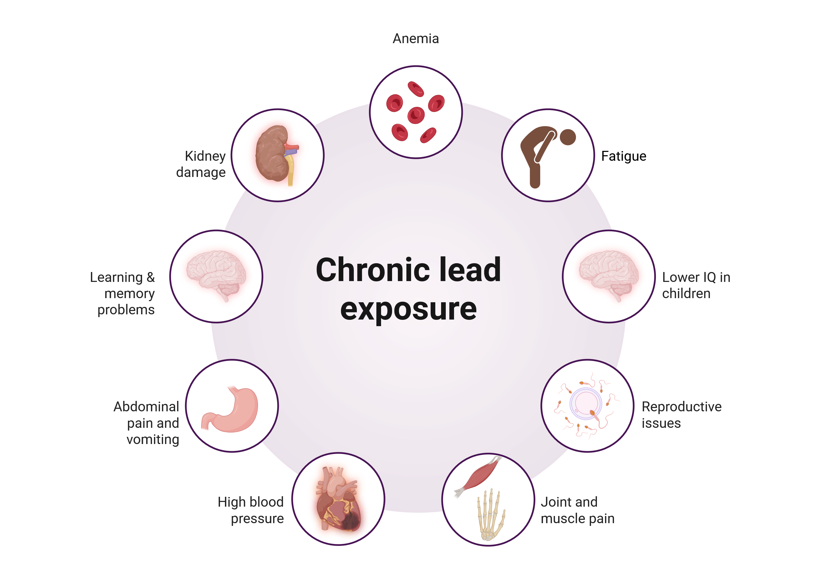
Lead—Same Chemical, Different Outcomes
Acute Toxicity
Chronic Toxicity
Accidentally swallowing a large amount
Drinking water from contaminated pipes for years
Severe stomach pain and vomiting
Seizures
Medical emergency
Created in BioRender. Curran, C. (2026) https://BioRender.com/c1g9xb0
© 2026 - Society of Toxicology
Created in BioRender. Curran, C. (2026) https://BioRender.com/28sc9r2

Slide 19
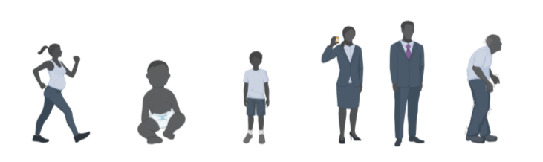



Additional Factors Affecting Responses
to Toxic Exposures
Your Age
Genetic Variability
Sex
Your occupation
© 2026 - Society of Toxicology

Slide 20
The Dose-Response Concept Is Used in Everything Toxicologists Do
Research
Medical
Assessing how chemicals cause harm
Treatment of poisonings
Consulting
Risk Assessment
Advising drug and chemical companies
Probability an exposure will cause an injury
Teaching
Forensics
Training students in toxicology
Poison detection in criminal cases
© 2026 - Society of Toxicology

Slide 21

Governmental Agencies Use Dose-Response to Establish Safe Exposures
US Food and Drug Administration (US FDA)
US Environmental Protection Agency
(US EPA)
Human & Veterinary Pharmaceuticals
Bottled Water
Air Pollution
Tap Water
Food Additives
Medical Devices
Pesticides and Fertilizers
Anti-Microbial Cleaning Products
© 2026 - Society of Toxicology

Slide 22
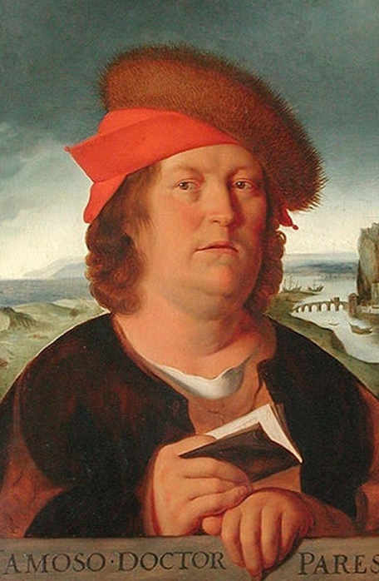
The Most Important Thing to Remember:
Everything is toxic at some dose.
"All things are toxic, for there is nothing without poisonous qualities. It is only the dose that distinguishes a remedy from a poison."
— Paracelsus, 1500s
© 2026 - Society of Toxicology

Slide 23


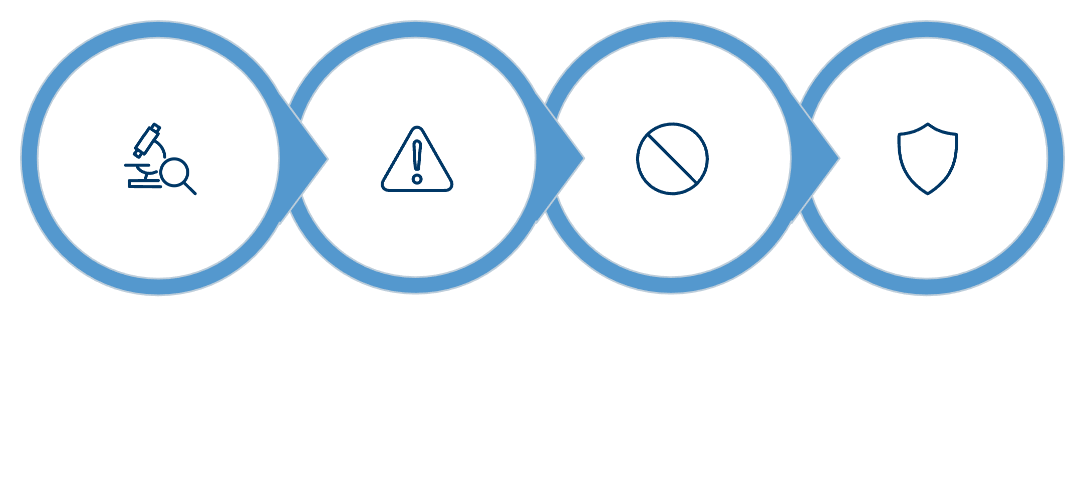

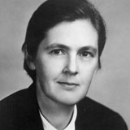

Toxicology Success Stories
Thalidomide and Drug Safety
DDT and Environmental Toxicology
Rachel Carson summarized the evidence from environmental toxicology to reveal how excessive DDT use harmed birds and ecosystems. This led to more responsible pesticide regulation and helped protect keystone species like the bald eagle.
Safety Concerns
FDA Blocks Approval
Lives Protected
Testing
=
In the 1960s, Frances Kelsey’s careful toxicological review prevented thalidomide from being approved for pregnant women in the US, avoiding thousands of birth defects seen in other countries.
Toxicology helps society make smarter decisions by identifying risks before they cause harm.
© 2026 - Society of Toxicology

Slide 24
What Research Tools Are Used in Toxicology?
Toxicologists use model systems and ethical practices to provide the most relevant data for each question.
In Silico
Computer models and predictions
In Vitro
Cells and tissue-based assays
Ex Vivo
Isolated tissue samples
In Vivo
Whole-organism responses observed
Created in BioRender. Curran, C. (2026) https://BioRender.com/hh6iot3
Good science is choosing the right method for the question being asked.
© 2026 - Society of Toxicology

Slide 25
Summary of Key Concepts
Toxicology is the study of adverse effects caused by exposures.
The dose determines if there will be an adverse effect.
The dose-response relationship varies by chemical or agent.
Toxicologists also study the effect of the chemicals and agents on the body.
Government agencies like the US EPA and US FDA use toxicology to protect human and environmental health.
Exposures occur every time we eat, drink, inhale or apply a compound.
Risk depends on age, sex, genetics and other factors.
Toxicologists study the absorption, distribution, metabolism and elimination of compounds that enter the body.
© 2026 - Society of Toxicology

Slide 26
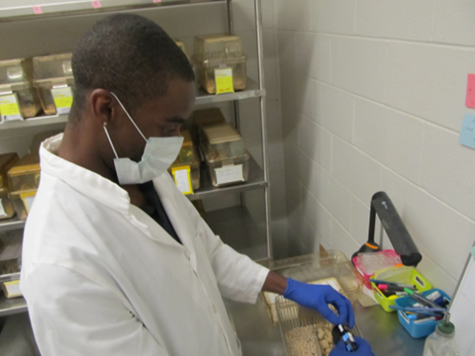

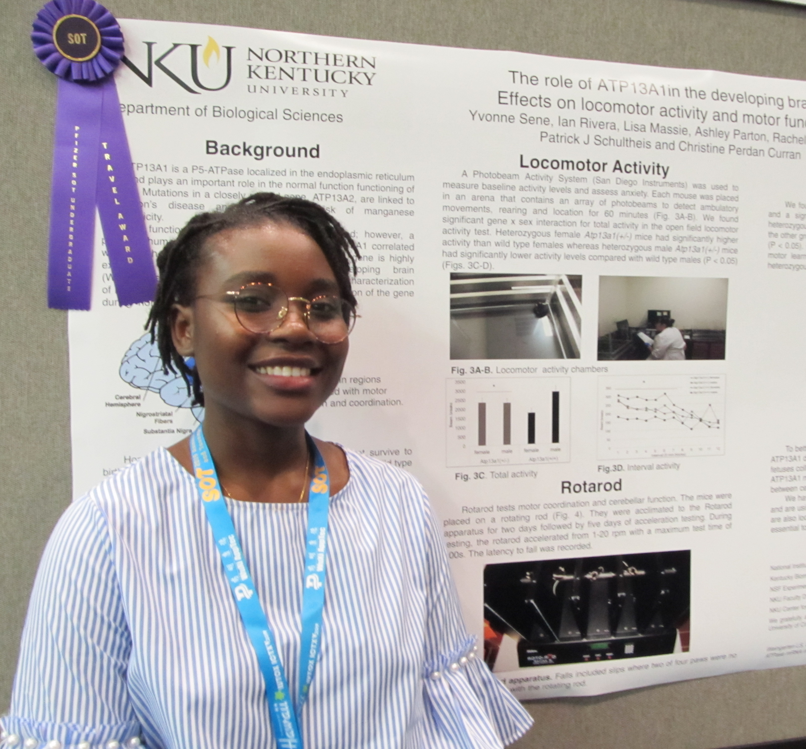
Toxicologists Help Create a
Safer World
Toxicology provides an interesting and exciting way to apply science to important problems of social, environmental, and public health significance.
Understanding how something produces a toxic effect can lead to new ways of preventing or treating chemically related diseases.
The Society of Toxicology offers networking and engagement in career-building.
Photos courtesy of Chris Curran, Northern Kentucky University

Slide 27




Information and Resources
Additional information and resources can be found on the Society of Toxicology website:
Website
Becoming a Toxicologist
www.toxicology.org
Career resources and pathways
Contact
sothq@toxicology.org
Bluesky | Facebook | Instagram | LinkedIn | TikTok | X | YouTube
© 2026 - Society of Toxicology

Slide 28
Additional Slides

Slide 29


In Silico (Computer Models)
Uses computers and mathematical models to predict how chemicals might behave in the body, screening many substances quickly.
Answers Questions Like:
Does this chemical resemble known toxins?
What effects might we expect before lab testing?
In Vitro (Cells and Tissues)
Studies cells, tissues, or 3D organoids in the lab to investigate specific biological processes.
Answers Questions Like:
Does this chemical damage cells?
Does it trigger inflammation or affect genes?
© 2026 - Society of Toxicology

Slide 30


Ex Vivo (Tissue Samples)
Uses tissues removed from humans or animals, maintaining more biological complexity than isolated cells.
Answers Questions Like:
How does a real tissue respond to exposure?
Does the chemical penetrate skin or affect an organ?
Animal Models
Understand whole-body effects
Study metabolism, development, and long-term outcomes
Human Clinical Studies
Observe responses under controlled conditions
Evaluate safety, tolerance, or effectiveness
Human Observational Studies
Observe responses under controlled conditions
Evaluate safety, tolerance, or effectiveness
© 2026 - Society of Toxicology

