Slide 1

Computational Toxicology and High-Throughput Risk Assessment
Richard Judson
U.S. EPA, National Center for Computational Toxicology
Office of Research and Development
NCAC SOT Regional Meeting April 19, 2011
The views expressed in this presentation are those of the author and do not necessarily reflect the views or policies of the U.S. EPA

Slide 2
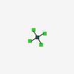
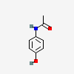
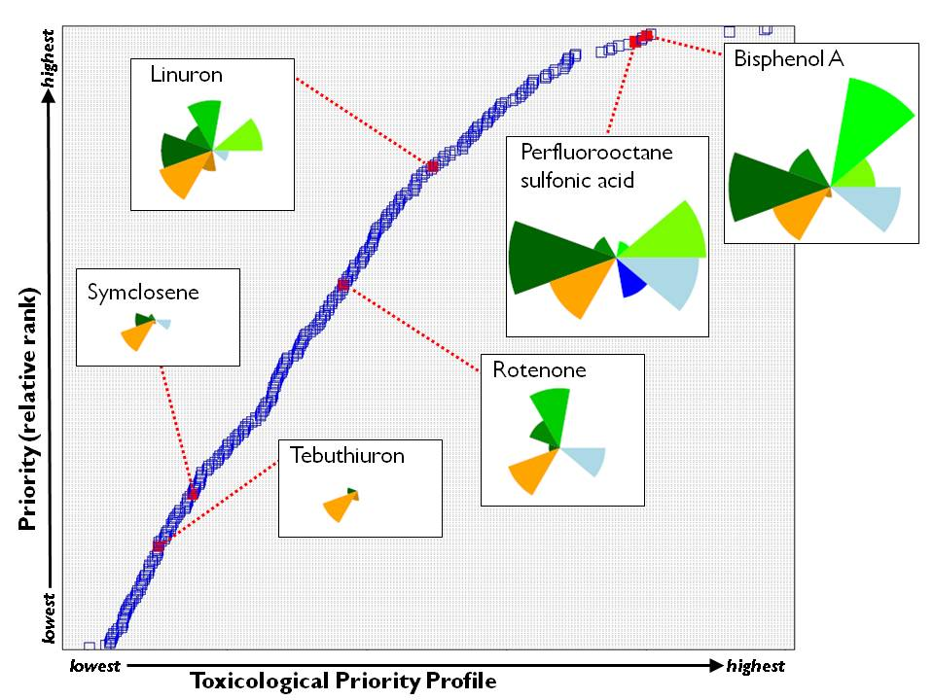
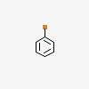
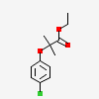

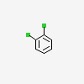
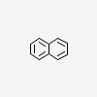
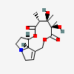
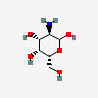
EPA CompTox Research
Thousand chemicals
ToxCast testing
Bioinformatics/
Machine Learning
Benefits
-Less expensive
-More chemical
-Fewer animals
-Solution Oriented
-Innovative
-Multi-disciplinary
-Collaborative
-Transparent
Chemical Toxicity Profile

Slide 3
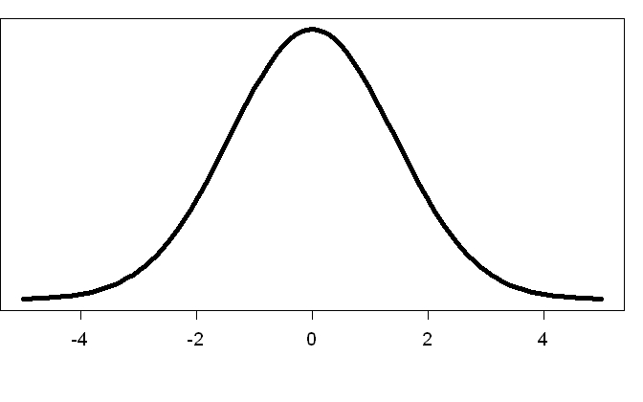
Model ToxCast Application
HTRA Report Card For Chemical: ABC
Pathway / Target / Model
CAR/PXR Pathway
ER / AR / Endocrine Targets
ReproTox Signature
DevTox Signature
Vascular Disruption Signature
Thyroid Cancer Signature
Critical Effect
No detect
No detect
No detect
Low High
Exposure / Dose
Upper no effect dose
Population
Variability
BPADL
Uncertainty
BPAD Distribution

Slide 4
Model ToxCast Application: High-Throughput Risk Assessment (HTRA)
Using HTS data for initial, rough risk assessment of data poor chemicals
Risk assessment approach
Estimate upper dose that is still protective
In HTRA: BPAD (Biological Pathway Altering Dose)
Analogous to RfD, BMD
Compare to estimated steady state exposure levels
Contributions of high-throughput methods
Focus on molecular pathways whose perturbation can lead to adversity
Screen 100s to 1000s of chemicals in HTS assays for those pathways
Estimate oral dose using High-Throughput pharmacokinetic modeling
Incorporate population variability and uncertainty

Slide 5
HTRA Outline
Identify biological pathways linked to adverse effects
Measure Biological Pathway Altering Concentration (BPAC) in vitro (ToxCast)
Estimate in vivo Biological Pathway Altering Dose (BPAD) (PK modeling)
Incorporate uncertainty and population variability estimates
Calculate BPAD lower limit – Estimated health protective exposure limit

Slide 6
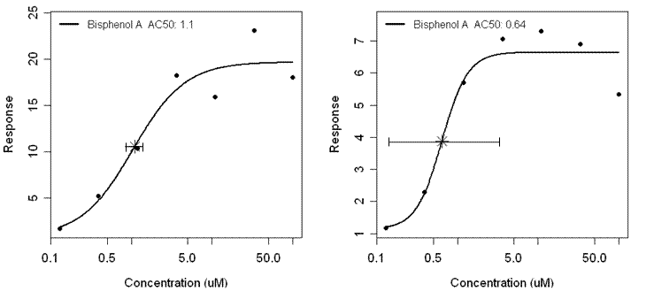
Example concentration-response curves
Sample curves for BPA in two ER assays
Note that full concentration-response profiles can be measured, at arbitrary spacing and to arbitrarily low concentrations (at moderate cost for a given chemical)

Slide 7
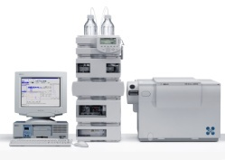
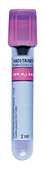

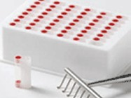
Experimental Assays for Characterizing Steady-State Pharmacokinetics
Human
Hepatocytes
(10 donor pool)
Add Chemical
(1 and 10 μM)
Remove Aliquots at 15, 30, 60, 120 min
Analytical Chemistry
Hepatic Clearance
Plasma Protein Binding
Human
Plasma
(6 donor pool)
Add Chemical
(1 and 10 μM)
Equilibrium
Dialysis
Analytical Chemistry
Combine experimental data with PK Model to estimate
dose-to-concentration scaling
“Reverse Toxicokinetics”
In collaboration with Hamner Institutes / Rusty Thomas

Slide 8
BPAD Probability Distribution
Population
Variability
BPADL
Uncertainty
BPAD = BPAC / C_{ss} / DR
BPAC and C_{ss} / DR ~ log-normal
BPAC: lowest AC50 for pathway assays
Estimate protective BPAD as the lower 99% tail (BPAD₉₉)
Add in uncertainty and take the lower 95% bound on BPAD₉₉ to give a more protective lower bound
BPADL₉₉ (“L” for lower)
BPAD Distribution

Slide 9
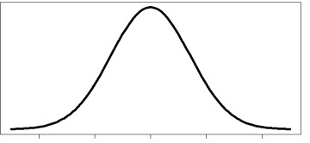

Slide 10
Combining in vitro activity and dosimetry
Range of in vitro AC50 values converted to human in vivo daily dose
Pyrithiobac-sodium
Triclosan
log (mg/kg/day)
Safety margin
Actual Exposure (est. max.)
Rotroff, et al. Tox.Sci 2010

Slide 11
Conazoles and Liver Hypertrophy
Conazoles are known to cause liver hypertrophy and other liver pathologies
Believed to be due (at least in part) to interactions with the CAR/PXR pathway
ToxCast has measured many relevant assays
Calculate BPADL for 14 conazoles
Compare with liver hypertrophy NEL/100

Slide 12
Conazole / CAR/PXR results
BPAD Range
Exposure estimate
NEL/100
LEL, NEL
Population
Variability
BPADL
Uncertainty
BPAD Distribution

Slide 13
Conazole Summary
Rough quantitative agreement
Significant BPADL vs. NEL/100 rank correlation (p=0.025)
12 of 14 chemicals have BPADL within 10 of NEL/100
For only 3 is BPADL significantly less protective than NEL/100
All BPADL > Exposure estimate
Some apples to oranges: human BPADL, rat NEL
Rat RTK underway for some of these chemicals

Slide 14
HTRA Summary
Select toxicity-related pathways
Develop assays to probe them
Estimate concentration at which pathway is “altered” (PD)
Estimate in vitro to in vivo PK scaling
Estimate PK and PD uncertainty and variability
Combine to get BPAD distribution and health protective exposure limit estimate (BPADL)
Many (better) variants can be developed for each step (1-6)
Use for analysis and prioritization of data-poor chemicals

Slide 15


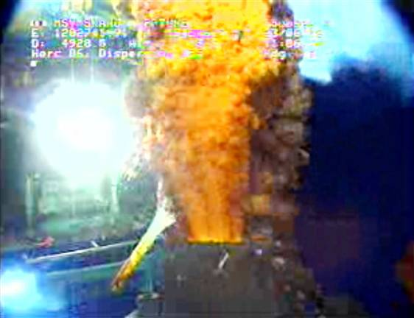
Deepwater Horizon
Oil Exploration Platform Explodes April 20, 2010
Estimated 4.9 million barrels of South Louisiana Crude released
1.8 million gallons of dispersant used
1072K surface; 771K subsea
Corexit 9500A (9527 early in spill)
EPA Administrator call for less toxic alternative
Verification of toxicity information on NCP Product Schedule
ORD involvement in assessments of dispersant toxicity

Slide 16
EPA Toxicity Studies
Phase I: Dispersant toxicity
Acute toxicity: fish and invertebrate
Comparison to toxicity info from NCP Product Schedule
Human cell line cytotoxicity
in vitro estrogenicity, androgenicity
Phase II: Oil & oil-dispersant mixture toxicity
Acute toxicity: fish and invertebrate
Oil-only
Dispersant+oil
In vitro assays were not used in this phase

Slide 17
What is a dispersant?
Complex mixture
Proprietary / Confidential Business Information
Hydrocarbon component
Breaks up clumps of oil
Like kerosene
Detergent / surfactant component
Solubilizes oil components into water
Water
Colorants
Stabilizing agents

Slide 18
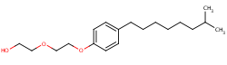
Goals of the NCCT Oil Dispersants Project
Test 8 candidate dispersants for endocrine (ER, AR, TR) activity
Driven by fact that some dispersants contain nonylphenol ethoxylates, known ER agonists
Evaluate relative cytotoxicity
Look for other types of bioactivity using broad in vitro screen
Return analysis in ~6 weeks

Slide 19
Assay Technologies Used
NCCT Assay Goals:
Have collection of assays that can be run on thousands of chemicals
Willing to sacrifice some level of accuracy for throughput
Use: prioritization of large number of previously untested chemicals
Competitive binding (Novascreen)
Cell-free
Human, mouse, bovine
ER/AR reporter-gene assays (NCGC)
Agonist and antagonist mode
Quantitative Cytotoxicity
Collection of 81 nuclear-receptor-related assays (Attagene)
Includes AR, ER, TR
Other xenobiotic response pathways
Quantitative cytotoxicity and cell-stress readouts
HepG2 cells – limited biotransformation capability

Slide 20
Dispersant Cytotoxicity Results
Significantly more cytotoxic (statistically but not biologically)
Attagene: HepG2
NCGC: Bla ER/AR
NHEERL RTP: T47D, MDA, CV1
NHEERL Gulf Breeze:
M. Berylina (silverside minnow)
A. Bahia (brine shrimp)
More potent
Less potent
Bottom line: no significant difference across products

Slide 21
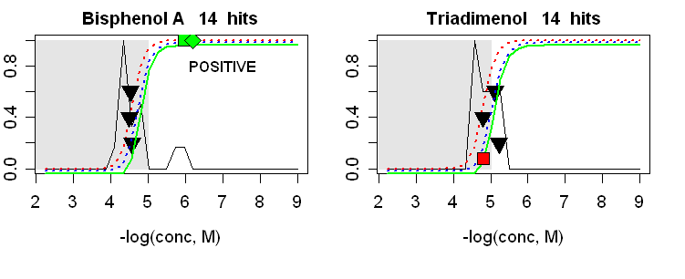
In vitro assay issues to watch for
All assays have some false positives / false negatives
Assay-specific filtering can help eliminate false positives
Using multiple assays can mitigate problem of false negatives in any one assay
Example: Attagene – use cell-stress assays to filter out false positives
339 chemicals tested
127 showed some indication of ER activity in one or both ER assays
75 showed activity above cell-stress threshold in one or both ER assays
20 were active above cell-stress level in both ER assays – mostly known positives
ER assays

Slide 22
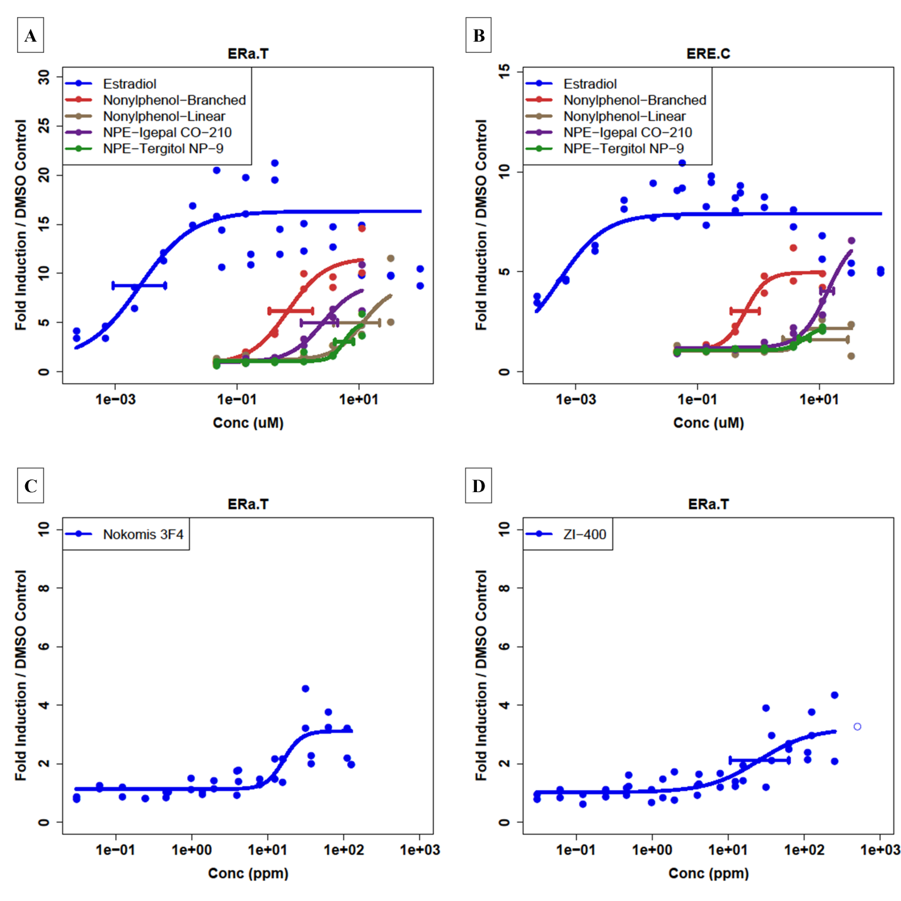
Concentration-Response Profiles for ER in test samples
Estradiol and
Nonylphenol compounds
ERa.T=Attagene ERa TRANS
ERE.C=Attagene ERa CIS
CIS Efficacy less than
half TRANS efficacy for
reference compounds
Dispersant Positives
TRANS assay efficacy near
detection threshold for these
dispersants

Slide 23
Dispersant Endocrine Assay Results
No AR activity (after discounting false positive)
Weak ER activity seen for 2 dispersants in one ER assay
Nokomis 3-F4
ZI-400
Both of these (probably) contain nonylphenol ethoxylates
Nokomis web site said they have alternative formulations without NPE, implying standard formulation includes NPE

Slide 24
Biological Pathway Results for Dispersants
Multi-assay pile-up
Indication of generalized cell stress
Prelude to cytotoxicity
Xenobiotic
metabolism
Estrogen
Receptor
Activity
More potent
Less potent
Bottom line: 2 products show weak estrogen activity
“Not Significant Biologically”

Slide 25
Dispersant Conclusions
Weak evidence of ER activity in 2 dispersants
Seen in single, perhaps over-sensitive assay (1 of 6)
Not of biological significance
Consistent with presence of NPE
Activity only at concentrations >> seen in Gulf after dilution
No AR activity
No ER activity seen in Corexit 9500
Corexit is in the middle of the pack for cytotoxicity
No worrisome activity seen in other NR assays

Slide 26
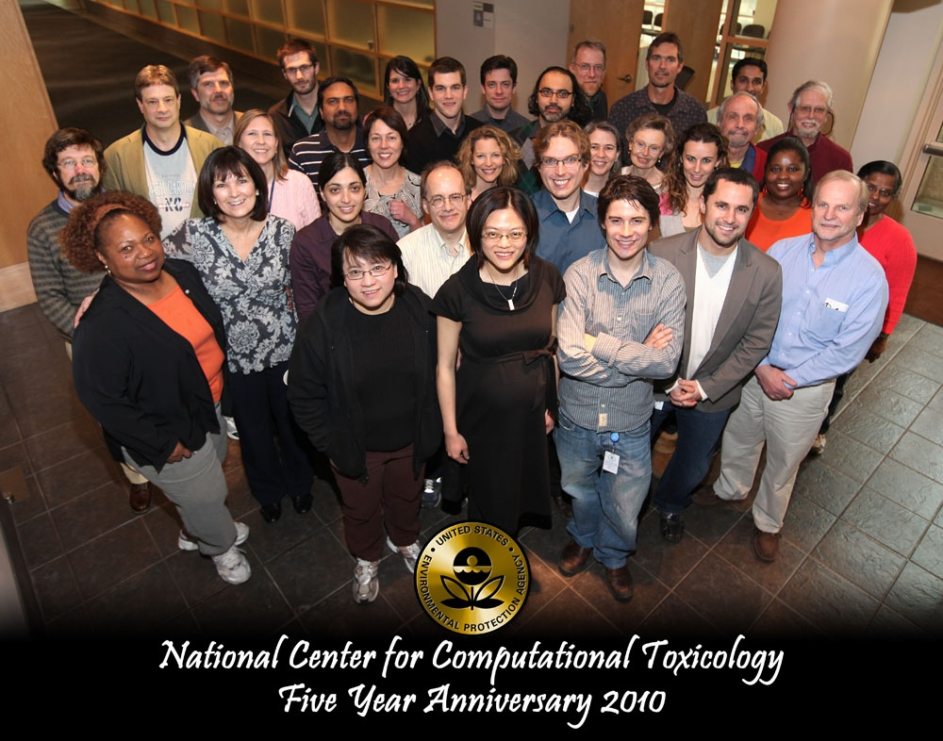
Thank You for Listening
judson.richard@epa.gov

