Slide 1
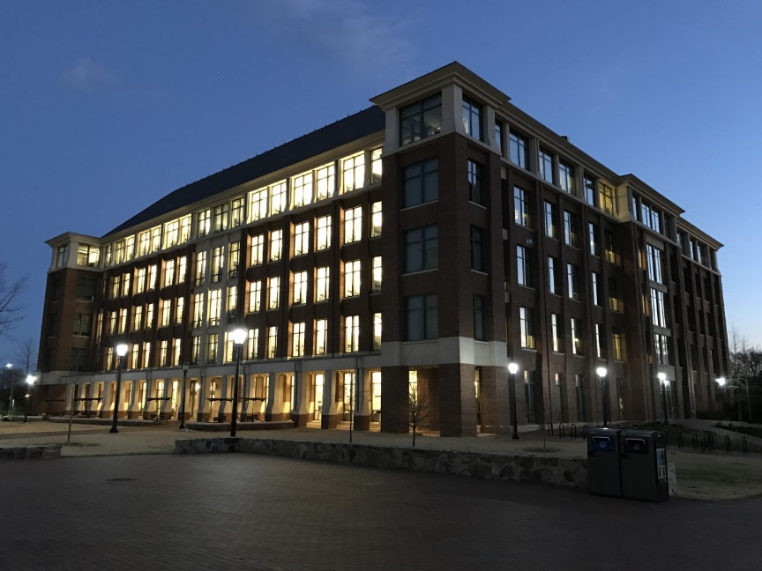
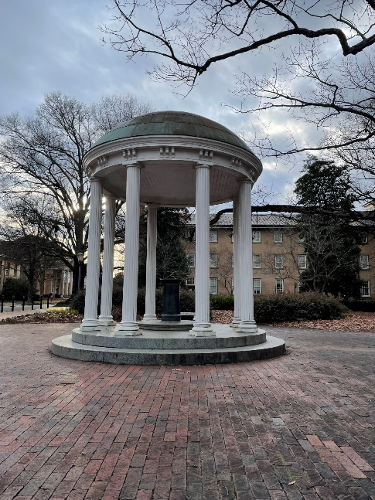
Ozone-induced changes in lung extracellular vesicle miRNA
Gregory J. Smith, Ph.D.
Assistant Professor
Department of Genetics
University of North Carolina at Chapel Hill
Kelada Lab
Notes:
-Thank you to IRSS and the organizers Judy, Holger, and Meghan for inviting me to talk with you today.
-My goal for this half of the webinar is to provide you with a short introduction to lung EVs from a Respiratory Toxicology perspective.

Slide 2
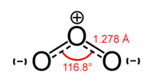
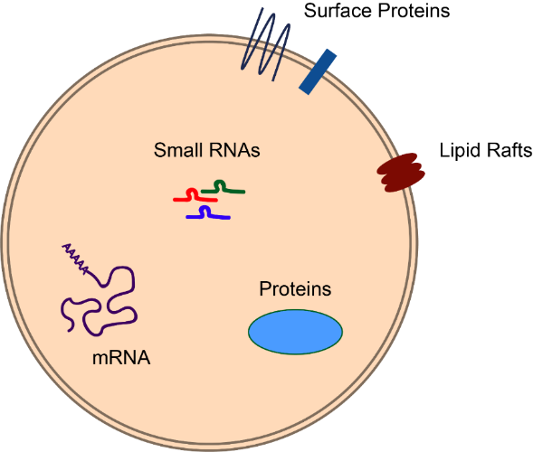
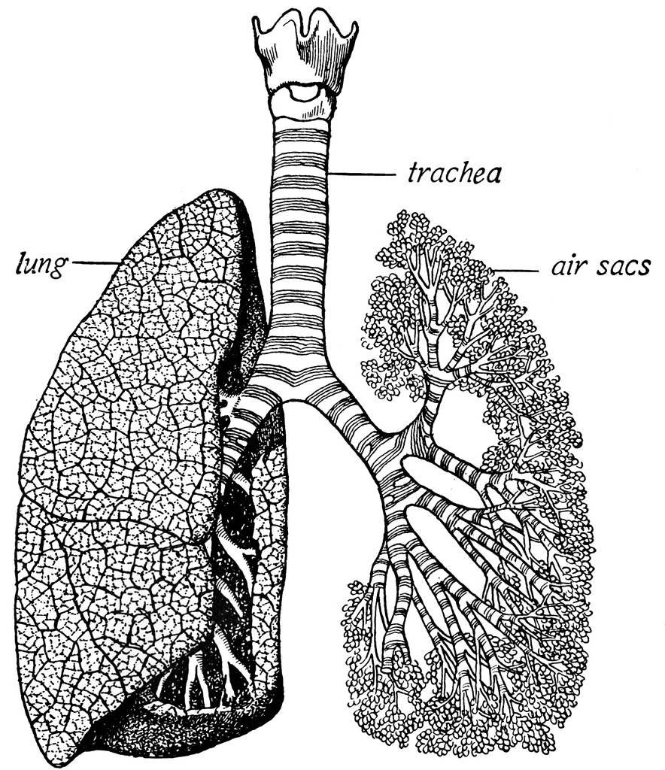
Outline
Lung EVs
Ozone & lung EV miRNA
Future studies
Q&A
Notes:
-First, we’ll take a brief look at examples of the types of work being done in the field.
-Then I will show you our study of Ozone-induced changes in the lung EV miRNA landscape
-and finally provide some future areas for investigation based on our data.

Slide 3
Lung extracellular vesicle (EV) studies
Notes:
-There’s a growing number of studies looking at the role of EVs in respiratory inflammation and in the response to inhaled toxicants.
-I will break them down into a few categories, although there’s plenty of overlap.

Slide 4
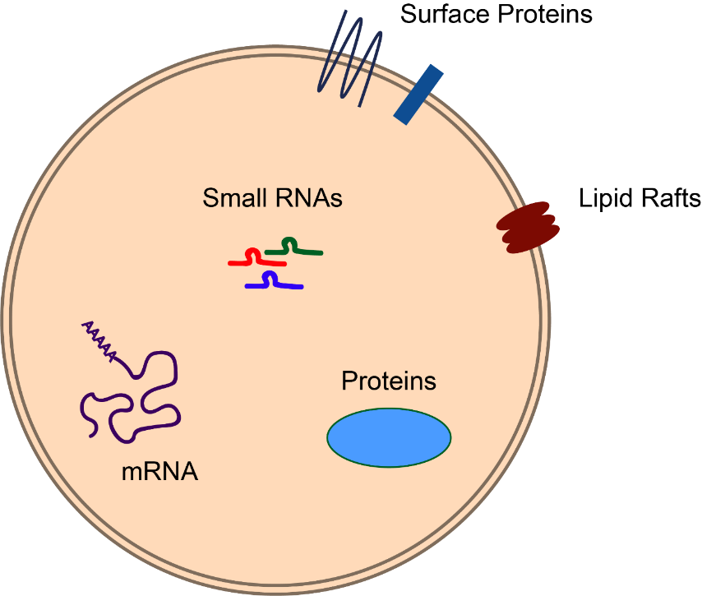
Content
The lung EV-lipid profile differs in asthmatics (Hough 2018)
The lung EV-proteome is altered by repeated ozone-exposure (Choudhary et al. 2021)
Lung EV-miRNA content is altered by hyperoxia (Lee et al. 2016)
Notes:
-In the first category, are studies looking at EV content.
-And in general they show that the content of Lung EVs is widely variable depending on the context.
-For example, it has been shown that the profile of lung EV lipids differ in asthmatic vs. healthy lungs, repeated ozone exposure can alter the protein content of EVs, and the microRNA content can also be altered by inflammation.
-However, prior to our work, a high-throughput sequencing approach had not been applied to lung EVs after inhaled toxicant exposure.

Slide 5
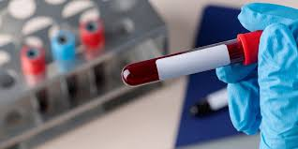
Biomarkers
Particulate matter exposure alters circulating EVs (Rota et al. 2020)
Association between ozone and serum EV miR-150, -155 (Chen et al. 2020)
Notes:
-There’s a few studies that are relevant to respiratory toxicology have looked at using circulating EVs as biomarkers of air pollution exposure.
-For example colleagues of mine at the EPA recently explored serum EV-miRNA biomarkers of ozone exposure.
-In this area, with the development of better techniques and surface markers, it may be possible to detect lung specific EVs in circulation.

Slide 6
Source
Hematopoietic cell-derived EVs increase in allergic inflammation (Pua et al. 2019)
Target
Epithelial cell-derived microvesicles are taken up by macrophages (Lee et al. 2017)
Notes:
-Of course one of the big questions is where do the EVs come from and what are their targets, there are fewer studies in this area with respect to Resp Tox but progress is being made.
-For example, this have employed lineage tracing methods and membrane tags to get at this question.

Slide 7

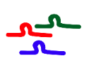
Function
Transfer of EVs from models of infectious and noninfections lung inflammation (Lee et al. 2018)
Transfer of EVs potentiates fibrosis in a bleomycin model (Parimon et al. 2019)
Neutrophil-derived elastase coated “activated” exosomes degrade extracellular matrix in COPD (Genschmer et al. 2019)
miRNA enriched EVs suppress bacterial lung inflammation (Zhang et al. 2019)
Treated
Naive
Naive
Naive
and other variations
Notes:
-Of course, we also want to know if EVs are functional.
-There are a variety of approaches being used to test EV function.
-Although the most commonly used are transfer studies.
-For example its been shown that inflammatory or disease phenotypes can be conferred by the transfer of lung EVs to a naïve mouse
-Another strategy I’ve seen is to deliver miRNA enriched EVs and in this example they were able to suppress inflammation with an anti-inflammatory miRNA.

Slide 8

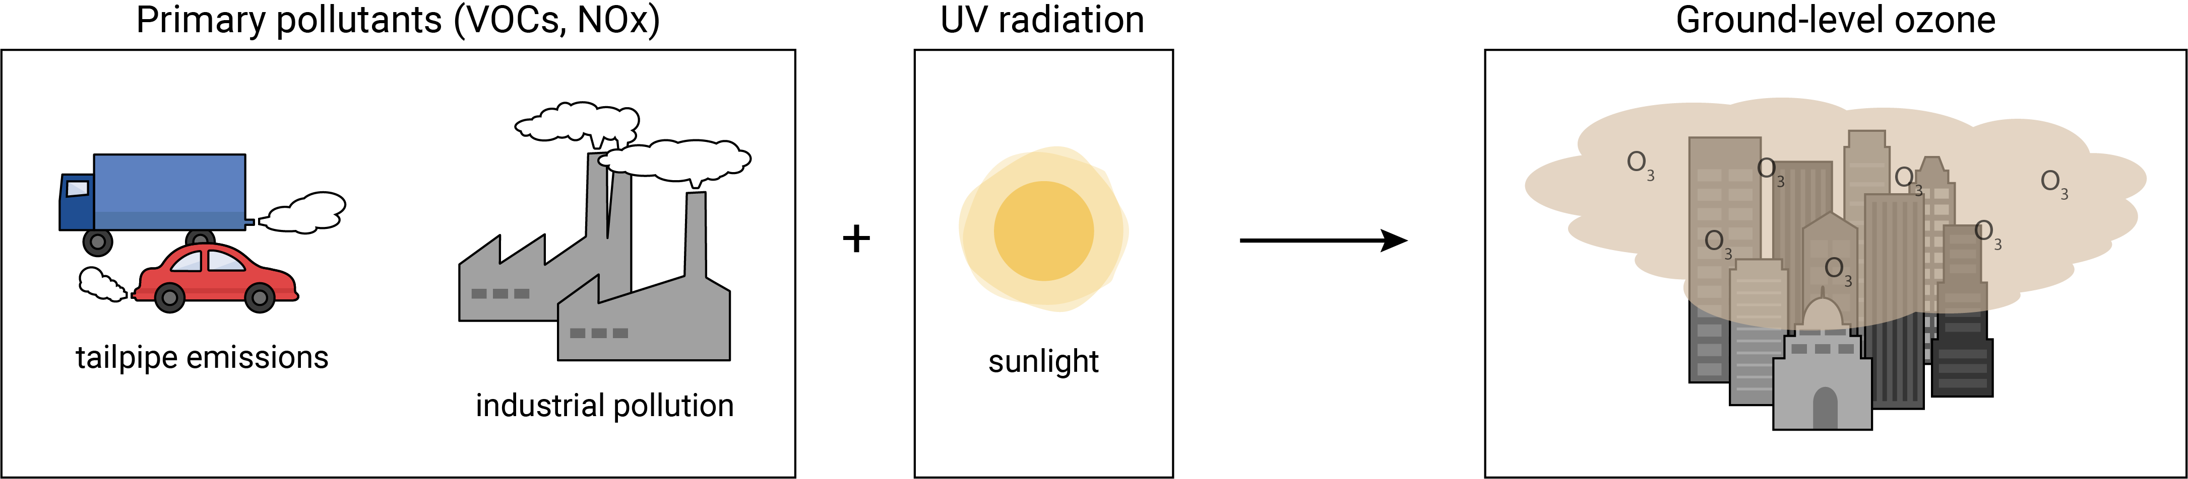
Ground level ozone (O₃)
Heat
EPA criteria air pollutant: current NAAQS – 0.07 ppm
NOx = Nitrogen Dioxides
VOC = Volatile Organic Compounds
Notes:
-I mentioned a couple of studies related to EVs and Ozone
-Our lab in is interested in mechanisms of the respiratory effects of Ozone, and I got interested in looking at the effects of Ozone on airway EVs.
-As most of you are probably familiar. The ground level ozone we are exposed to is an oxidant gas formed from reactions of primary air pollutants in the presence of UV radiation and heat.
-Notably, because this reaction is promoted by heat, the number of high-ozone exposure days is predicted to rise due to climate change induced warming.

Slide 9
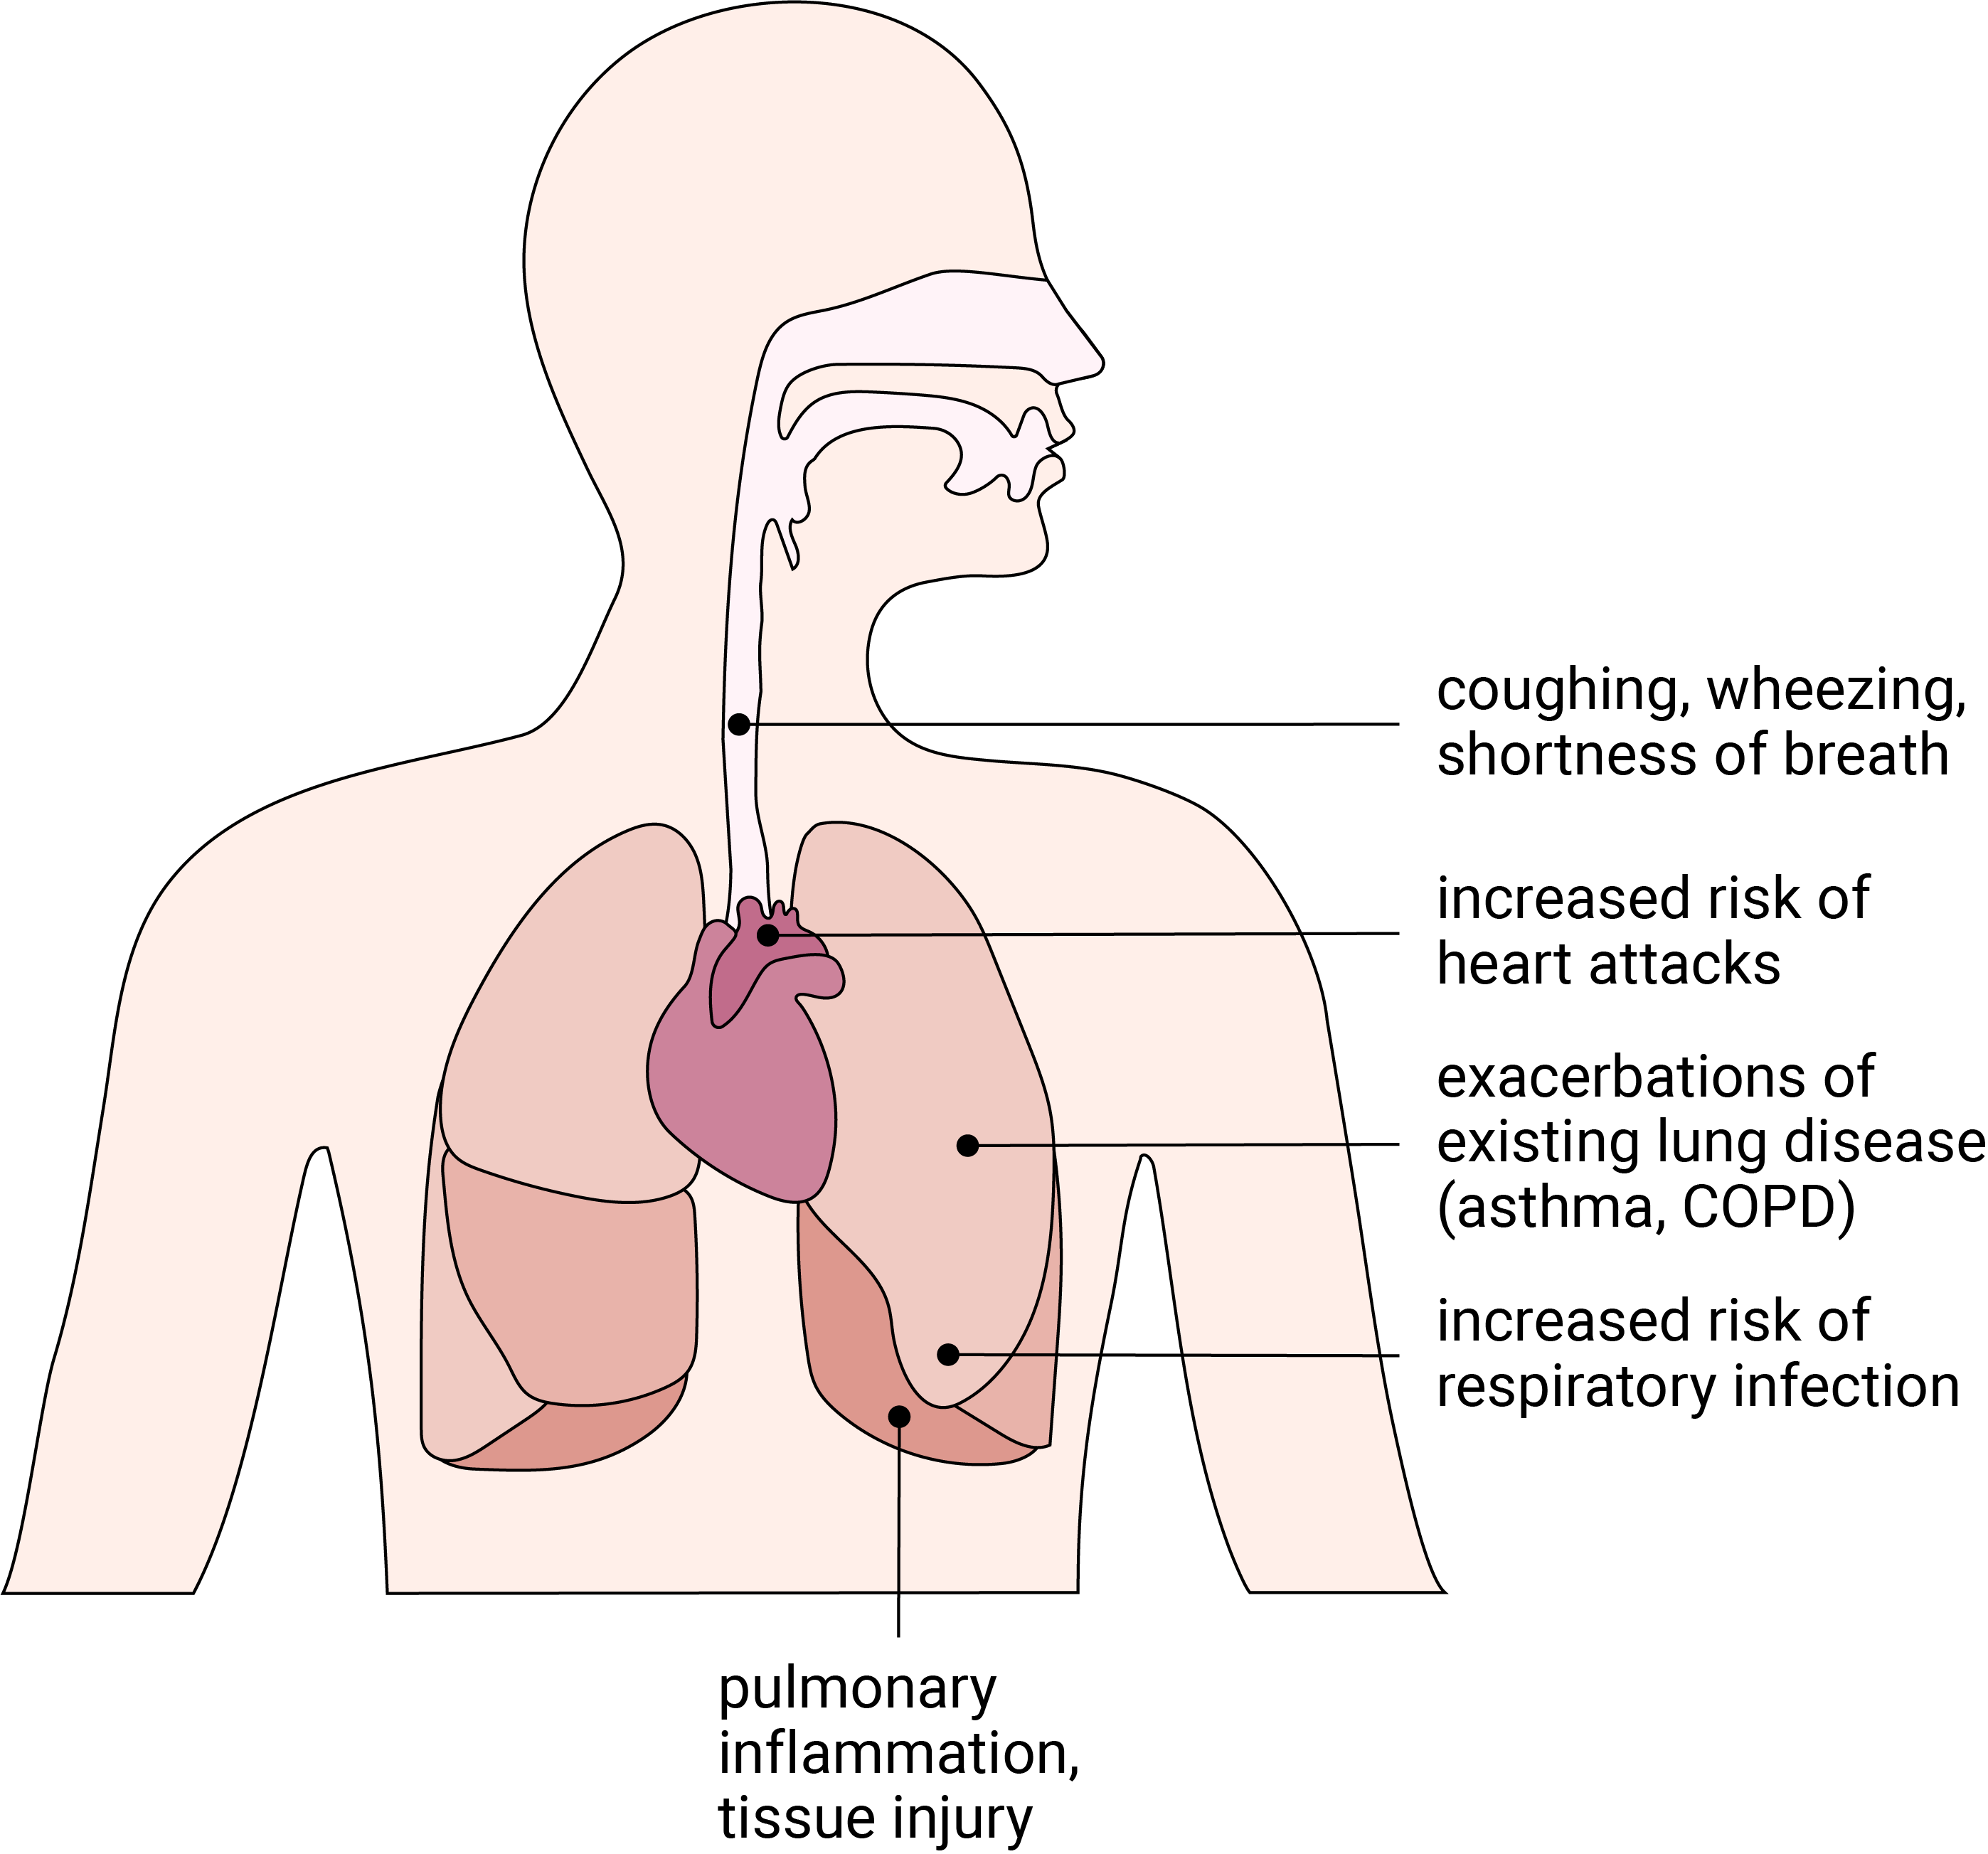
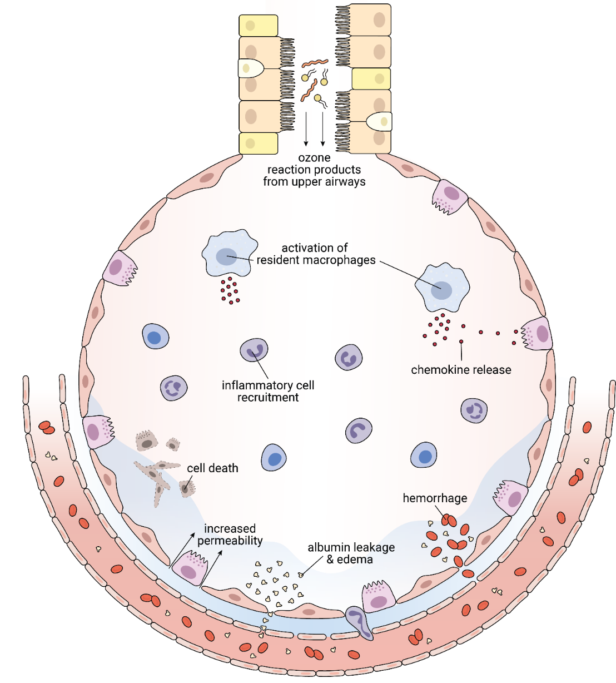
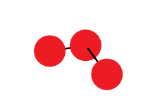
Respiratory effects of O₃
Reduced lung function (FEV₁) at 0.06 ppm (Kim et. al. 2011)
Notes:
-The respiratory effects of acute exposure to O3 include decreases in pulmonary function as well as inflammation and injury, which can lead to exacerbations of lung disease and increased risk of respiratory infection.
-These effects stem from the reaction of ozone with components of the airway lining fluid and the response of the cells of the airway to these reaction products.

Slide 10
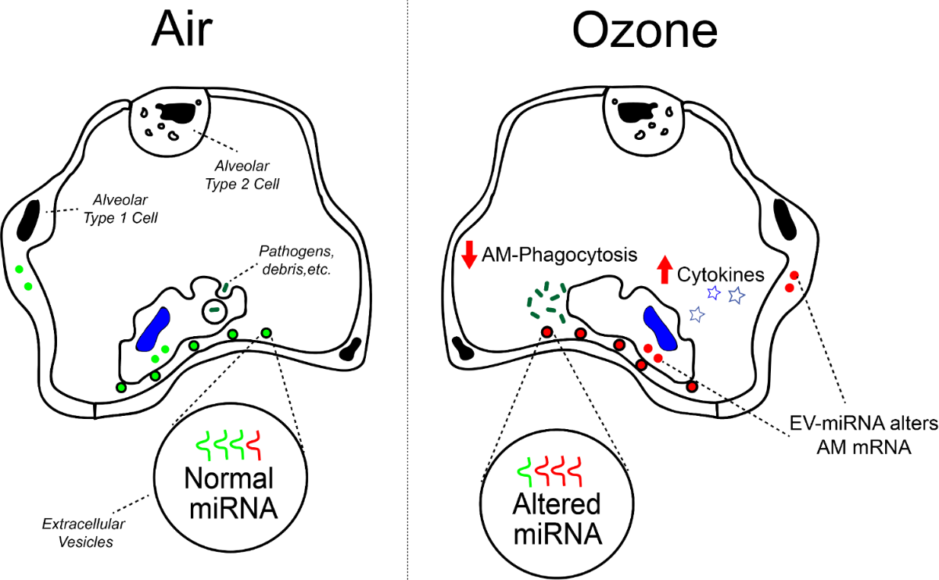
O₃ and lung EV-miRNA
Alveolus
Epithelial Cells
Macrophages
Homeostasis
Inflammation & Resolution
Notes:
-We know that two of the key airway cell types involved in the response to ozone are airway epithelial cells and macrophages, which release cytokines to attract inflammatory cells to the lung.
-Based on what we know about EVs as a mediator of intercellular communication, it is likely that EVs play a role in regulating the responses to Ozone.
-We specifically hypothesized that this could be through alterations in the miRNA content of EVs and resulting changes in gene expression in the cells which take up the EVs released into their microenvironment.

Slide 11
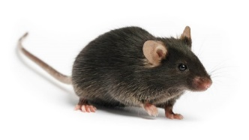
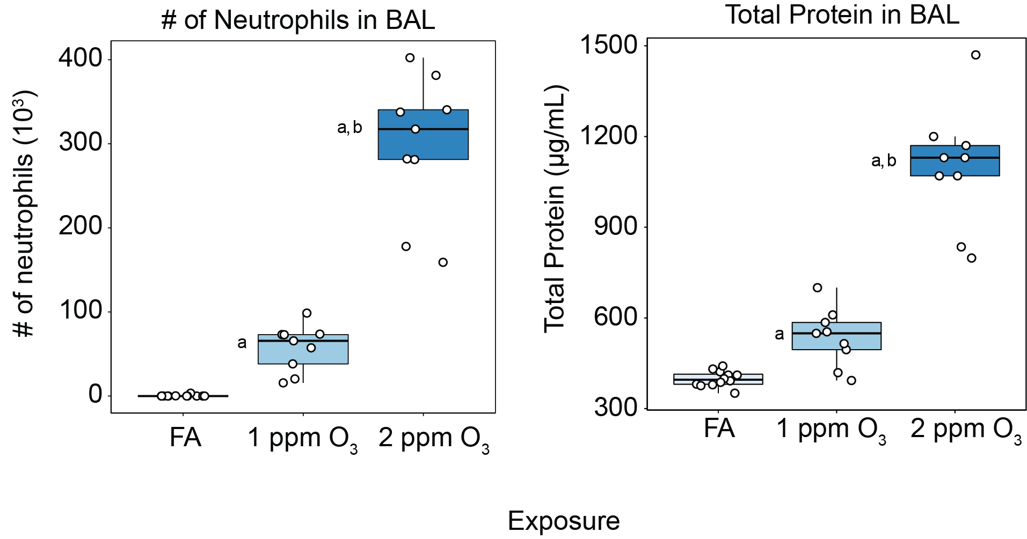
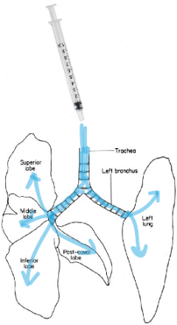
Acute O₃ exposure model
Inflammation and Injury at 24h
♀
C57BL/6J
Age: 8-10 of age
Bronchoalveolar Lavage (BAL)
N=9-12/group
Notes:
-To begin exploring this idea, we used an acute Ozone-exposure model
-where adult, female B6 mice were exposed to Filtered air, 1ppm or 2 ppm ozone for 3h
-24 hours later we collected bronchoalveolar lavage fluid to examine both inflammation and injury, as well as capture EVs.
Note on dose: 1,2 in mice = 0.2 and 0.4 ppm in humans. Mice require 4-5x more ozone to induce comparable lung inflammation to exercising humans (nose breathers). 10-30fold higher than NAAQS.
Note on timing: 21h gives a good snapshot of all the inflammatory processes (peaks of responses are all different) and it is also a good time point for doing co-exposures.
Note on female mice only?:

Slide 12
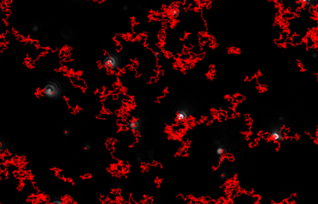
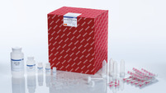
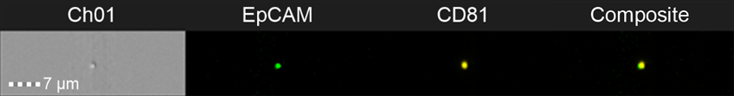
EV Isolation and Characterization
Nanoparticle Tracking Analysis (NTA)
Pre-column
Slow
Fast
BAL
400 x g
16k x g
Post-column
Isolate intact EVs w/ affinity column
Imaging flow-cytometry
Notes:
-To isolate EVs from the lavage fluid, we used an ExoRNEasy kit from qiagen which is an affinity column based purification method.
-We examined the number and size distribution of particles using NTA.
-In a follow-up experiment with FA and 2 ppm mice we eluted intact EVs performed NTA again.
-And also, with the help of Jessy DeShane at University of Alabama, looked at surface marker expression using imagestream analysis.

Slide 13
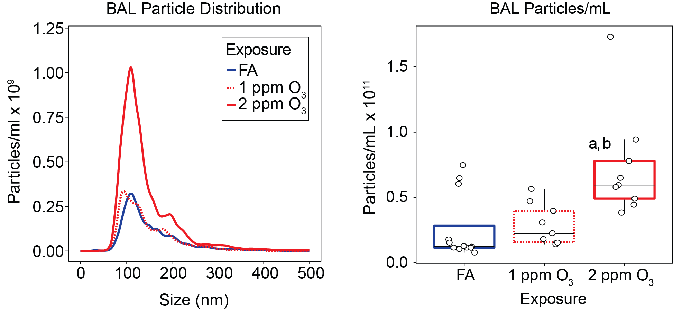
Pre-column NTA
Notes:
-We found a significant increase in the total number of EV-sized particles in the lavage fluid which had a similar pattern to our markers of injury and inflammation.

Slide 14
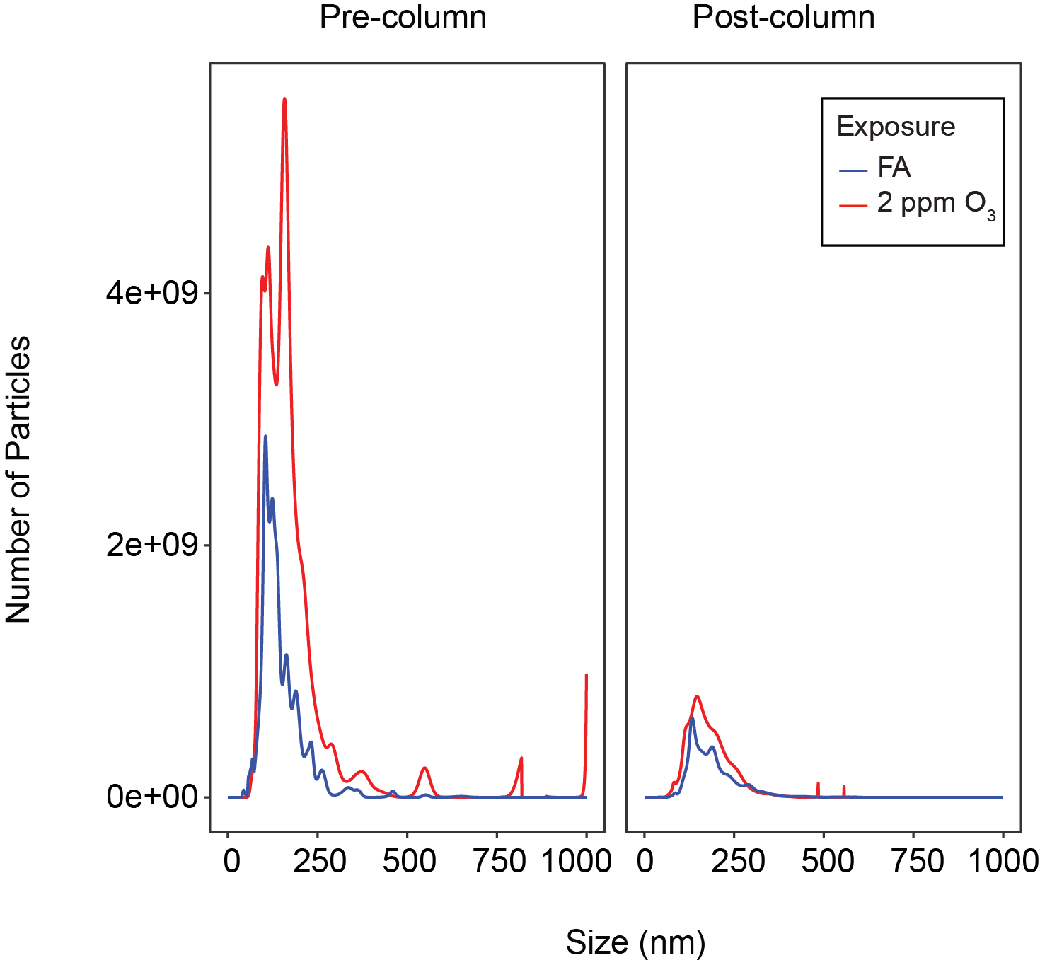
Pre vs. post-column
Notes:
-As you might expect, there is a large loss of particles overall when eluting particles from the column. Yet the increase in the number of EVs is still apparent in the 2 ppm O₃ group.

Slide 15
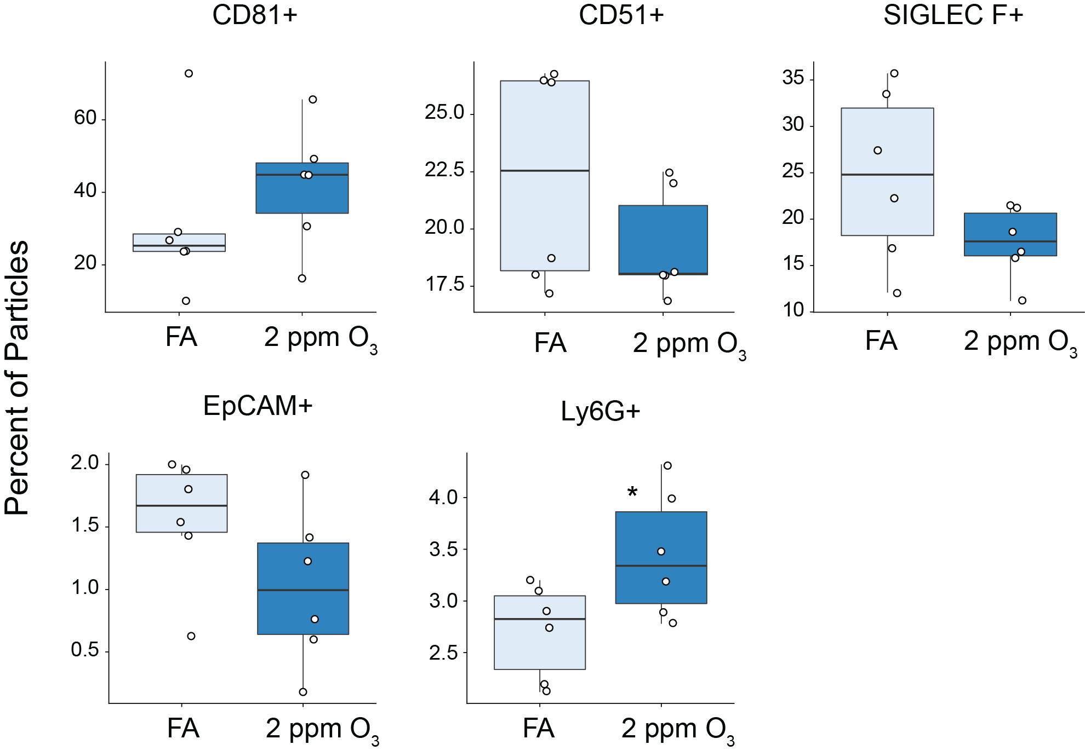
Imaging flow-cytometry
Notes:
-Imagestream analysis showed that the majority of the eluted particles expressed typical exosome and microvesicle markers CD81, CD51.
-20-30 percent expressed Siglec F, a marker of alveolar macrophages origin.
-however, very few expressed the epithelial marker EpCAM.
-And there were some vesicles which expressed Ly6G+, a marker of neutrophils, and as you might expect these were significantly increased by Ozone.
-So we know that the population of EVs in the lung following ozone is heterogeneous, we have EVs from different subtypes and different cell types.
-Which is what we wanted for the first small RNAseq study of lung EVs.

Slide 16
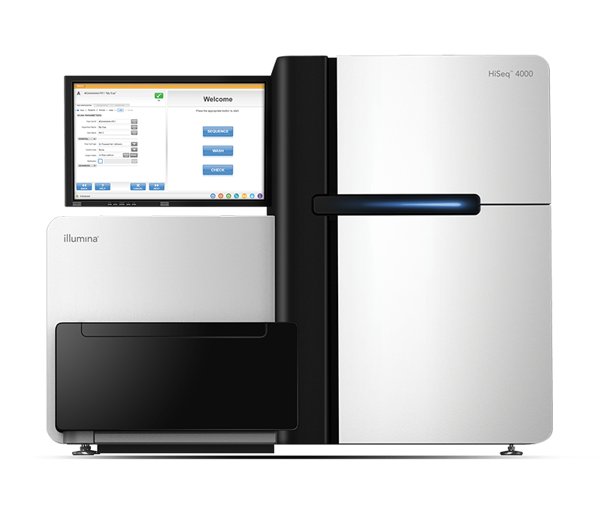

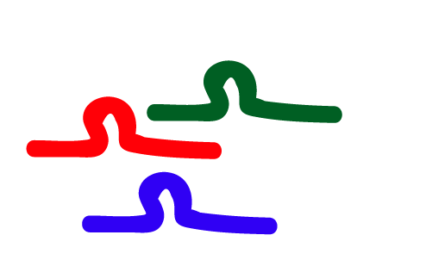
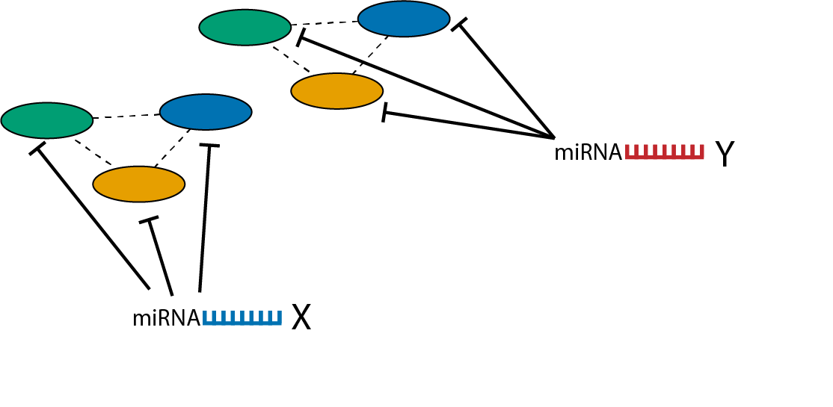
Lung EV small RNA sequencing
Small RNAseq
Lysis of column-bound EVs
400 x g
16,000 x g
BAL
Expression Analysis
miRquant 2.0
miRNA-mRNA target prediction
miRhub
Notes:
-For our sequencing study, instead of eluting intact vesicles the column bound EVs were lysed with qiazol.
-Then we proceeded to have small RNAsequencing run on our samples. (BioOScientific NextFLex v3).
-We analyzed the data with a bioinformatics algorithm called miRquant 2.0 (which handles annotation, quantification, and differential expression analysis)
-Used a predictive algorithm called miRhub to predict miRNA-mRNA target relationships from another sequencing dataset we had from mice exposed to FA, 1, or 2 ppm ozone.

Slide 17
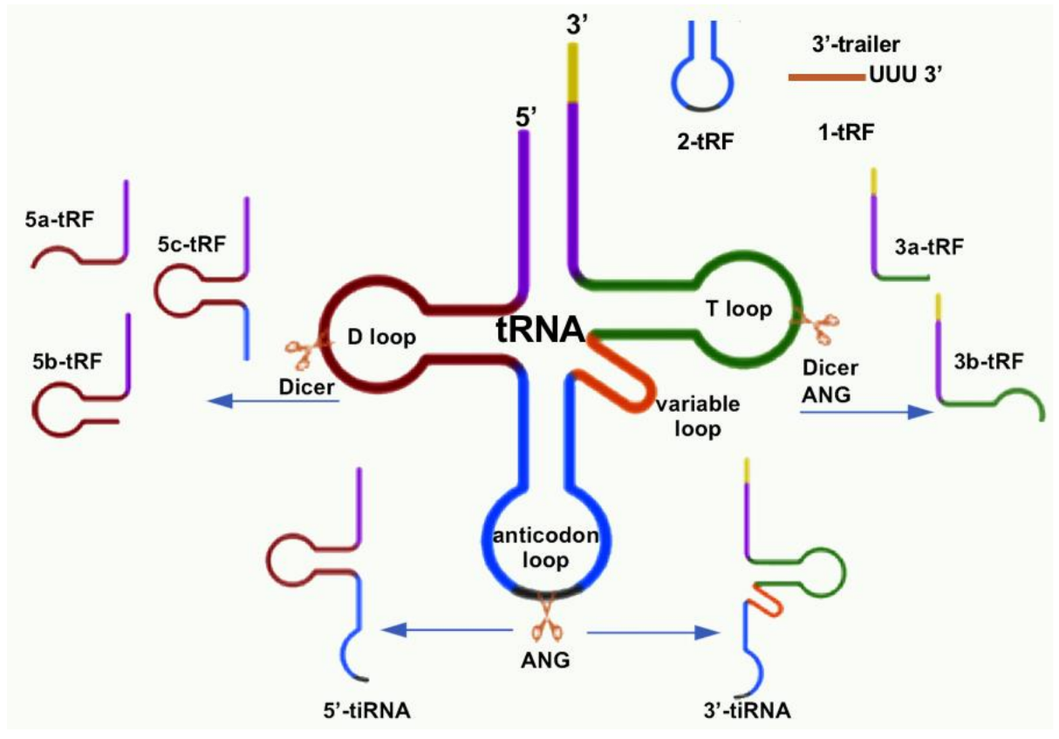
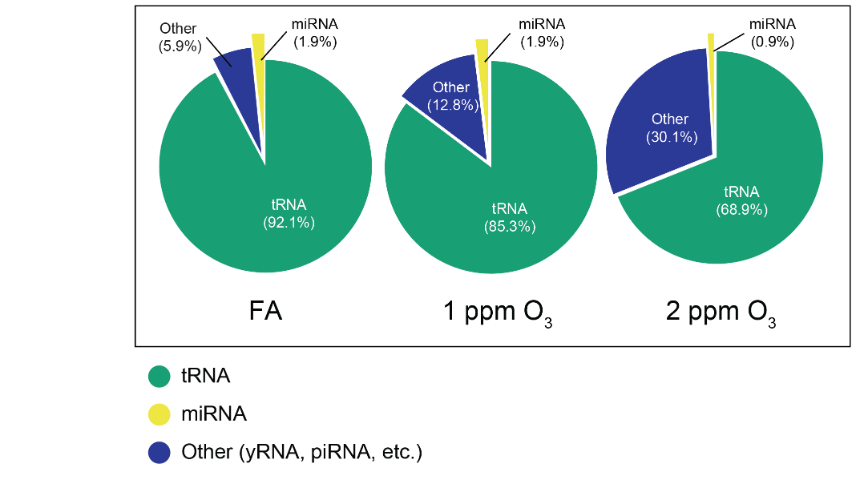
EV-small RNA mapping stats
Majority mapped to tRNA genes
Percent mapped by type
Peak size of ~35 nucleotides suggests tRNA halves
Notes:
-Somewhat surprising was the proportion of reads that mapped to different smallRNAs.
-We saw that a large portion mapped to tRNAs, and were in the size range of tRNA fragments.
-The function of these in EVs is not well understood, but they may also play a role in regulating gene expression.

Slide 18
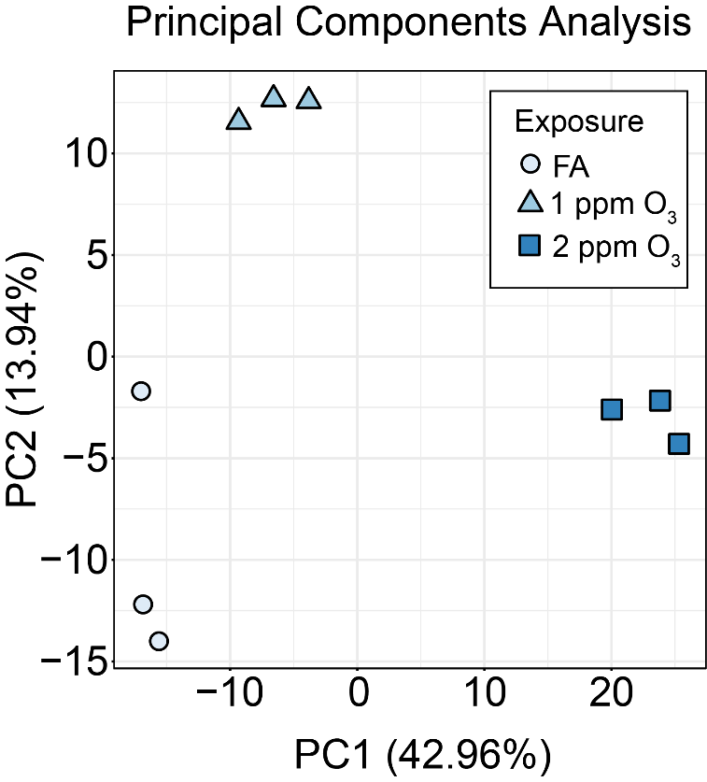
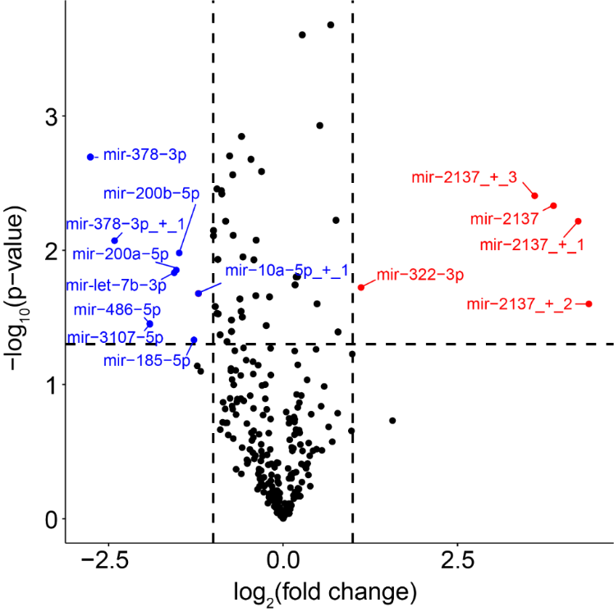
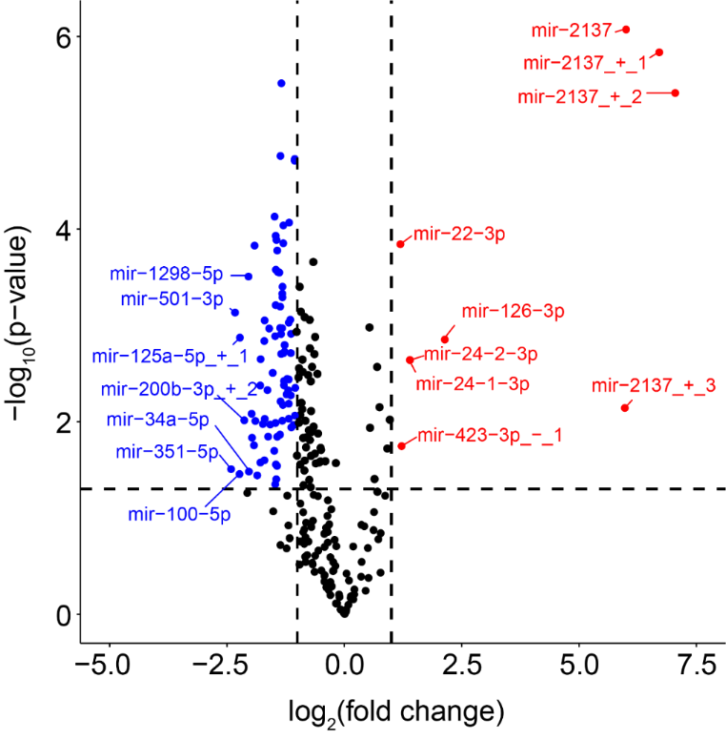
1 ppm O₃
O₃ alters EV-miRNA expression
2 ppm O₃
Notes:
-We found that there were distinct patterns of expression by exposure, as you can see based on the separation of groups in this PCA plot.
-These volcano plots indicate concentration dependent differential expression of EV-microRNAs compared to Filtered air exposed mice.
-Greater differences were noted in the 2 ppm group vs. FA, than 1 ppm vs FA and overall more miRNAs were downregulated.

Slide 19
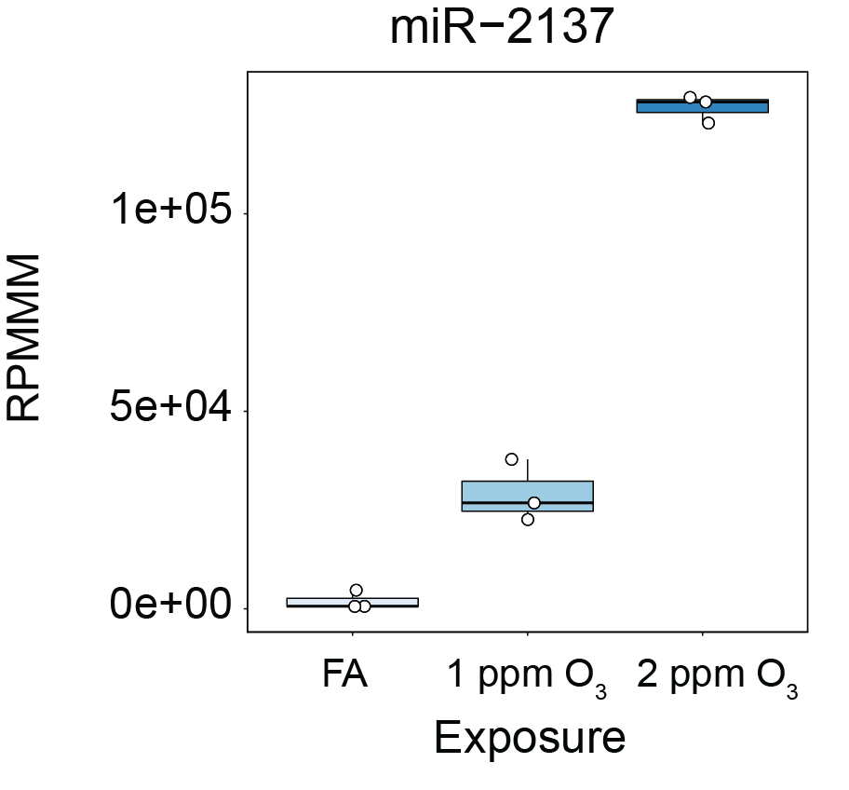
miR-2137 was DE in BMDMs infected with P. gingivalis bacteria
Anti-miR-2137 increased expression of pro-inflammatory TNF-alpha
Huck et al. Infect. Immun. 2017
Notes:
miR-2137 was identified as the most highly upregulated and expressed EV miRNA across both the 1 (~14-fold) and 2 ppm O3 (~120-fold) groups.
This is interesting because differential expression of miR-2137 was recently observed in bone marrow-derived macrophages after infection with Porphyromonas gingivalis bacteria (Huck et al., 2017).
In this study, inhibiting miR-2137 increased expression of the pro-inflammatory cytokine TNFalpha.
This suggests that miR-2137 may be an anti-inflammatory EV cargo following O3 exposure and play a role in the resolution of inflammation.
miR-126-3p = Pro-inflammatory, targets nF-kb inhibitor alpha (IkB), impairs intestinal barrier function.
miR-378-3p = negatively regulate macrophage proliferation
miR-351-5p = down-regulation is anti-inflammatory (pro-resolving pattern seen in our data).
Could perform a pathway analysis, but we have mRNA expression data from similarly exposed mice.
-Why was 2137 not a hit? Not listed in targetscan as a regulator of any of the DEGs. Could be the timing of the response, perhaps 2137’s effect on gene expression has not kicked in yet? Or-2137 could be effecting a cell type we are not adequately sampling? Dendritic cells for example.

Slide 20

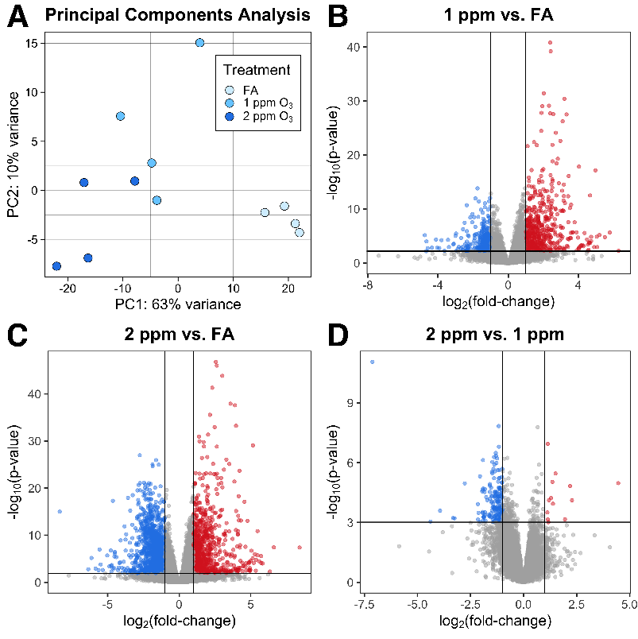
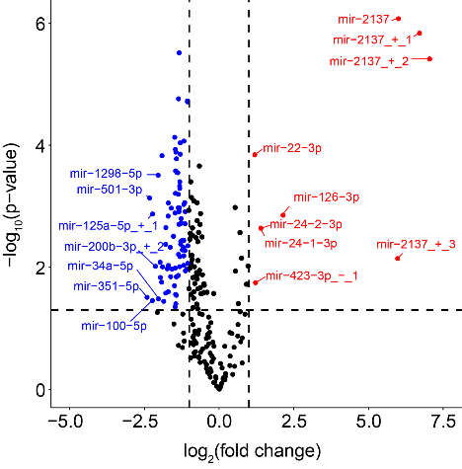

Integrating EV-miRNA w/tissue mRNA
Airway macrophage
mRNA expression
Lung EV-miRNA
Tovar et al. Toxicol. Sci. 2020
Notes:
-Although miR-2137 and other highly differentially expressed miRNAs make good candidates by themselves.
-To better narrow down our search for potentially interesting EV-miRNAs.
-We employed a bioinformatics approach to integrate EV-microRNA expression data with target mRNA expression data we previously generated for airway macrophages.

Slide 21
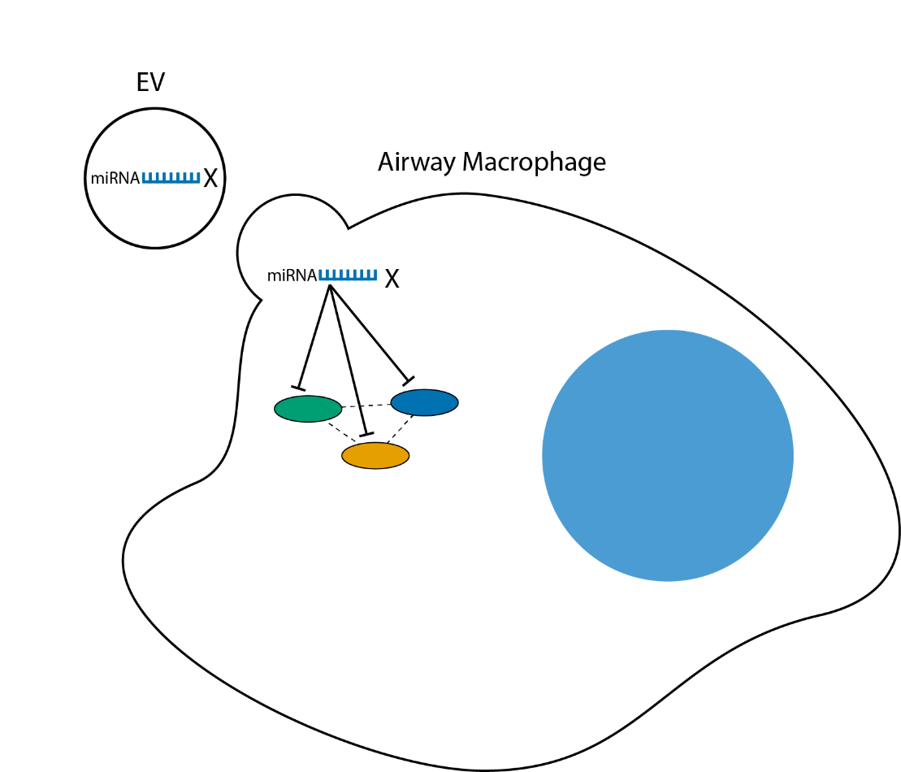
Predicting regulatory miRNAs: miRhub
3) Match with DE EV-miRNAs
1) Input lists of DE genes from O₃-exposed AM
Gene A
Gene B
Gene 2
Gene C
Gene 1
Gene 3
2) miRhub predicts miRNAs that target DE genes
Notes:
-The bioinformatics algorithm we used for prediction is called miRhub.
-What we did is input lists of differentially expressed genes in airway macrophages, and mirhub predicts groups of miRNA likely to target our differentially expressed macrophage mRNA.
-Then we looked at which of those miRNAs matched miRNA differentially expressed in the EVs.

Slide 22
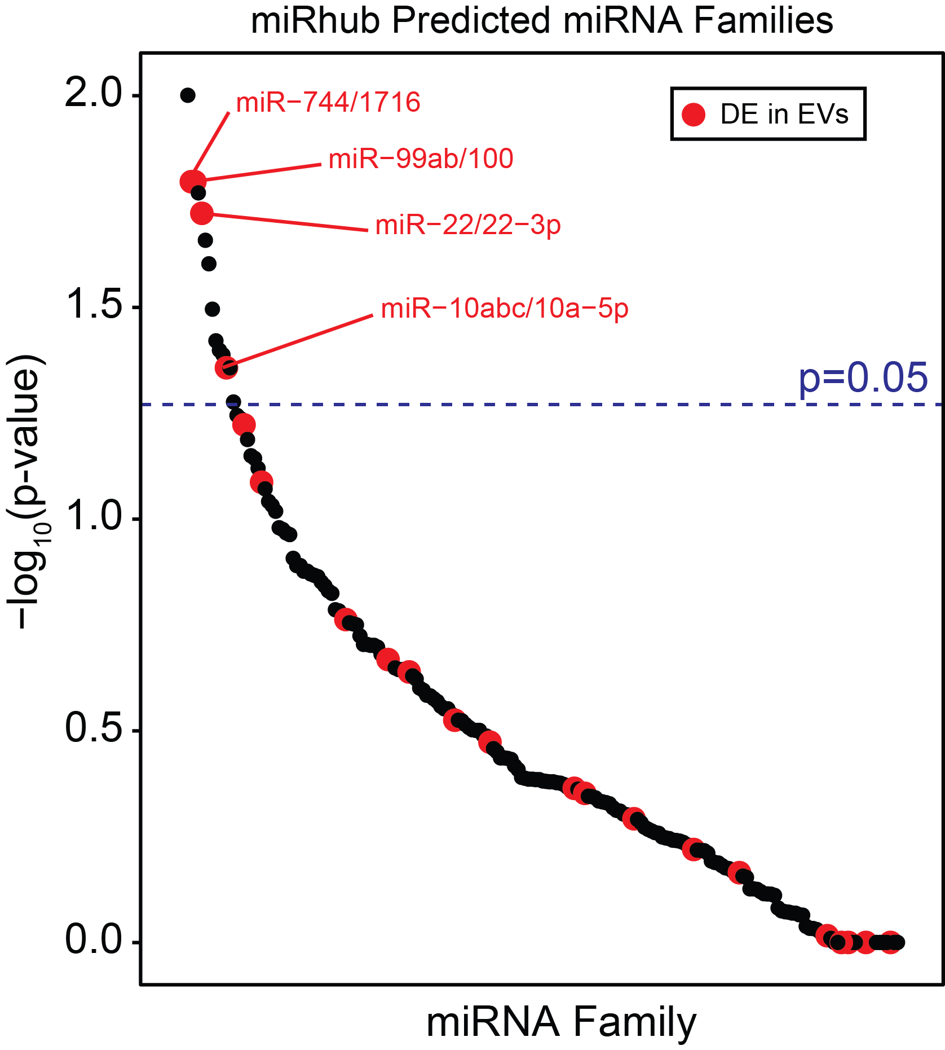
Candidate EV-miRNA: miR-22-3p
Notes:
-You can see here the -log10(p-values) for each miRNA family generated by miRhub from our macrophage genelist
-And the color coded miRNAs which were also differentially expressed in EVs.
-Of the predicted miRNAs that were DE in EVs, miR22 was upregulated had the highest expression.

Slide 23
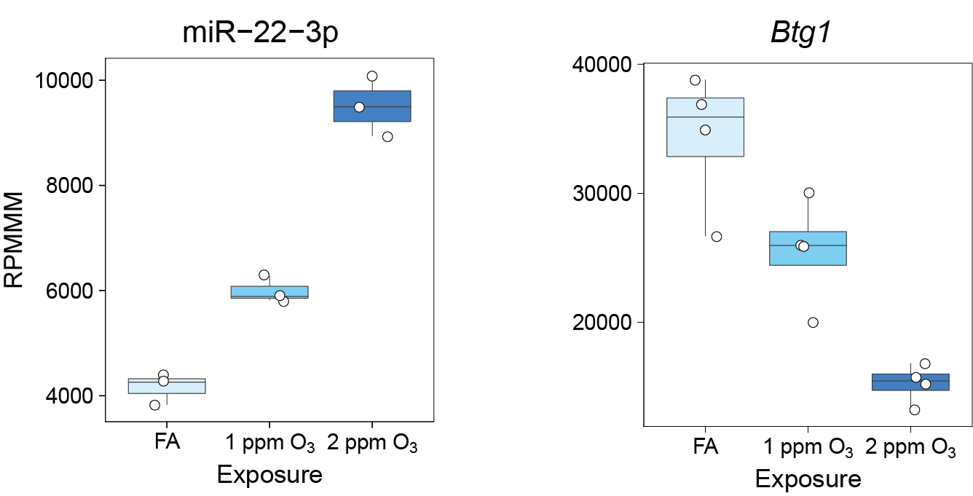
Candidate EV-miRNA: miR-22-3p
EV miRNA
Target mRNA
Normalized Counts
Notes:
One of it’s predicted targets, Btg1 is down in macrophages after ozone.

Slide 24
Recent miR-22-3p studies
Fang et al. MicroRNA-22-3p alleviates spinal cord ischemia/reperfusion injury by modulating M2 macrophage polarization via IRF5. J Neurochem. 2021 Jan
Effects on macrophage polarization
Guo et al. microRNA-22-3p plays a protective role in a murine asthma model through the inhibition of the NLRP3-caspase-1-IL-1β axis. Exp Physiol. 2021 Aug
Reduces inflammation by targeting NLRP3 inflammasome (directly binds NLRP3 mRNA).
Hu et al. Protective effects of microRNA-22-3p against retinal pigment epithelial inflammatory damage by targeting NLRP3 inflammasome. J Cell Physiol. 2019 Aug
Zheng et al. Exosomal miR-22-3p from human umbilical cord blood-derived mesenchymal stem cells protects against lipopolysaccharid-induced acute lung injury. Life Sci. 2021 Mar
Exosomal miR-22-3p protects against ALI
Notes:
Mechanistically, the dual-fluorescent reporter suggested miR-22-3p directly binds NLRP3 mRNA. Moreover, overexpression of miR-22-3p could significantly reduce whereas inhibition miR-22-3p could increase the mRNA and protein expressions of NLRP3, Caspase-1, and mature IL-1β. Collectively, our results indicate that miR-22-3p plays a suppressive role in RPE damage by targeting NLRP3, which provides new insights into the future intervention to retinopathy.
Fang H, Yang M, Pan Q, Jin HL, Li HF, Wang RR, Wang QY, Zhang JP. MicroRNA-22-3p alleviates spinal cord ischemia/reperfusion injury by modulating M2 macrophage polarization via IRF5. J Neurochem. 2021 Jan;156(1):106-120. doi: 10.1111/jnc.15042. Epub 2020 Jun 8. PMID: 32406529
Guo S, Chen R, Zhang L, Wu M, Wei Y, Dai W, Jiang Y, Kong X. microRNA-22-3p plays a protective role in a murine asthma model through the inhibition of the NLRP3-caspase-1-IL-1β axis. Exp Physiol. 2021 Aug;106(8):1829-1838. doi: 10.1113/EP089575. Epub 2021 May 20. PMID: 33932961.
Zheng Y, Liu J, Chen P, Lin L, Luo Y, Ma X, Lin J, Shen Y, Zhang L. Exosomal miR-22-3p from human umbilical cord blood-derived mesenchymal stem cells protects against lipopolysaccharid-induced acute lung injury. Life Sci. 2021 Mar 15;269:119004. doi: 10.1016/j.lfs.2020.119004. Epub 2021 Jan 6. PMID: 33417960.
Wang X, Chi J, Dong B, Xu L, Zhou Y, Huang Y, Sun S, Wei F, Liu Y, Liu C, Che K, Lv W, Chen Y, Wang Y. MiR-223-3p and miR-22-3p inhibit monosodium urate-induced gouty inflammation by targeting NLRP3. Int J Rheum Dis. 2021 Apr;24(4):599-607. doi: 10.1111/1756-185X.14089. Epub 2021 Mar 1. PMID: 33650318.
Hu Z, Lv X, Chen L, Gu X, Qian H, Fransisca S, Zhang Z, Liu Q, Xie P. Protective effects of microRNA-22-3p against retinal pigment epithelial inflammatory damage by targeting NLRP3 inflammasome. J Cell Physiol. 2019 Aug;234(10):18849-18857. doi: 10.1002/jcp.28523. Epub 2019 Mar 29. PMID: 30927257.

Slide 25
Conclusions and Future Directions
Ozone induces an increase in EVs in parallel with markers of airway inflammation and causes differential airway EV-miRNA expression
EVs and their contents (miRNAs, etc.) may influence airway cellular gene expression and function during inflammation and should be further investigated
Future studies:
Evaluate miR-2137 and miR-22-3p w/gain and loss of function approaches
Evaluate EVs and/or candidate miRNAs in the context of EVs
Source
Uptake studies
EV enrichment
Explore tRNA or other smallRNA species
Notes:
So, now we have a couple of hits as far as microRNA
We also know the EVs are altered by ozone
Couple of directions we can go…Focus on the function of miR-22, 2137 and others. In the context of EVs (engineered EVs).

Slide 26


Acknowledgements
Kelada Lab
Samir Kelada
Adelaide Tovar
Katie McFadden
Sethupathy Lab (Cornell)
Praveen Sethupathy
Matt Kanke
Rowan Beck
Deshane Lab (UAB)
Jessy Deshane
Yong Wang
UNC
High-throughput sequencing facility
Mike Love
Funding Sources
Leon and Bertha Golberg
Postdoctoral Fellowship
T32 ES007126-34
R01 ES024965
P30 ES010126
Notes:
-Thank you to Samir and the members of my lab.
-The Sethupathy lab, Praveen and Matt for their help with mirQuant analysis.
-Everyone else at UNC, including the HTSF and Mike Love
-And the funding sources for this project.

Slide 27
Notes:
-Thank you to IRSS and the organizers Judy, Holger, and Meghan for inviting me to talk with you today.
-My goal for this half of the webinar is to provide you with a short introduction to lung EVs from a Respiratory Toxicology perspective.

Slide 29

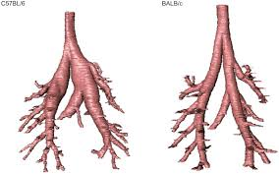
Assessing transfer/source of miRNA by qPCR
EVs
Microdissected
Airways
Airway macrophages
Known
mir-22a-3p
1)
Pri-mir-22
mir-22a-3p
Unknown
2)
Pri-mir-22
mir-22a-3p
Pri-mir = Primary microRNA transcript before processing by Drosha/Dicer
Notes:
-Strategy to get an idea of whether the miRs we identified were likely transferred to the cell by EVs, rather than created intracellularly.
-It will also tell us if these miRs or their primary transcripts are up or down regulated in the two cell types (AM and CA).
-If we hypothesize that miRNAs 22 and 99 are only transferred from CA to AM by EVs, the conditions below are most probable.

Slide 30

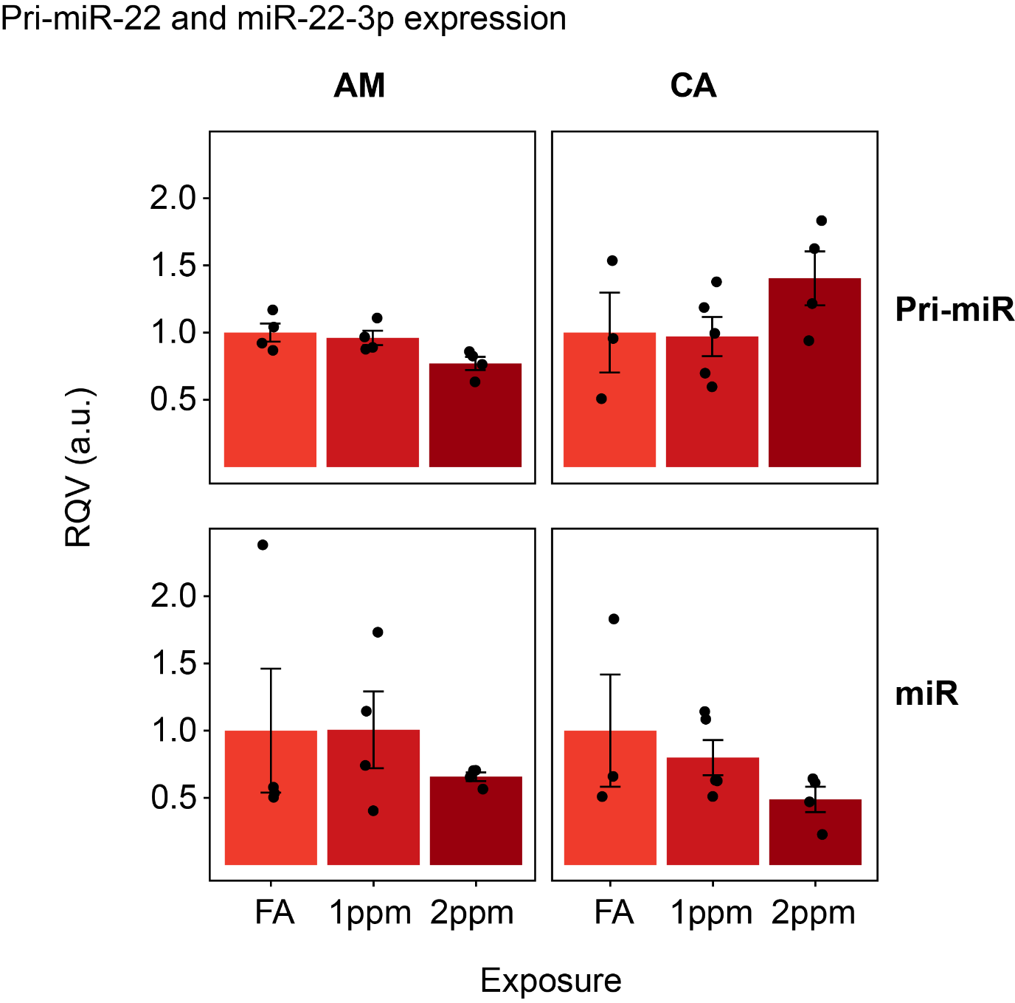
Assessing transfer/source of miRNA by qPCR
Expression of both Pri-miR-22 and miR-22-3p in both tissues
No significant effect of O₃
Notes:
-Pri-mir 22 high in AM, very low mir 22 in AM
-What do the Cq’s say about the abundance of Pri-miR-22 vs miR-22

Slide 31
Assessment of qPCR results:
Stoichiometry- fractional miRNA counts on per particle basis
Timing of collection (21h): missed alteration of Pri/miR-22 expression in CA and AM tissues
Another mechanism of differential expression: miRNA-22 is DE in EVs not because of transcriptional regulation (e.g. differential loading)
Missed true source/recipient cell-types or tissue: not adequately sampled by our methods (e.g. dendritic cells, endothelium)
Notes:
A couple of thoughts on these results:
-There’s not enough of these miRs to matter in our cells of interest. Points to the Null hypothesis, which is that EV-microRNAs might just be getting taken out with the trash.
-Timing: missed the boat all together.
-Another mechanism for differential expression besides what we sampled.
-The source cell-type not adequately sampled: Looked at the wrong boat.
-Not the end of miR-99 and 22, but altogether this experiment suggests we should focus our attention elsewhere.

