Slide 1
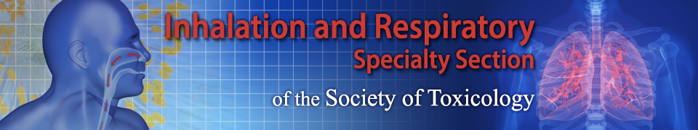

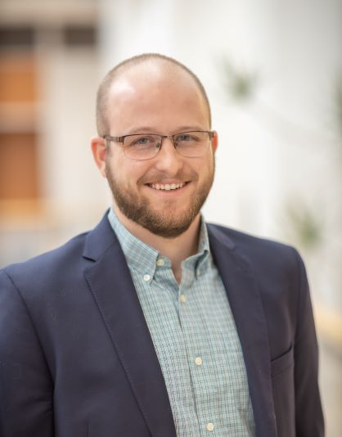
Webinar Series 2021-2022
“Introduction to extracellular vesicles and their role in respiratory toxicology”
Wednesday, March 2nd, 2021 at 2:00 – 3:00 PM EDT.
Angelica Ortiz, Ph.D.
Assistant Professor, Department of Environmental Medicine, NYU Langone Health
Greg Smith, Ph.D.
Assistant Professor, Department of Genetics, University of North Carolina at Chapel Hill
Moderators:
Judith Zelikoff, Ph.D., Professor, New York University School of Medicine
Holger Behrsing, Ph.D., Director, Respiratory Toxicology Program, IIVS, Inc.
Meghan Rebuli, Ph.D., Assistant Professor, University of North Carolina at Chapel Hill

