Slide 1
SOT 2012
March 11-15
San Francisco, CA

Slide 2
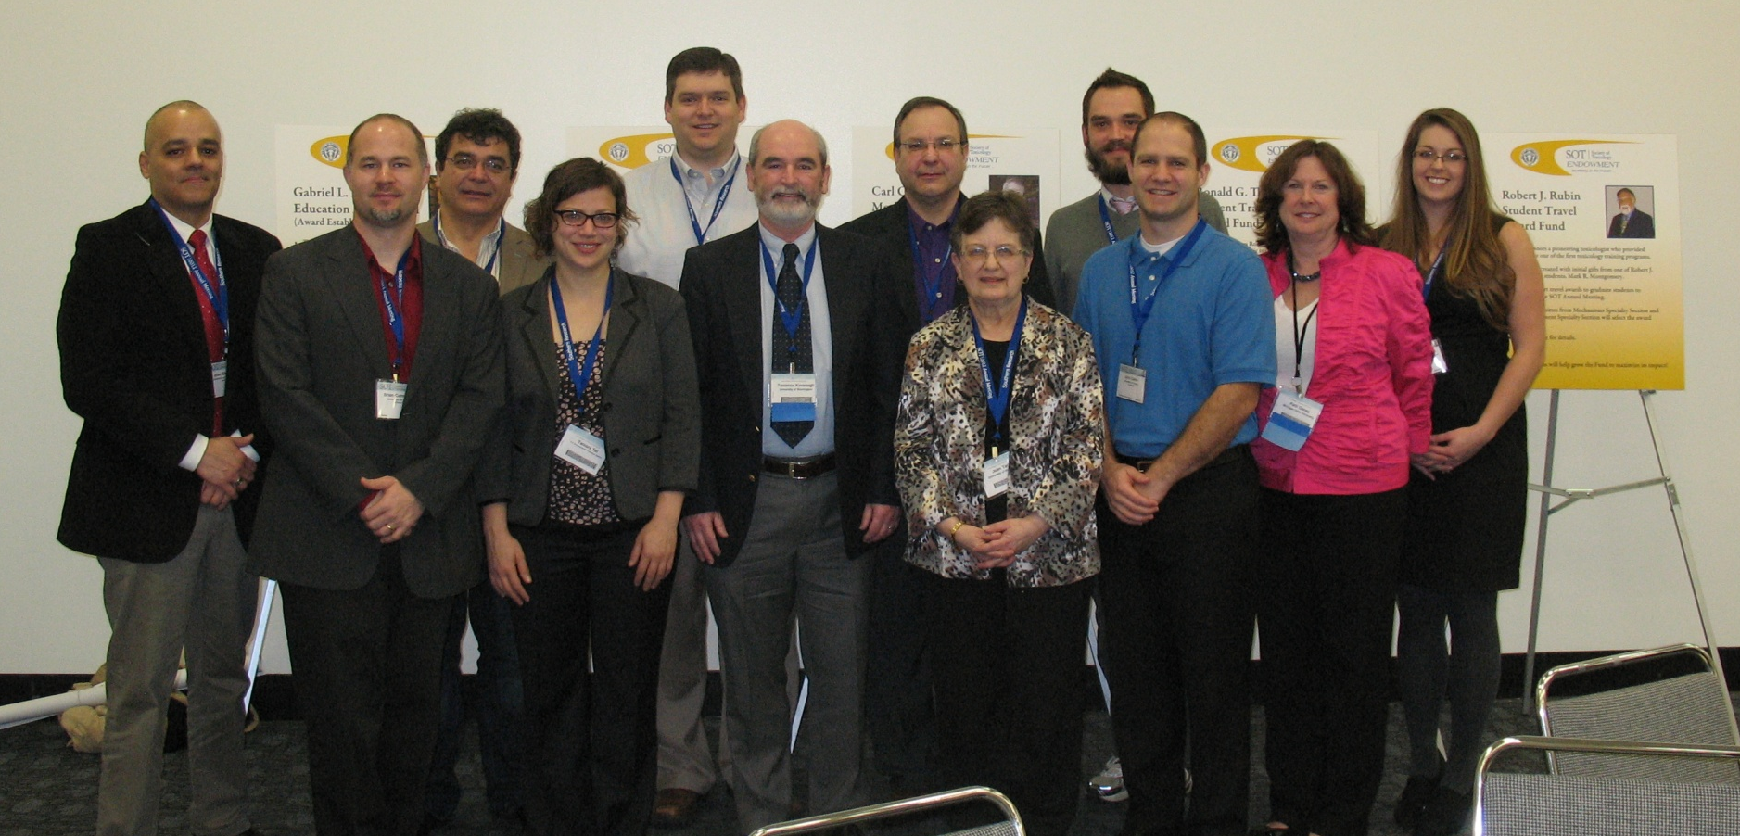
Officers (left to right): Jose Manautou, past president; Brian Cummings, councilor; Vasilis Vasiliou, councilor (2012), vice president-elect (2013); Tamara Tal, post-doctoral councilor; Nathan Cherrington, secretary/treasurer (2013); Terry Kavanagh, vice president-elect (2012); Mike Aleo, vice president (2012); Joan Tarloff, president; Kyle Poulsen, student councilor (2013); John Clarke, post-doctoral councilor (2013); Patti Ganey, secretary/treasurer (2012); Becky Smathers, student councilor (2012)

Slide 3
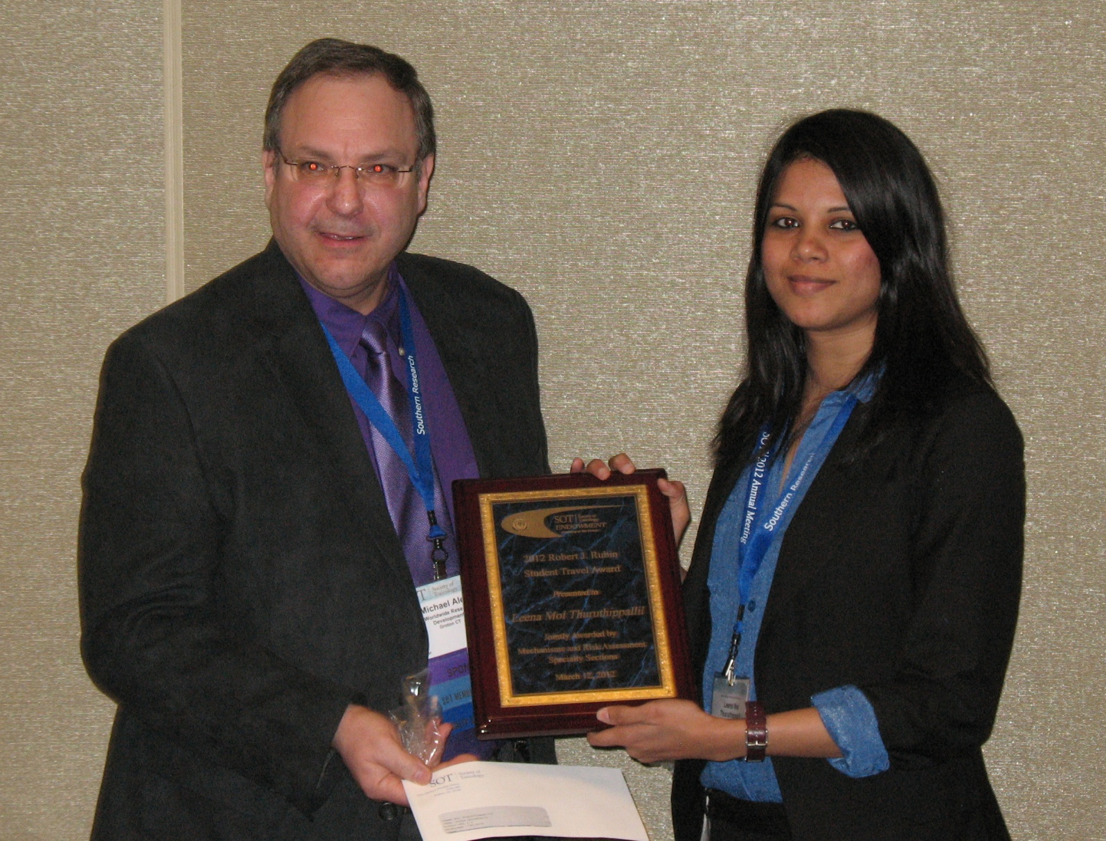
Vice-President Mike Aleo (Pfizer) and Robert J. Rubin Student Travel Award winner Leena Thuruthippallil (Ehime University)

Slide 4
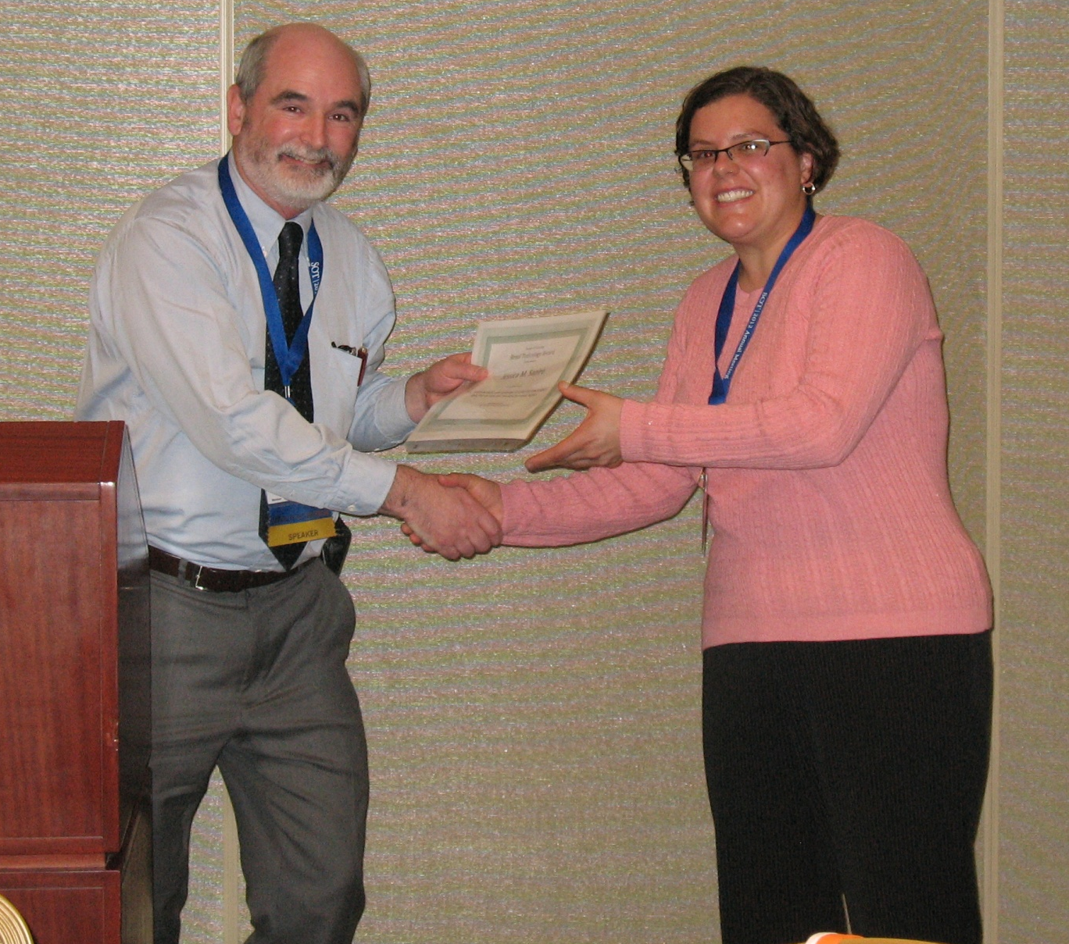
VP elect Terry Kavanagh (University of Washington) presents 2012 Renal Toxicology Award to Jessica M. Sapiro (University of Arizona)

Slide 5
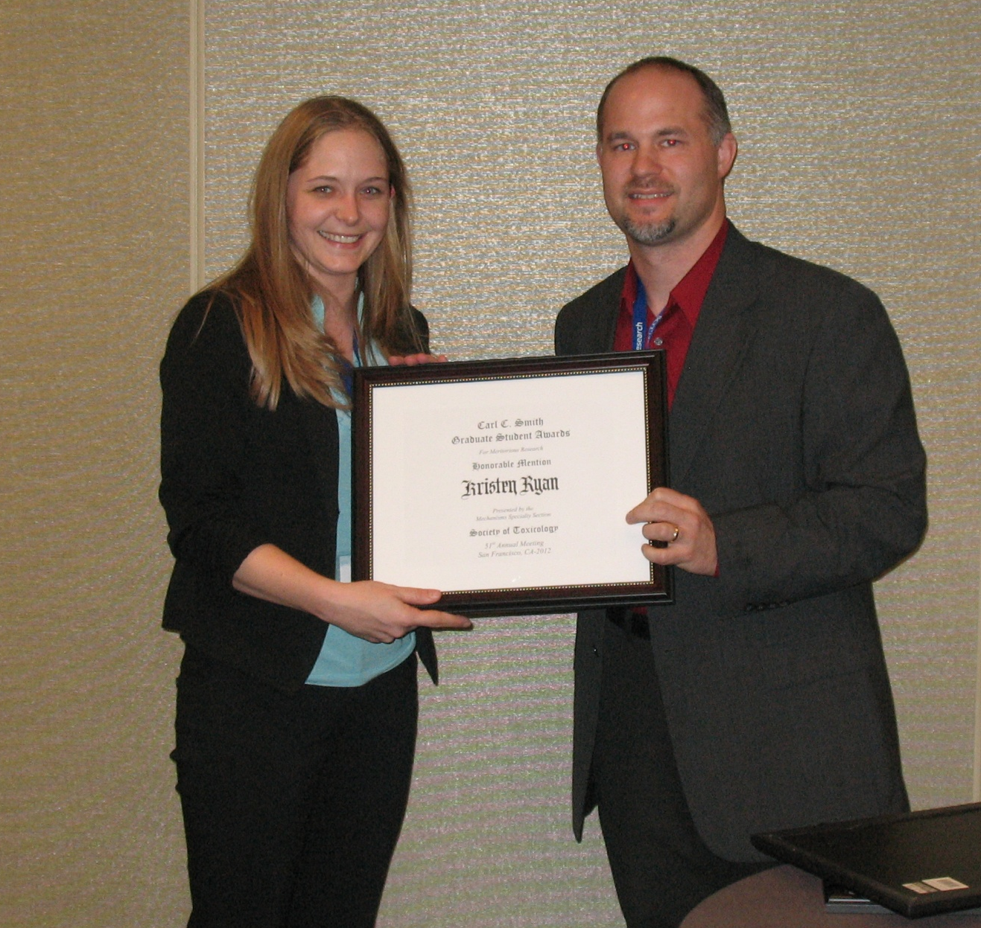
Carl C. Smith Graduate Student Award honorable mention awardee Kristen Ryan (University of Colorado Anschutz Medical campus) and Jr. Councilor Brian Cummings (University of Georgia)

Slide 6
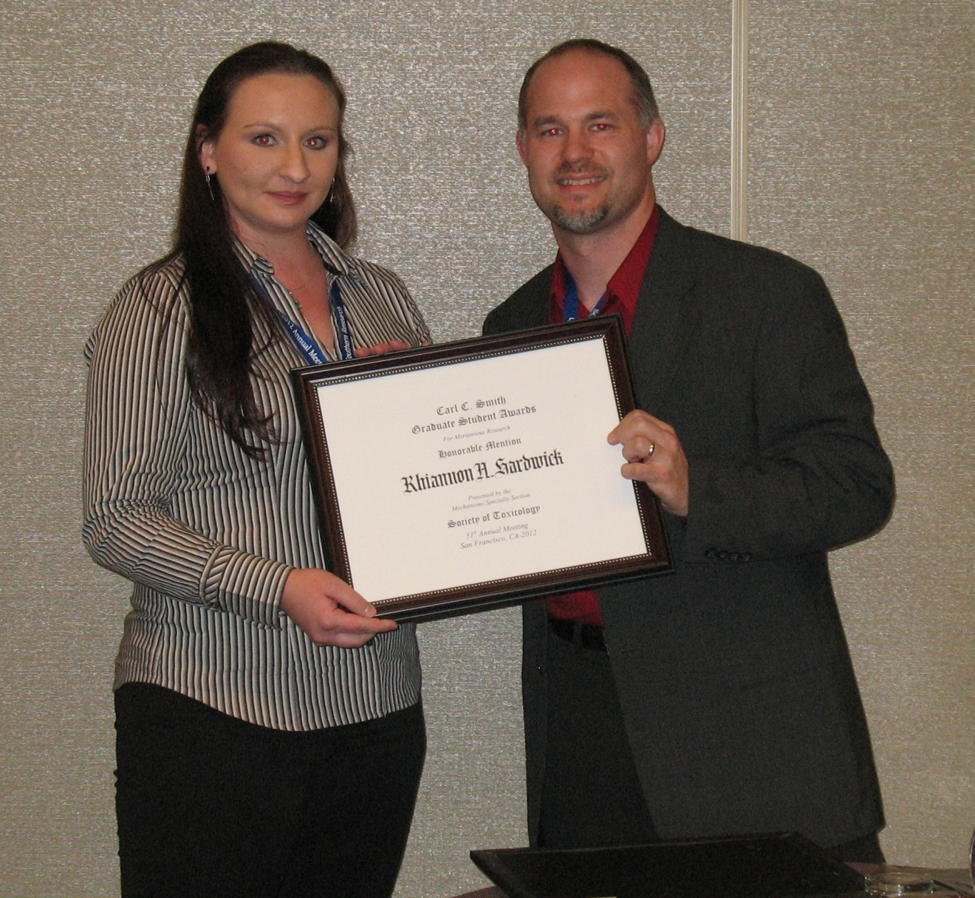
Carl C. Smith Graduate Student Award honorable mention awardee Rhiannon Hardwick (University of Arizona) and Jr. Councilor Brian Cummings (University of Georgia)

Slide 7
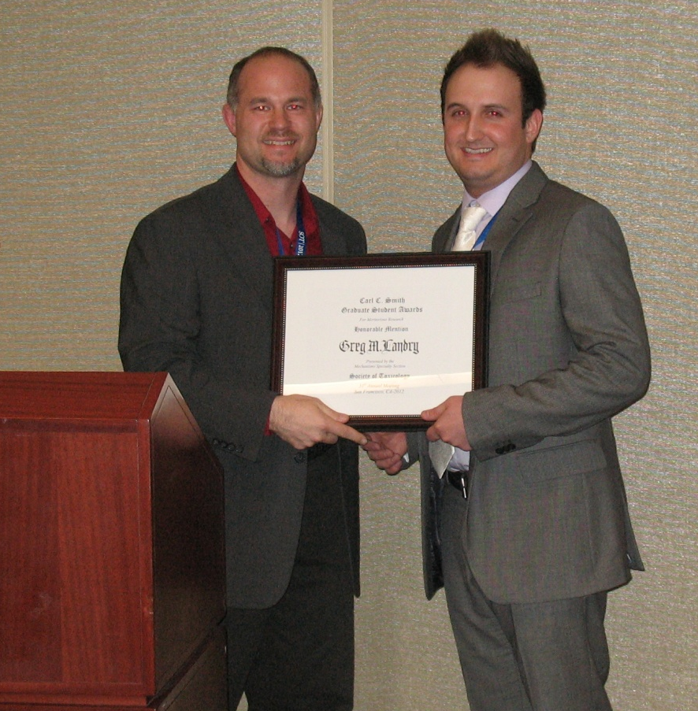
Jr. Councilor Brian Cummings (University of Georgia) and Carl C. Smith Graduate Student Award honorable mention awardee Greg Landry (Louisiana State University Health Sciences Center)

Slide 8
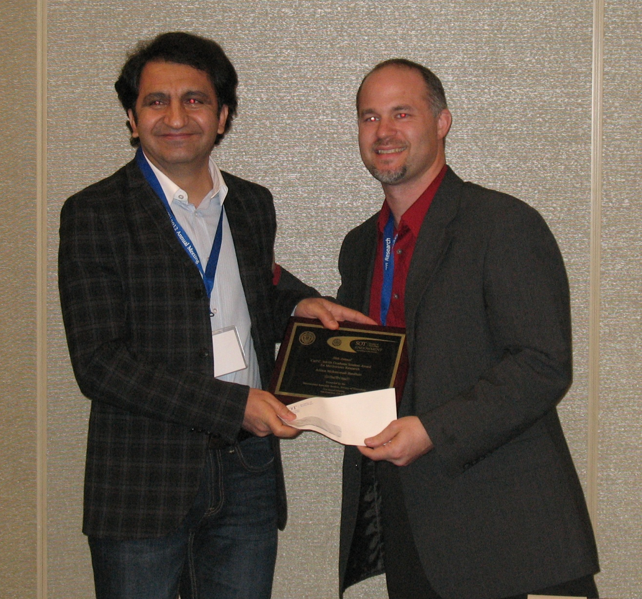
Carl C. Smith Graduate Student Award Third Place Awardee Afshin Momammadi Bardbori (Karolinska Institute) and Jr. Councilor Brian Cummings (University of Georgia)

Slide 9
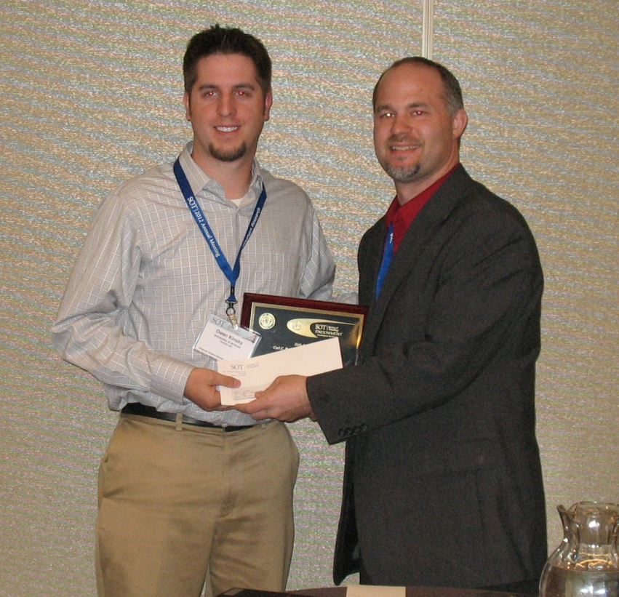
Carl C. Smith Graduate Student Award Second Place awardee Owen Kinsky (University of Arizona) and Jr. Councilor Brian Cummings (University of Georgia)

Slide 10
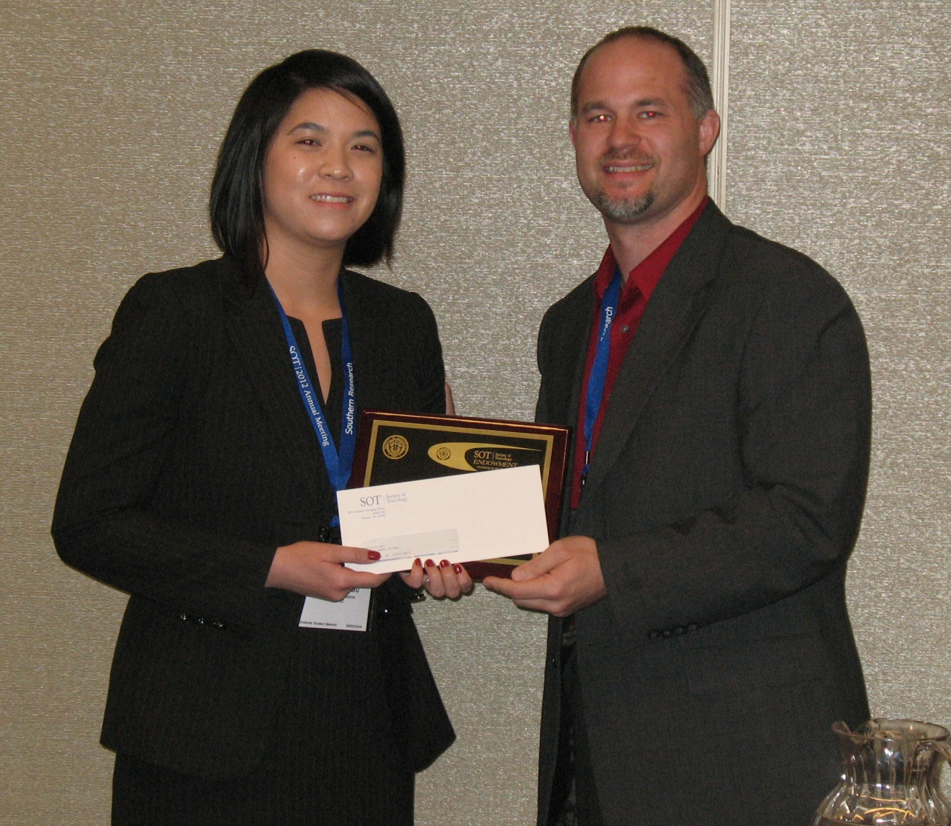
Carl C. Smith Graduate Student Award First Place awardee Alexandria Lau (University of Arizona) and Jr. Councilor Brian Cummings (University of Georgia)

Slide 11
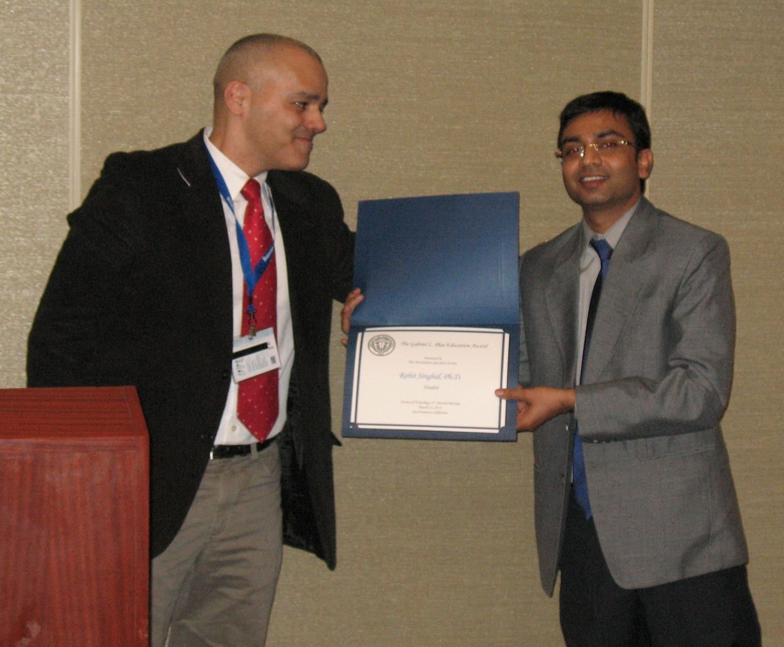
Past President Jose Manautou (UCONN) and Gabriel L. Plaa Education Award finalist Rohit Singhal (Michigan State University)

Slide 12
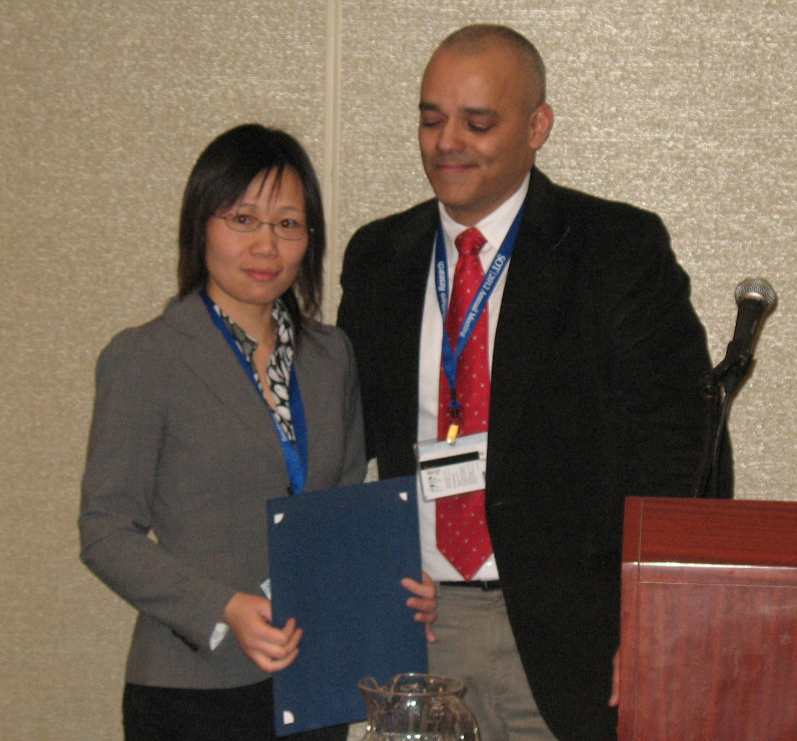
Gabriel L. Plaa Education Award finalist Xia Wen (Rutgers University) and Past President Jose Manautou (UCONN)

Slide 13
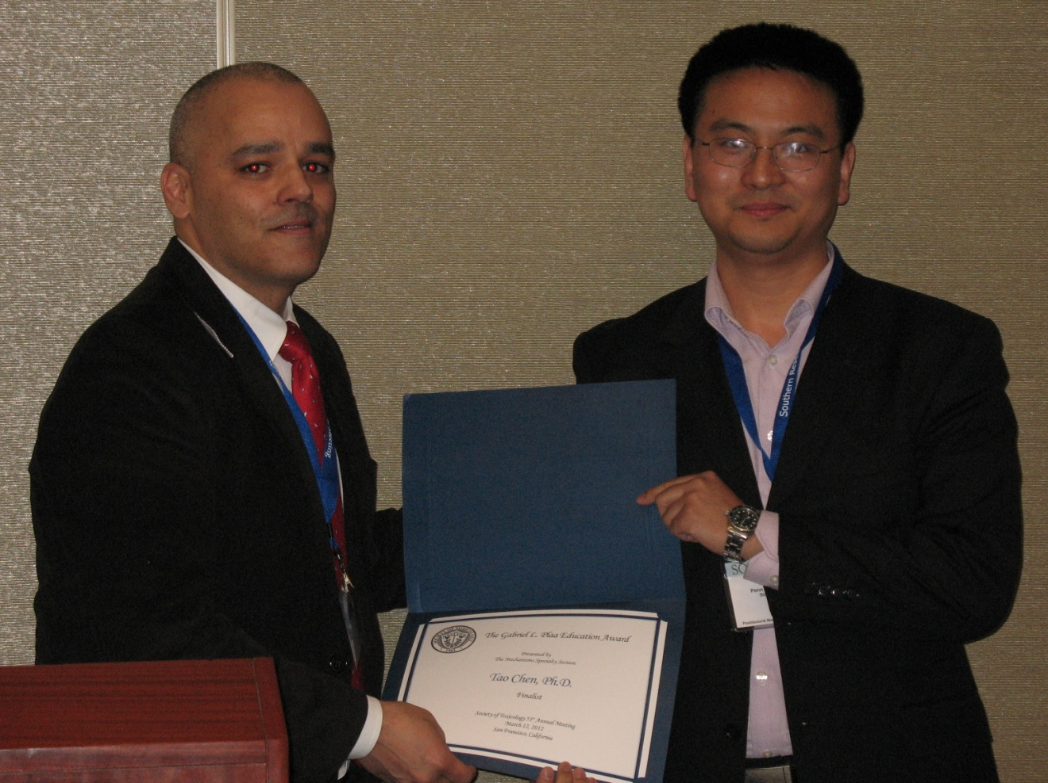
Past-President Jose Manautou (UCONN) and Gabriel L. Plaa Education Award winner Tao Chen (Pennsylvania State University)

