Slide 1


RDTSS Awards
New-Career Scientist Award Sponsored by Covance
New Award – New Career scientist award, started in 2019
Recognize outstanding contributions of a younger career scientist in RDTSS
Thank you to the judges: Aileen Keating, Natasha Catlin, Ed Dere
2019
Patrick Allard
2020
Notes:
Reproductive and Developmental Toxicology Specialty Section Mid-Career Research Award
This award recognizes an active, regular member of the Reproductive and Developmental Toxicology Specialty Section for outstanding research and scientific contribution achieved as an independent investigator (completed since graduate and/or postdoctoral training). The criteria for the award are originality, discovery, and excellence in the field of Reproductive and Developmental Toxicology as evidenced by peer-reviewed manuscripts in journals of high caliber, teaching, mentorship, contributions to regulatory DART practice/guidelines, and/or other commensurate evidence of expertise in the field. Individuals working in academia, government, and industry will be equally eligible to compete for this award. Candidates must be between at least eight years and no more than twenty years from the date of their last formal training.
Nomination procedure: The letter of nomination should be accompanied by two supporting letters from other individuals which emphasize the independent research achievements of the nominee since completion of training. The Reproductive and Developmental Toxicology Specialty Section awards committee will consider the significance of the issues under investigation, the breadth and depth of the analyses performed, and the level of originality manifested in the publications of this work. The award will be presented at the Reproductive and Developmental Toxicology Specialty Section reception at the Society of Toxicology annual meeting.

Slide 2
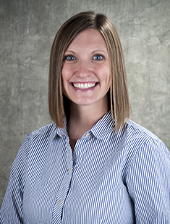

2020 RDTSS New-Career Scientist Award Sponsored by Covance
Dr. Natalie Johnson,
Texas A&M University

Slide 3
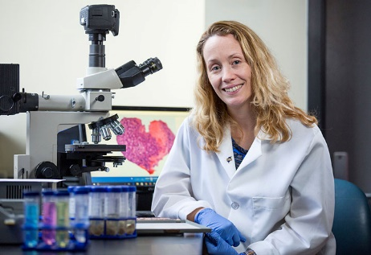
RDTSS Awards
Stephen B. Harris Mid-Career Scientist Award Sponsored by Inotiv
New Award – Mid-Career scientist award, started in 2019
Recognize outstanding contributions of a mid-career scientist in RDTSS
Thank you to the judges: Lauren Aleksunes, Patrick Allard, Kimberly Hatfield, Kembra Howdeshell, Jeffrey Moffit and Caitlin Murphy
2019
Aileen Keating
2020
Notes:
Reproductive and Developmental Toxicology Specialty Section Mid-Career Research Award
This award recognizes an active, regular member of the Reproductive and Developmental Toxicology Specialty Section for outstanding research and scientific contribution achieved as an independent investigator (completed since graduate and/or postdoctoral training). The criteria for the award are originality, discovery, and excellence in the field of Reproductive and Developmental Toxicology as evidenced by peer-reviewed manuscripts in journals of high caliber, teaching, mentorship, contributions to regulatory DART practice/guidelines, and/or other commensurate evidence of expertise in the field. Individuals working in academia, government, and industry will be equally eligible to compete for this award. Candidates must be between at least eight years and no more than twenty years from the date of their last formal training.
Nomination procedure: The letter of nomination should be accompanied by two supporting letters from other individuals which emphasize the independent research achievements of the nominee since completion of training. The Reproductive and Developmental Toxicology Specialty Section awards committee will consider the significance of the issues under investigation, the breadth and depth of the analyses performed, and the level of originality manifested in the publications of this work. The award will be presented at the Reproductive and Developmental Toxicology Specialty Section reception at the Society of Toxicology annual meeting.

Slide 4
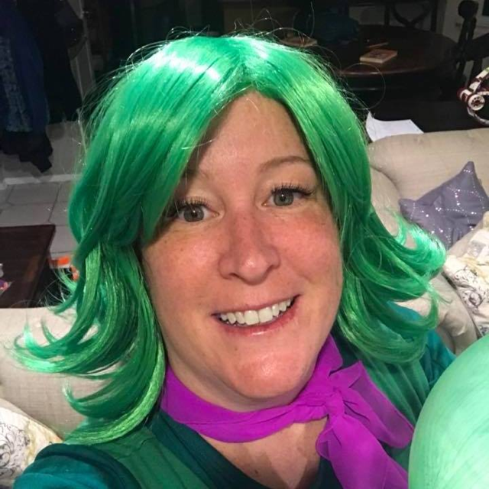
2020 Stephen B. Harris Mid-Career Scientist Award Sponsored by Inotiv
Dr. Kary Thompson
Bristol Myers Squibb

Slide 5
RDTSS Best Paper Award
Pragati S. Coder, PhD, DABT
Charles River Laboratories Ashland LLC
RDTSS Senior Councilor

Slide 6

Considered manuscripts published in Toxicological Sciences between January 2019 and December 2019
To be considered for the award, a paper must:
have at least one member of RDTSS as an author
be in a subject relevant to the specialty section
be primary research (review articles were not considered)
Queried the current RDTSS membership roster by name and affiliation.
Notes:
Eligibility: Papers published during the previous calendar year in Toxicological Sciences. Publication date is defined as the date the paper appears in the print form of Toxicological Sciences. Papers in the areas of reproductive or developmental toxicology are automatically eligible. Publication under the “Reproductive and Developmental Toxicology” table of contents subheading is not required. At least one author must be a member of RDTSS.

Slide 7
65 Manuscripts in the areas of Reproductive or Developmental Toxicology appeared in Toxicological Sciences in 2019.
27 Manuscripts by RDTSS members were eligible for the award.
19 RDTSS Members made up the judging committee.
Any conflicts were addressed, and papers were randomly distributed.
Each paper was reviewed by at least 3 individual judges.
Each judge reviewed up to 5 papers each.

Slide 8
27 Papers were judged based on:
Originality
Scientific Quality
Relevance to the field
Contribution to the field
Scores were averaged and ranked following the initial review.
Top 4 papers were redistributed to a subset of 7 judges.
Same criteria were applied, and scores were averaged and ranked.

Slide 9

Katie Chiang
Pragati Coder
Sue Fenton
Curt Grace
Bethany Hannas
Mary Hixon
Alan Hoberman
Jeff Moffit
Eve Mylchreest
John Richburg
Linda Roberts
Dan Spade
Dinesh Stanislaus
Don Stump
Kary Thompson
Caren Villano
Atlee Watson
Amy Williams
Leah Zorrilla
Notes:
Atlee Watson (1) Katie Chiang (2) Pragati Coder (3) Sue Fenton (4) Mary Hixon (5) Bethany Hannas (6) Alan Hoberman (7) Dan Spade (8) Linda Roberts (9) Caren Villano (10) Curt Grace (11) Amy Williams (12) Jeff Moffit (13) Eve Mylchreest (14) Kary Thompson (15) Don Stump (16) Dinesh Stanislaus (17) John Richburg (18) Leah Zorilla (19)

Slide 10

This Photo by Unknown Author is licensed under CC BY-NC

Slide 11

This Photo by Unknown Author is licensed under CC BY-NC

Slide 12


Slide 13
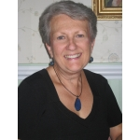
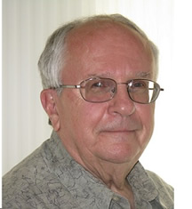
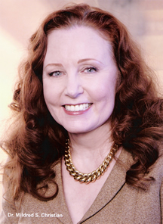
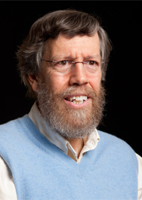
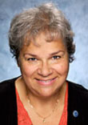
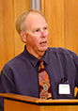
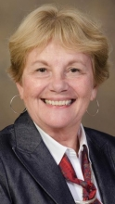
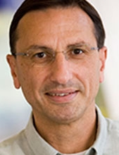
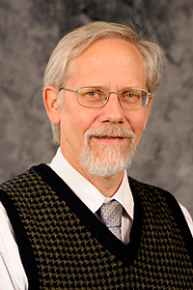
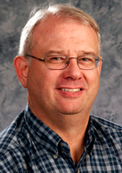

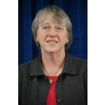
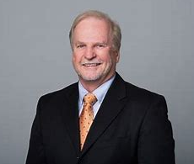

RDTSS Scientific Achievement Award
Xiaozhong “John” Yu, University of Georgia
RDTSS Junior Councilor
2006
Carole Kimmel
2007
James Shardein
2008
Thomas Collins
2009
Mildred Christian
2010
Robert Chapin
2011
Rochelle Tyl
2012
Earl Gray
2013
Patricia Hoyer
2014
George Daston
2015
Kim Boekelheide
2016
Paul Foster
2017
Barbara Abbott
2018
Robert Kavlock
2019
Peter Wells
2020
2021
DART
Rules!

Slide 14

RDTSS Scientific Achievement Award
RDTSS member for lifetime achievement or for contribution of a particularly influential body of work to the field of reproductive and developmental toxicology.
The awardee is selected from among membership nominations by a committee formed by the RDTSS Executive Committee. Nominations included a short narrative or list of the accomplishments upon which the nomination was based, a CV, and letter(s) of support.
The nominations were judged based on:
Contributions to Reproductive and Development Toxicology
Contributions to RDTSS and SOT
Role in Mentoring Next Generation of Toxicologists
The nomination letters and CVs were distributed to the judging committee:
Jodi Flaws, George Daston, Thomas Knudsen, Aileen Keating, Xiaoqin Ye, Kim Boekelheide, Sarah Campion, Shuo Xiao, Jamie Karmel, Viki Sutherland, Jennifer Rayner, Joshua Robinson, Mary Alice Smith, Cochran Chrissy

Slide 15
2020 RDTSS Scientific Achievement Award
Dr. Robyn Tanguay,
Oregon State University

Slide 16
RDTSS Trainee Poster Awards
Could not proceed due to SOT cancellation
Bethany Hannas
RDTSS Vice President Elect

Slide 17

New RDTSS Officers
Vice President elect – Caren Villano (BMS)
Junior Councilor – Ed Dere (Genentech)
Career Councilor – Daniel Spade (Brown University)
Secretary/treasurer – Pragati Coder (Charles River)
Graduate Student Representative – Vicki Mourikes (UIUC)

Slide 18

Acknowledgement of Outgoing Officers
Secretary/Treasurer Natasha Catlin, Pfizer
Senior Councilor Pragati Coder, Charles River
New Career Councilor Ed Dere, Genentech
Graduate Student Rep Katie Chiang, UIUC
Past President Vicki Sutherland, National Toxicology Program

